Slide 1
June 2022
Yaakov Waksman, Ph.D.
Head of Research & Development waksmanya@gmail.com
Research Proposal
Genetic susceptibility to THC & CBD
Development of Diagnostic Tool

Slide 2
General Introduction

Slide 3
CBD & the ECS

Slide 5
Therapeutic Effects of CBD
CBD has been touted for a wide variety of health issues, but the strongest scientific evidence is for its effectiveness in treating some of the cruelest childhood epilepsy syndromes, such as Dravet syndrome [DS] and Lennox-Gastaut syndrome (LGS), which typically don’t respond to anti-seizure medications. In numerous studies, CBD was able to reduce the number of seizures, and, in some cases, stop them altogether. "Epidiolex", which contains natural CBD, is the first cannabis-derived medicine approved by the FDA for these conditions. Animal studies, and self-reports or research in humans, suggest CBD may also help with:
Anxiety: Studies and clinical trials are exploring the common report that CBD can reduce anxiety.
Insomnia: Studies suggest that CBD may help with both falling asleep and staying asleep.
Chronic pain: Further human studies are needed to substantiate claims that CBD helps control pain. One animal study from the European Journal of Pain suggests CBD could help lower pain and inflammation due to arthritis when applied to skin. Other research identifies how CBD may inhibit inflammatory and neuropathic pain, which is difficult treat.
Multiple sclerosis [MS]: One symptom of MS is spasticity, which causes the muscles to feel stiff and may lead to difficulty moving. Research suggests that oral CBD spray may help to reduce spasticity.
Neuro-protection: One review highlights that oral administration of CBD can have neuro-protective properties against conditions such as Alzheimer disease [AD] and Parkinson disease [PD].
Addiction: CBD can help lower cravings for tobacco (nicotine) and heroin under certain conditions, according to some research in humans. Animal models of addiction suggest it may also help lessen cravings for alcohol, cannabis, opiates, and stimulants such as cocaine.
Acne: CBD may reduce acne. A 2014 study found it can have a positive impact on human sebocytes. These are the cells that cause sebum that may cause spots. Using topical CBD oil may be beneficial.

Slide 6
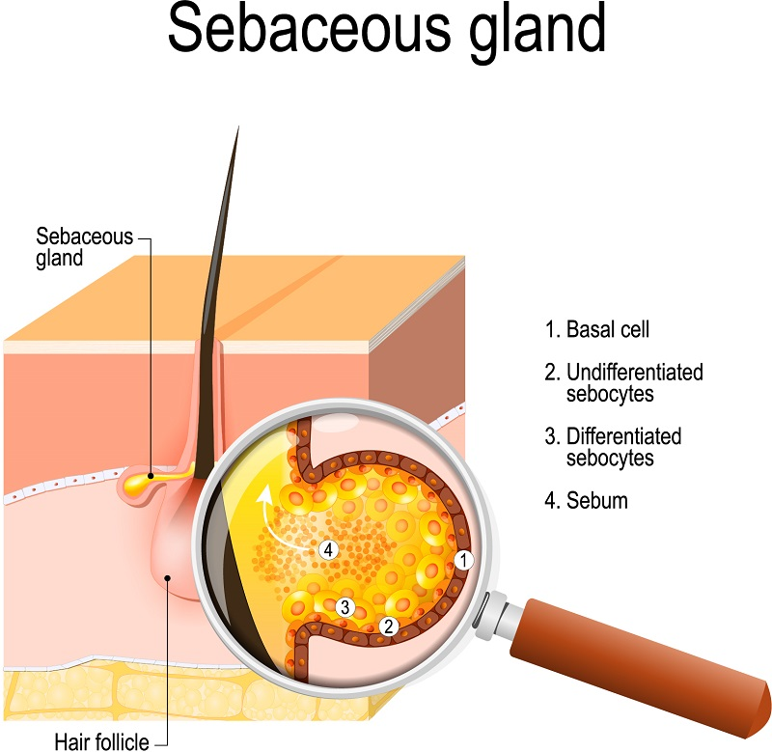
Sebocytes are highly specialized, sebum-producing epithelial cells that release their content by rupture of the cell membrane and cellular degradation (holocrine secretion).

Slide 7
Personalized pCBs Therapy
Lately, the use of CBD among individuals for both specific health conditions and general health and well-being is widespread. CBD is being used as a specific therapy for a number of diverse medical conditions—particularly pain and inflammatory disorders, anxiety, depression, and sleep disorders. A large percentage of respondents indicate that CBD treats their condition(s) effectively in the absence of conventional (synthetic) medicine(s) and with only few non-serious adverse effects.
However, some individuals do not feel the therapeutic effects of CBD and the reason may be their specific genetic background.

Slide 8
Review of Relevant Current Research:
Species-specific susceptibility to cannabis-induced convulsions (2019)
Br. J. Pharmacol. 2019 May; 176(10):1506-1523.
Benjamin J Whalley, et al.
Background and purpose: Numerous claims are made for cannabis' therapeutic utility upon human seizures, but concerns persist about risks. A potential confounder is the presence of both Δ9 -tetrahydrocannabinol (THC), variously reported to be both pro- and anticonvulsant, and cannabidiol (CBD), widely confirmed as anticonvulsant. Therefore, we investigated effects of prolonged exposure to different THC/CBD cannabis extracts on seizure activity and associated measures of endocannabinoid (eCB) system [ECS] signaling.
Experimental approach: Cannabis extract effects on in vivo neurological and behavioral responses, and on bioanalyte levels, were measured in rats and dogs. Extract effects on seizure activity were measured using electroencephalography [EEG] telemetry in rats. eCB signaling was also investigated using radioligand binding in cannabis extract-treated rats and treatment-naïve rat, mouse, chicken, dog and human tissue.
Key results: Prolonged exposure to cannabis extracts caused spontaneous, generalized seizures, sub served by epileptiform discharges in rats, but not dogs, and produced higher THC, but lower 11-hydroxy-THC (11-OH-THC) and CBD, plasma concentrations in rats versus dogs. In the same rats, prolonged exposure to cannabis also impaired cannabinoid type 1 receptor (CB1R)-mediated signaling. Profiling CB1R expression, basal activity, extent of activation and sensitivity to THC, suggested interspecies differences in eCB signaling, being more pronounced in a species that exhibited cannabis extract-induced seizures (rat) than one that did not (dog).

Slide 9
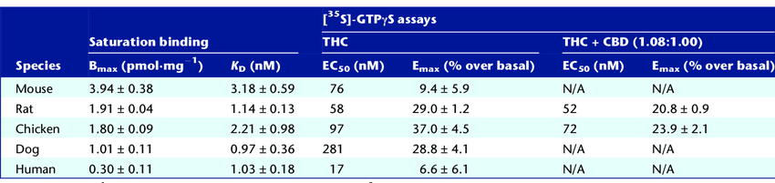
Conclusions and implications: Sustained cannabis extract treatment caused differential seizure, behavioral and bioanalyte levels between rats and dogs. Supporting radioligand binding data suggest species differences in eCB signaling. Interspecies variations may have important implications for predicting cannabis-induced convulsions from animal models.
Rats are very different from mice. The fact that rats treated with CBD have lower CBD plasma levels as well as lower 11-OH-THC plasma levels may indicate inactive hepatic CYP450 enzymes – CYP3A4, 2C9 or 2C19 subtypes.
Species-specific response in radioligand binding assay
Bmax (pmol·mg−1) and KD (nM) derived from saturation binding of [³H]‐SR141716A and EC50 (nM) (derived from a single fit to group data) and Emax (% over basal) for THC and THC + CBD (1.08:1.00 ratio) derived from [³⁵S]‐GTPγS assays conducted using membranes prepared from treatment‐naïve cerebellae. EC50 for THC + CBD (derived from a single fit to group data) is expressed against concentration of THC present in the assay. CBD alone was also examined in all species but revealed approximately negligible [³⁵S]‐GTPγS binding, as was also the case for THC + CBD in human, dog and mouse membranes. In these cases, EC50 and Emax could not be confidently estimated and are omitted and recorded as N/A = not available. Values shown are mean ± SEM; experiments in triplicate in three separate preparations.

Slide 10
Fatty acid amide hydrolase [FAAH]
FAAH (EC 3.5.1.99, oleamide hydrolase, anandamide amidohydrolase) is a member of the serine hydrolase family of enzymes. It was first shown to break down anandamide [AEA] in 1993. In humans, it is encoded by the gene FAAH.
FAAH is an integral membrane hydrolase with a single N-terminal trans-membrane domain. In vitro, FAAH has esterase and amidase activity. In vivo, FAAH is the principal catabolic enzyme for a class of bioactive lipids called the fatty acid amides (FAAs). Members of the FAAs include:
Anandamide (N-arachidonoylethanolamine [AEA]), an endocannabinoid [eCB].
Arachidonoylglycerol (2-AG), also an eCB.
Other N-acylethanolamines, such as: N-oleoylethanolamine [OEA] and N-palmitoylethanolamine [PEA].
The sleep-inducing lipid mediator – oleamide [OLA].
The N-acyltaurines, which are agonists of the transient receptor potential (TRP) family of calcium ion channels.
FAAH knockout[ KO] mice display highly elevated (>15-fold) levels of N-acylethanolamines and N-acyltaurines in various tissues. Because of their significantly elevated anandamide levels, FAAH KOs have an analgesic phenotype, showing reduced pain sensation in the hot plate test, the formalin test, and the tail flick test. Finally, because of their impaired ability to degrade AEA, FAAH KOs also display super-sensitivity to exogenous anandamide, a cannabinoid receptor agonist. Due to the ability of FAAH to regulate nociception, it is currently viewed as an attractive drug target for the treatment of pain.

Slide 11

A Scottish woman with a previously unreported genetic mutation (dubbed FAAH-OUT) in her FAAH gene with resultant elevated anandamide levels was reported in 2019 to be immune to anxiety, unable to experience fear, and insensitive to pain. The frequent burns and cuts she suffered due to her hypo-Algeria healed quicker than average.
Could this Scottish woman feel the therapeutic effects of CBD?
A 2017 study found a strong correlation between national percentage of very happy people (as measured by the World Values Survey) and the presence of the A allele in the FAAH gene variant rs324420 in citizens' genetic make-up.
The rsID number is a unique label ("rs" followed by a number)
used by researchers and databases to identify a specific SNP
(Single Nucleotide Polymorphism). It stands for Reference SNP
cluster ID and is the naming convention used for most SNPs.

Slide 12
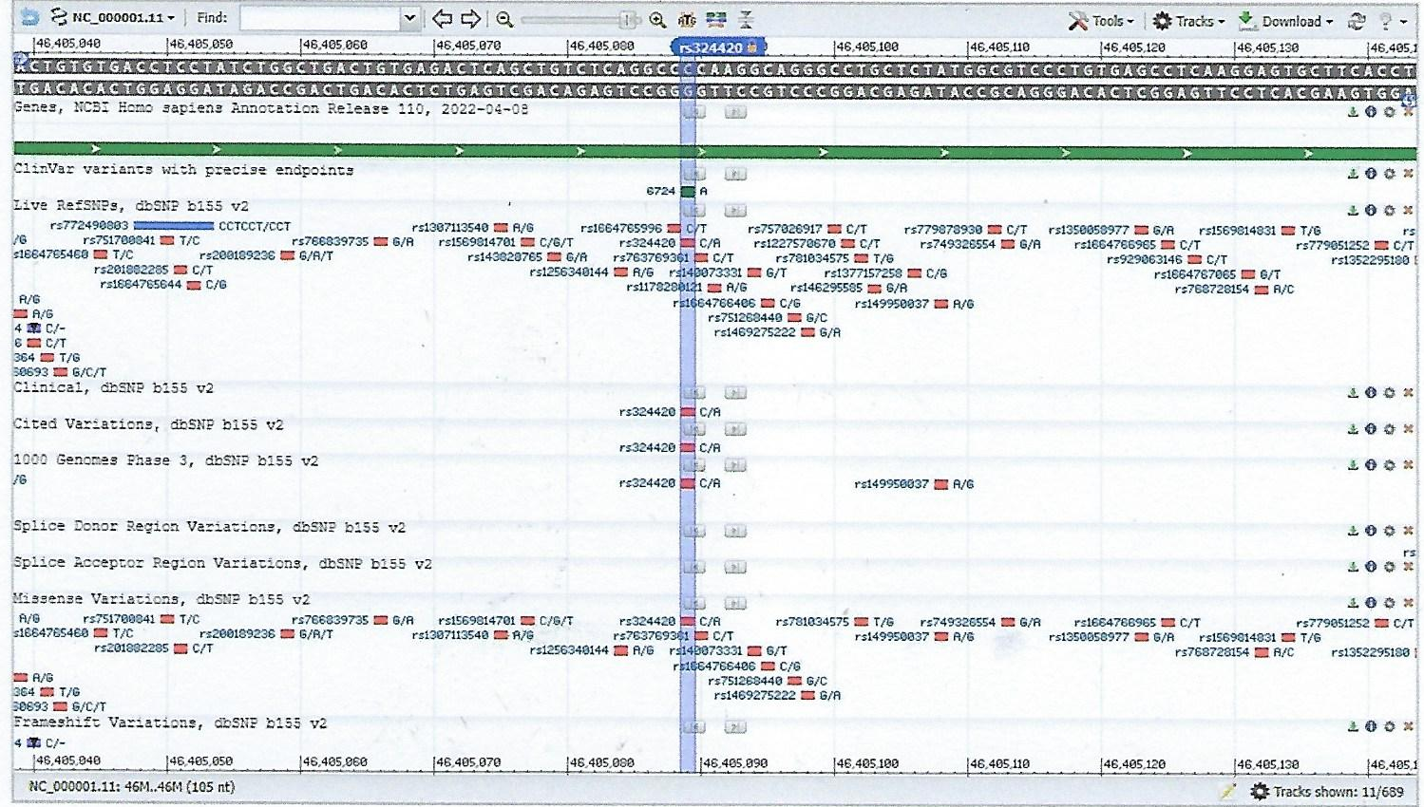
rs324420, also known as c.385C>A or Pro129Thr, is a single nucleotide polymorphism [SNP] in FAAH gene, which has shown associations with substance use disorders [SUDs]. rs324420(C) encodes the more common Pro, while the (A) allele encodes the rare Thr.
Among 80 individuals with drug abuse or alcoholism and over 1,000 controls, the odds ratio for risk of problem drug or alcohol use among rs324420 (A;A) individuals was 4.5 (CI: 2.2 - 8.4); the odds ratio for risk of street drug use was 2.2 (CI: 1.3–3.7); and the odds ratio for risk of combined street drug use and problem drug/alcohol use was 4.9 (CI: 2.5–9.7). When this study was pooled with the results of another study of 249 subjects with documented multiple different drug addictions compared to drug free individuals of the same ethnic backgrounds, the results were consistent and even more significant (p = 0.00003). Risk for drug dependence (and drug abuse) was associated with rs324420(A;A) homozygotes.

Slide 13
In a study of 40 daily marijuana users who abstained for 24 h and were then presented with a cue-elicited craving paradigm, followed by smoking a marijuana cigarette, rs324420(A) was significantly associated with changes in withdrawal after abstinence and with happiness after smoking marijuana, but was not associated with changes in heart rate after smoking or with changes in craving or other acute effects.
This variant has also been associated with pain insensitivity. In a 2016 study, about 1000 women undergoing surgery for breast cancer were tested for cold and heat pain sensitivity; rs324420(A;A) individuals reported significantly lower cold pain sensitivity and less need for postoperative analgesia. The rs324420(A;C) genotype was also seen in a woman with unusually high pain tolerance, along with a ~8kb heterozygous micro-deletion of the adjacent FAAH pseudo-gene.
From a different perspective, a 2016 study published in the Journal of Happiness Studies found a strong correlation between a nation's happiness and the presence of the (rs324420) A allele in the FAAH gene.
A mutation in FAAH gene was initially provisionally linked to drug abuse and dependence but this was not borne out in subsequent studies.
Studies in cells and animals and genetic studies in humans have shown that inhibiting FAAH may be a useful strategy to treat anxiety disorders.
Based on the hydrolytic mechanism of FAAH, a large number of irreversible and reversible inhibitors (such as CBD) of this enzyme have been found in nature and many others were developed.

Slide 14
A:A = Low pain sensitivity (high pain tolerance), drug abuse
A = Happiness, cannabis dependence, easy withdrawal
A:C = High pain tolerance
C = Substance use disorder [SUD] C:C = ?
A missense mutation in human fatty acid amide hydrolase associated with problem drug use (2002)
Jack C. Sipe, Kyle Chiang, Alexandra L. Gerber, Ernest Beutler, and Benjamin F. Cravatt.
PNAS, June 11, 2002, 99 (12) 8394-8399.
Problem drug use and dependence are neurobehavioral disorders of complex origin. Although environmental factors contribute to drug abuse and addiction, genetic factors also play a significant role estimated at 40–60% of the total risk. Nonetheless, the precise identities of human genes that confer vulnerability to problem drug use remain mostly unknown. Here, we describe a natural single nucleotide polymorphism [SNP] in the human gene that encodes the principal endocannabinoid-inactivating enzyme, fatty acid amide hydrolase (FAAH) that in homozygous form is strongly associated with both street drug use and problem drug/alcohol use. This SNP results in a missense mutation (385C→A) that converts a conserved proline residue to threonine (Pro129→Thr), producing a FAAH variant that displays normal catalytic properties but an enhanced sensitivity to proteolytic degradation. Collectively, these results suggest that genetic mutations in FAAH may constitute important risk factors for problem drug use and support a potential link between functional abnormalities in the endogenous cannabinoid system [ECS] and drug abuse and dependence.

Slide 15
Drug abuse and dependence are neurobehavioral disorders of complex origin in which both environmental and genetic factors are perceived to contribute to vulnerability. Genetic factors have been estimated to account for up to 60% of the risk in susceptible individuals. Although the primary molecular sites of action for many drugs of abuse are well characterized, efforts to identify genetic alterations in these neural signaling systems that are associated with problem drug use and addiction have, to date, been mostly unsuccessful. One neural signaling pathway generally implicated in drug abuse and addiction is the endogenous cannabinoid system [ECS]. This system includes a G protein-coupled receptor [GPCR] CB1 that binds the principal psychoactive component of marijuana, Δ-9-tetrahydrocannabinol [THC], and the endogenous CB1 ligands, anandamide )AEA( and 2-arachidonoylglycerol (2-AG). Recent evidence suggests that the ECS may contribute not only to the development of dependence on marijuana but also other drugs of abuse. Mice with a targeted disruption in the CB1 receptor exhibit reduced withdrawal responses to morphine, suggesting that significant crosstalk exists between endogenous opioid and cannabinoid systems in neural pathways that mediate addiction. Consistent with this notion, withdrawal from cannabinoids is significantly reduced in mice lacking prepro-enkephalin or the μ-opioid receptor [MOR].
Hypothesis: The ECS is actually connected to the Opioid System.

Slide 16
Recently, a third central component of the endogenous cannabinoid system, the integral membrane enzyme fatty acid amide hydrolase (FAAH), has been identified. Several lines of evidence suggest that FAAH serves as a primary catabolic regulator of anandamide and related fatty acid amide-signaling molecules in vivo. Specifically, mice with a targeted disruption in the FAAH gene (FAAH−/−) are severely impaired in their ability to degrade anandamide and exhibit exaggerated behavioral responses to this fatty acid amide, including hypomotility, hypothermia, analgesia, and catalepsy. Moreover, endogenous brain levels of anandamide and related fatty acid amides are increased over 10-fold in FAAH−/− mice, correlating with enhanced CB1-dependent analgesia in these animals. Collectively, these findings suggest that FAAH may control the magnitude and duration of fatty acid amide signaling in vivo by setting an endocannabinoid tone in the brain as well as possibly in other parts of the nervous system. Because it is known that exogenous cannabinoids influence the sensitivity or vulnerability to other drugs of abuse in both humans and mammals, we interpreted the neurobehavioral and neurochemical abnormalities in FAAH−/− mice as circumstantial evidence that mutations in the human FAAH gene may result in dys-regulation of endogenous cannabinoid signaling and, thereby produce alterations in brain addiction/reward pathways that could ultimately influence drug use. To explore this hypothesis, we conducted a search for mutations in the human FAAH gene in subjects with several neurobehavioral disorders, including street drug use and problem drug or alcohol use.

Slide 17
Oligonucleotide primers and polymerase chain reaction [PCR] conditions were designed for each of the 15 FAAH exons. Each exon was completely sequenced with patient and control DNA samples for a total of 1,550 sequences. Single nucleotide polymorphisms (SNPs), or microsatellite repeats occurring in more than 1% of samples, were evaluated for predicted amino acid change in the mature protein and for alternative splice sites. SNPs were confirmed by comparison with two SNP databases and numbered based on the predicted ATG start site of the human FAAH cDNA (the ATG was considered bases 1–3). The FAAH SNP cDNA 385A was identified as potentially significant because this polymorphism predicts the conversion of Pro residue 129, conserved in all mammalian FAAH proteins sequenced to date (human, mouse, rat, pig, and cow), to Thr. Therefore, the cytosine 385 to adenosine (385C→A) missense mutation was selected for further study. Because the gene frequency of the C allele is the highest, it is designated throughout as the wild type (wt).
FAAH 385A/385A Homozygous State Is Associated with Street Drug Use and Drug/Alcohol Abuse
In the first data analysis, the frequencies of the mutant 385A allele in the white problem drug or alcohol user group (n = 80) and white control group composed of subjects denying street drug use and problem drug or alcohol use (n = 1737) were 0.256 and 0.1796, respectively. These allele frequencies differed significantly (Fisher's exact test, P = 0.0190). The allele frequency of the same white problem drug or alcohol user group (n = 80) also differed significantly from control group II composed of white neuropsychologically normal subjects denying street drug use and problem drug or alcohol use.

Slide 18
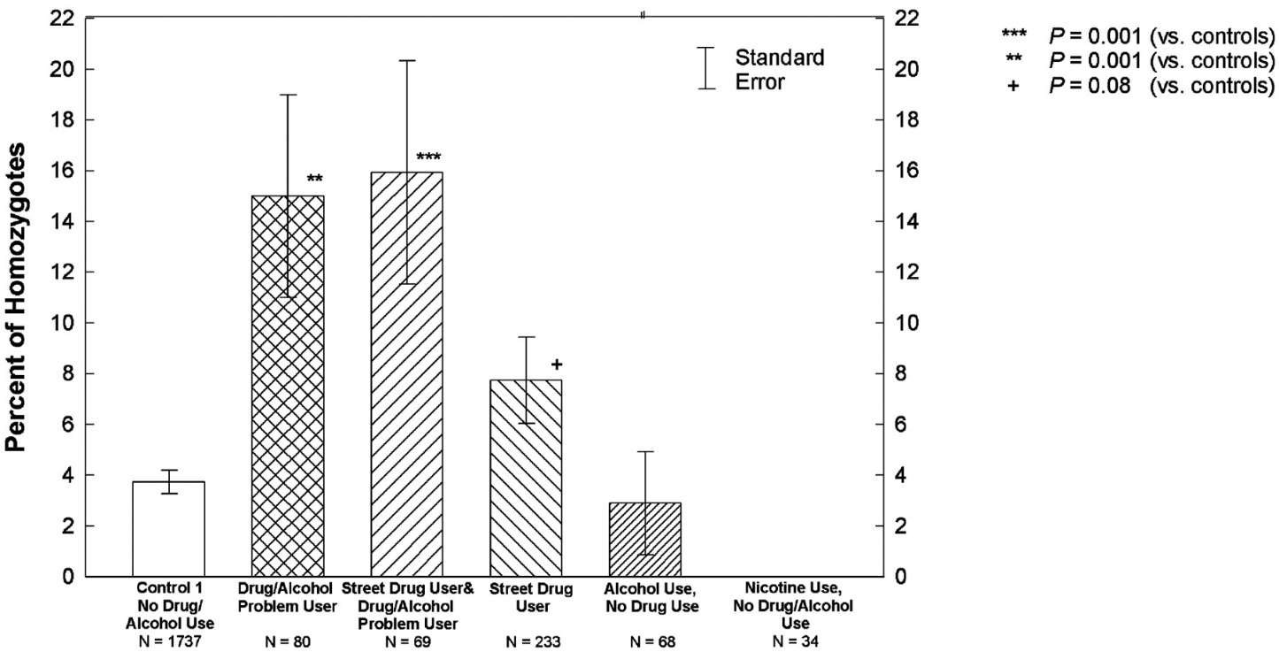
A more detailed analysis of the occurrence of the FAAH cDNA 385A SNP revealed that 385A/wt heterozygotes were not overrepresented in the street drug user or problem drug/alcohol user groups relative to the distribution of the wt/wt FAAH genotype. In contrast, comparisons of 385A/385A individuals with wt/wt or pooled groups containing the 385A/wt and wt/wt genotypes revealed a strong and selective association of the 385A/385A genotype with street drug use and problem drug/alcohol use. The odds ratio for risk of problem drug or alcohol use in individuals with the 385A/385A homozygous genotype was 4.5, with a 95% CI between 2.2 and 8.4. Similarly, the odds ratio for risk of street drug use in 385A/385A individuals was 2.2. Finally, the odds ratio for risk of combined street drug use and problem drug/alcohol use in 385A/385A individuals was 4.9 (95% CI, 2.5–9.7).

Slide 19
Percentage of FAAH 385A/385A homozygous subjects in groups of patients reporting street drug use and/or problem drug or alcohol use, matched controls with no drug/alcohol use, alcohol use but no drug use, and nicotine use but no drug/alcohol use. Error bars represent standard errors calculated for a binomial distribution of the indicated homozygote frequencies.
Discussion: The present study report a naturally occurring SNP in the human FAAH gene, 385A, that is strongly associated with street drug use and problem drug/alcohol use. This association seems especially relevant to illegal drug use, because neither alcohol nor nicotine abuse alone showed any significant relationship to the 385C→A missense mutation. Moreover, we did not observe an association of the 385A SNP with any of the other neurobehavioral or neuropsychiatric disorders examined by our questionnaire, including depressive symptoms, suicidal ideation, schizophrenia, bipolar disorder, and autism.
FAAH is the primary catabolic regulator of a family of neural-signaling molecules, the fatty acid amides, that includes the endogenous cannabinoid, anandamide. Previous efforts to identify genetic relationships between the ECS and drug and alcohol abuse have focused on the analysis of the CB1 receptor gene and so far have produced mixed results.

Slide 20
A frequent silent mutation in CB1 has been identified (1359G→A), but its functional significance and relevance to drug and alcohol abuse remains controversial. In contrast, pharmacological studies have provided substantial evidence that activation of the cannabinoid system leads to key molecular and cellular changes associated with addiction. For example, cannabinoids have been shown to enhance mesolimbic dopaminergic [DA] transmission in a manner similar to heroin. Likewise, long-term cannabinoid administration alters corticotropin-releasing factor [CRF] activity, a neuroadaptive process generally related to drug dependence.
Considering that the genetic deletion of FAAH in mice results in an adult with greatly increased endogenous brain levels of anandamide and related fatty acid amides - polymorphisms in the human FAAH gene that produce a functionally altered enzyme also might be expected to shift tonic levels of these signaling lipids. The FAAH SNP identified in this study produces a missense mutation (385C→A) that results in the conversion of a Pro residue to Thr (P129T). Interestingly, this Pro residue is completely conserved among all mammalian FAAH enzymes characterized to date, including the human, mouse, rat, pig, and bovine FAAH orthologues. Although the P129T mutation was not found to alter the general catalytic properties or structural stability of FAAH, it did produce a FAAH variant with significantly increased sensitivity to proteolytic degradation.

Slide 21
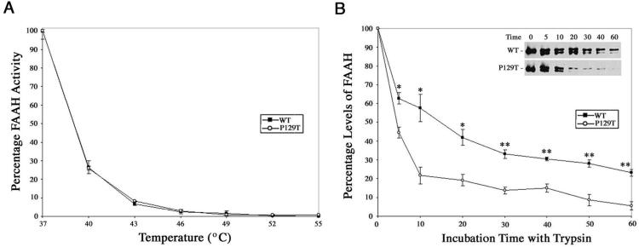
Relative structural stability of wild-type and Pro129→Thr human FAAH proteins.
(A) Heat-inactivation profiles for wild-type and Pro129→Thr FAAH variants. Membranes from COS-7 cells transfected with human FAAH proteins were preincubated for 30 min at the indicated temperatures and then assayed for oleamide hydrolysis activity. Activities are presented as a percentage of the activity observed for control reactions preincubated at 37°C (n = 3 for each temperature). Control activities for oleamide hydrolysis were 2.36 nmol × mg−1 × min−1 and 1.59 nmol × mg−1 × min−1 for wild-type and Pro129→Thr FAAH variants, respectively.
(B) Protease sensitivity profiles of wild-type and Pro129→Thr FAAH variants. Membranes from COS-7 cells transfected with human FAAH proteins were preincubated with trypsin for the time points indicated, after which the levels of remaining FAAH protein were measured by covalent labeling with an active site-directed fluorescent probe, FP-rhodamine. Levels of FAAH protein are presented as a percentage of the levels observed for control samples run in the absence of trypsin (n = 3 for each time point). *, P < 0.025; **, P values < 0.01, Student's t test. (Inset) Levels of FAAH estimated by Western blot analysis after incubation of the enzymes with trypsin for the indicated time points.

Slide 22
Clinical eCB deficiency (CECD) is a medical theory that proposes that a deficiency of eCBs is the underlying pathophysiology of migraines, fibromyalgia, & irritable bowel syndrome. The deficiency may sometimes start in the womb as a result of maternal obesity.
Although these findings are provocative in that they offer a potential link between functional alterations in the ECS and a predisposition to illegal drug use, alternative interpretations of the data are also possible. One confounding possibility is that of linkage disequilibrium, in which the FAAH 385C→A mutation would be linked to a nearby risk-determining gene mutation. Data interpretation also could be complicated by stratification bias inherent in the clinical grouping by questionnaire responses. However, clinical studies have demonstrated that a high rate of comorbidity exists between alcoholism and poly-drug abuse, indicating that these diseases may share a common molecular and cellular foundation. Finally, one must consider that addiction is a complex trait, and the FAAH cDNA 385C→A mutation is undoubtedly only one of many genetic and environmental factors that may influence the expression of the pathological phenotype. Nonetheless, the FAAH 385A/385A genotype was sufficiently prevalent in street drug users and problem drug or alcohol users to detect above the background of many other genetic factors in the populations examined, and, therefore, may prove to be a useful diagnostic predictor of individuals at risk for drug-related disorders. More generally, the association of a naturally occurring human FAAH mutation with problem drug use provides further support that the ECS may play an important role in neural circuits that underlie drug abuse and dependence.

Slide 23
CBD inhibits FAAH activity
Most therapeutic effects of CBD may be due to its anti-oxidant properties, to its direct interaction with cytochrome p450-enzymes and other enzymes of the ‘arachidonate cascade', or to an action at specific receptors. Recent studies have investigated whether CBD interacts with proteins of the ‘endocannabinoid [eCB] signaling system' other than the CB1/CB2 receptors. These proteins are:
1. Fatty acid amide hydrolase (FAAH), the intracellular enzyme catalyzing the hydrolysis of the endogenous cannabinoid ligand, anandamide (arachidonoylethanolamide, [AEA]). However, one recent study claimed that in humans, CBD does not inhibit FAAH activity.
2. The ‘anandamide membrane transporter' (AMT), which facilitates the transport of AEA across the cell membrane and, subsequently, its intracellular degradation. AMT is different from FABP. It was found that CBD inhibits both AEA hydrolysis by FAAH-containing membrane preparations and AEA uptake by RBL – 2H3 cells via the AMT. Although these effects were observed at high μM concentrations, these findings raised the possibility that some of the pharmacological actions of CBD might be due to inhibition of AEA degradation, with subsequent enhancement of the endogenous levels of this lipid mediator [AEA], for which neuro-protective and anti-inflammatory properties have been previously suggested.

Slide 24
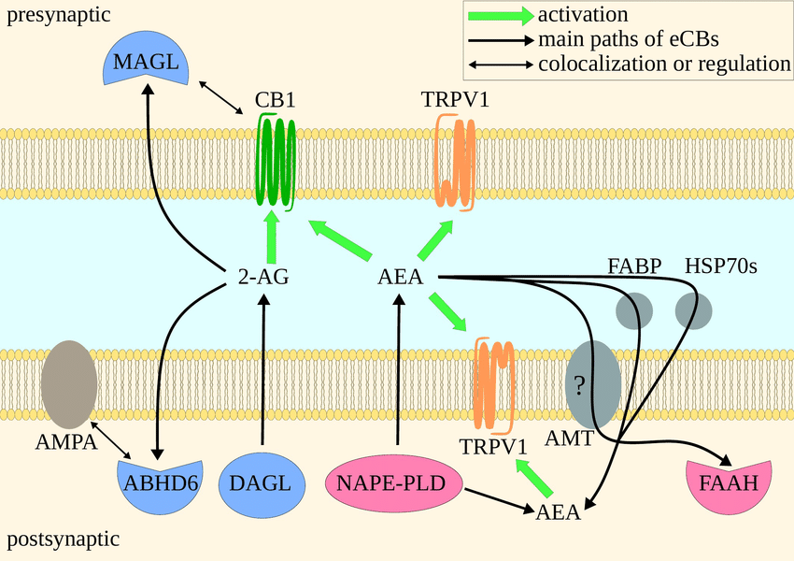
Both AMT, FABP & HSP70 transport AEA to FAAH.
CB1R, MAGL & TRPV1 on presynapse.
TRPV1, NAPE-PLD, DAGL, ABHD6, AMPA, AMT & FAAH on postsynapse.
Post-synaptic DAGL produces 2-AG,
Pre-synaptic MAGL degrades it.

Slide 25
Alpha/beta-hydrolase domain [ABHD6]
ABHD6 is a member of the eCB signaling system, enzymatically controlling levels of the most abundant eCB 2-AG, controlling activation of CB1 and CB2 receptors, and thereby modulating many cell functions.
ABHD6 modulates neuronal activity in an eCB-independent manner, through AMPA receptor trafficking and allosteric modulation of GABA receptor signaling. This illustrates the valuable multi-functionality of this enzyme with multiple therapeutic possibilities.
Novel inhibitors targeting ABHD6 have been developed with increasing selectivity and sensitivity that have led to elucidation of its biological function. Inhibition of ABHD6 has emerged as a promising therapeutic treatment of select neurological diseases.
The eCB signaling system modulates neurotransmission and inflammation, among other physiological functions. Its newest member, α/β-hydrolase domain-containing 6 (ABHD6), has emerged as a promising therapeutic target to treat several devastating diseases, including epilepsy. Here, we review the molecular mechanisms that mediate and control eCB signaling and, within it, the specific role of ABHD6. We also discuss how ABHD6 controls the abundance of additional lipids and the trafficking of ionotropic receptors to plasma membranes. We finish with several unexplored questions regarding this novel enzyme. Our current understanding of the molecular mechanism and biological function of ABHD6 provides a strong foundation for the development of small-molecule therapeutics to treat devastating diseases.

Slide 26
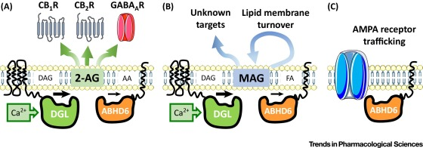
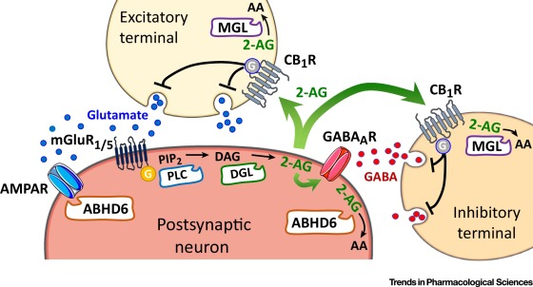
ABHD6 is a lipase that preferentially hydrolyses medium-chain saturated monoacylglycerols including 2-arachidonoylglycerol. Through 2-AG degradation it may regulate eCB signaling pathways.

Slide 27
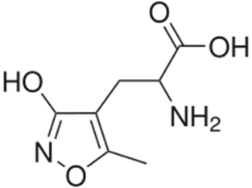
AMPA
AMPA (α-amino-3-hydroxy-5-methyl-4-isoxazolepropionic acid) is a compound that is a specific agonist for the AMPA receptor, where it mimics the effects of the neurotransmitter [NT] glutamate.
There are several types of glutamatergic ion channels in the CNS including AMPA, kainic acid [KA] and N-methyl-D-aspartic acid (NMDA) channels. In the synapse, these receptors serve very different purposes. AMPA can be used experimentally to distinguish the activity of one receptor from the other in order to understand their differing functions. AMPA generates fast excitatory postsynaptic potentials (FEPSP). AMPA activates AMPARs that are non-selective cationic channels allowing the passage of Na+ and K+ and therefore have an equilibrium potential near 0 mV. AMPA was first synthesized, along with several other ibotenic acid derivatives toward differentiating glutamate sensitive receptors from aspartate sensitive receptors.

Slide 28
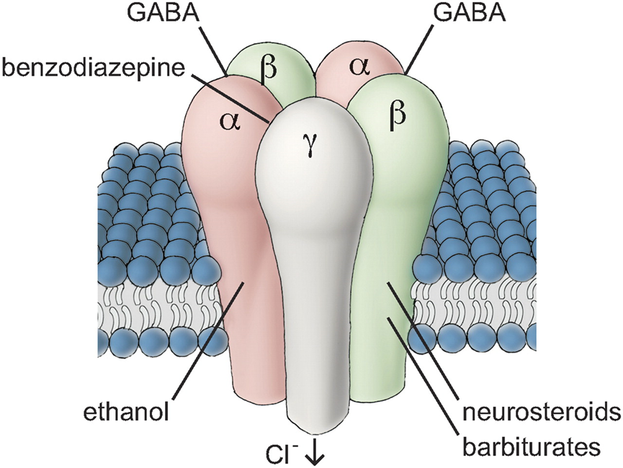
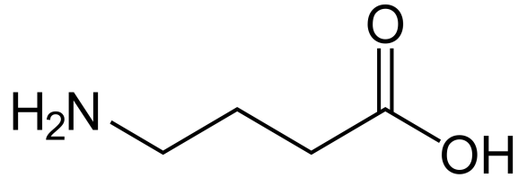
GABAa Receptor
The GABAa receptor (GABAaR) is an ionotropic receptor and ligand-gated ion channel. Its endogenous ligand is γ-aminobutyric acid (GABA), the major inhibitory neurotransmitter in the CNS.

Slide 29
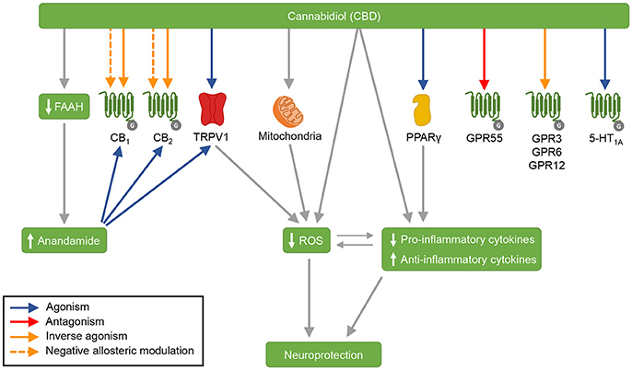
CBD's mechanisms of action: CBD acts as agonist of the receptors TRPV1, PPARγ, and 5-HT1A, and as antagonist of the receptor GPR55. CBD is an inverse agonist of the receptors GPR3, GPR6, and GPR12. Moreover, CBD antagonizes the action of CB1 and CB2 receptors agonists, and is suggested to act as an inverse agonist and a negative allosteric modulator of these receptors. CBD also inhibits FAAH, which results in increased anandamide levels. Anandamide activates CB1, CB2, and TRPV1 receptors. By acting on mitochondria, CBD increases the activity of mitochondrial complexes. In addition, CBD displays antioxidant and anti-inflammatory effects—that are partially mediated by CBD's actions on TRPV1, mitochondria and PPARγ.

Slide 30
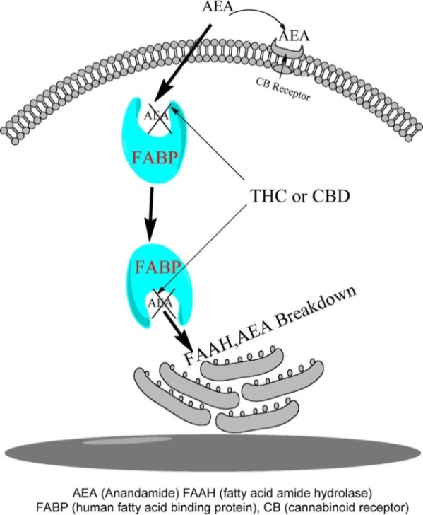
5-HT1A, serotonin receptor 1A; CB1, cannabinoid receptor type 1; CB2, cannabinoid receptor type 2; FAAH, fatty acid amide hydrolase; GPR3, G-protein-coupled receptor 3; GPR6, G-protein-coupled receptor 6; GPR12, G-protein-coupled receptor 12; GPR55, G-protein-coupled receptor 55; PPARγ, peroxisome proliferator-activated receptor gamma; ROS, reactive oxygen species; TRPV1 = transient receptor potential vanilloid type 1.
Fatty acid binding proteins [FABPs]
THC & CBD bind FABP binding pocket instead of AEA. As a result of the competitive binding, AEA cannot reach the Endoplasmic Reticulum [ER] and does not get inactivated by FAAH.

Slide 31
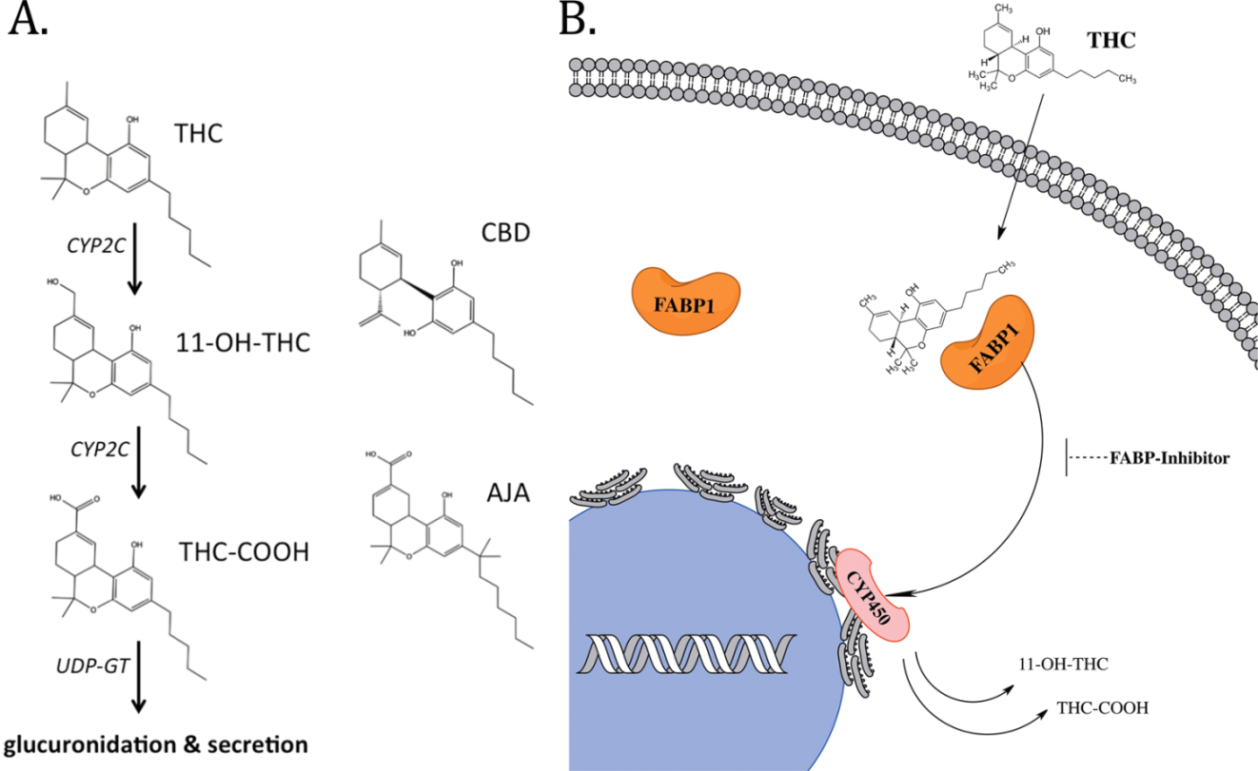
FABP1 carry pCBs in the cytoplasm to the Endoplasmic Reticulum [ER] to be metabolized by CYP450 enzymes. Inhibition of FABP1 reduces the metabolism of pCBs by CYP450.

Slide 32
Fatty acid binding proteins [FABPs] and their genes
The fatty-acid-binding proteins (FABPs) are a family of transport proteins for fatty acids and other lipophilic substances such as eicosanoids and retinoids. These proteins are thought to facilitate the transfer of fatty acids between extra- and intracellular membranes. Some family members are also believed to transport lipophilic molecules from outer cell membrane to certain intracellular & nuclear receptors such as PPAR. The FABPs are intracellular carriers that “solubilize” the endocannabinoid [eCB] anandamide (AEA), transporting it to the breakdown by FAAH.
Compounds that bind to FABPs block AEA breakdown, raising its level.
The cannabinoids (THC and CBD) are also discovered to bind few human FABPs (1, 3, 5, and 7) that function as intracellular carriers, as THC and CBD inhibit the cellular uptake and catabolism of AEA by targeting FABPs. Competition for FABPs may in part or wholly explain the increased circulating levels of eCBs reported after consumption of cannabinoids.
Levels of fatty-acid-binding protein have been shown to decline with ageing in the mouse brain, possibly contributing to age-associated decline in synaptic activity.
Interestingly, most CBD consumers are over 50 years old.
Hypothesis: Genetic variations in the FABPs genes and its expression are involved in determining the effect of CBD in humans.
Smoking cannabis enhance endogenous AEA levels treating eCB deficiency syndrome [EDS].

Slide 33
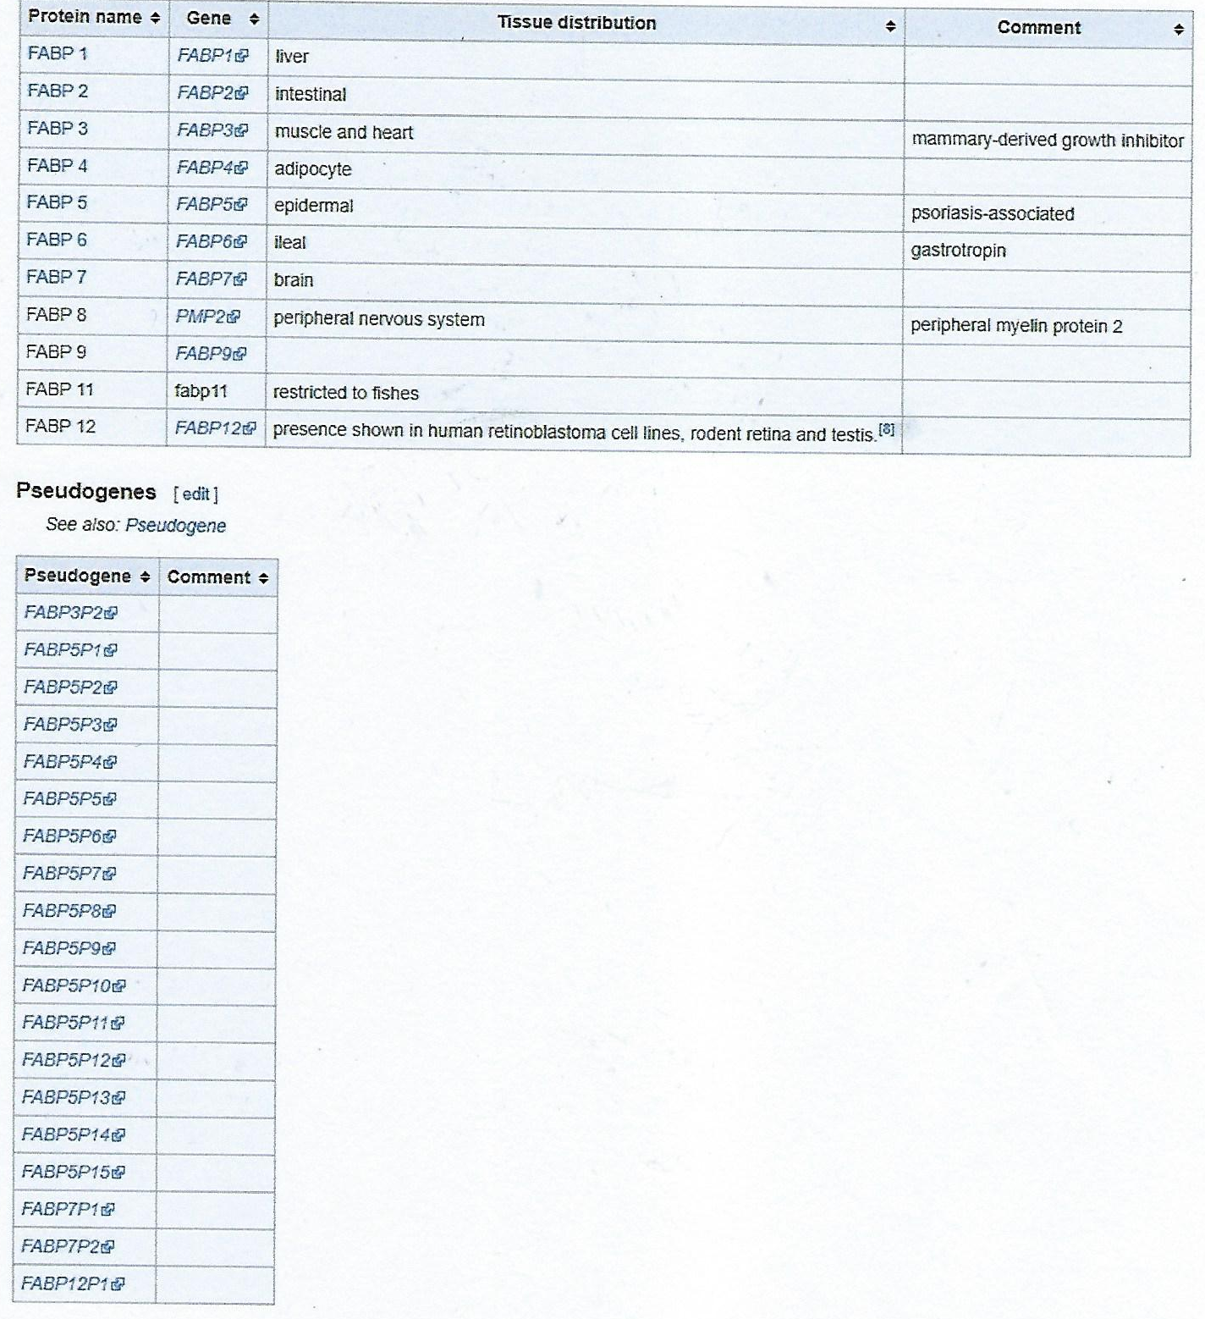
FABP1 in the liver,
FABP3 = muscle & heart,
FABP5 = epidermal cells,
FABP7 = brain.
19 FABP pseudo genes were also identified.

Slide 34
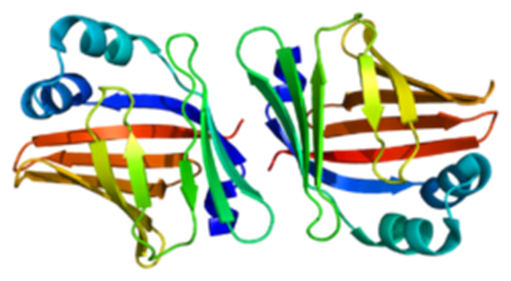
FABP7 protein & gene
The protein encoded by this gene is a brain FABP. Fatty acid binding proteins (FABPs) are a family of small, highly conserved, cytoplasmic proteins that bind long-chain fatty acids [LCFA] and other hydrophobic ligands. FABPs are thought to play roles in fatty acid uptake, transport, and metabolism.
FABP7 is expressed during development, in radial glia by the activation of Notch receptors.
Radial glia are specialized cells in the developing nervous system of all vertebrates, and are characterized by long radial processes. These processes facilitate the best known function of radial glia: guiding the radial migration of newborn neurons from the ventricular zone to the mantle regions.
Reelin was shown to induce FABP7 expression in neural progenitor cells via Notch-1 activation.

Slide 35
Polymorphism screening of brain-expressed FABP7, 5 and 3 genes and association studies in autism and schizophrenia in Japanese subjects (2010)
Motoko Maekawa et al.
Journal of Human Genetics volume 55, pages 127–130 (2010)
Fatty acid-binding protein gene family consist of at least 12 members, of which FABP7, 5 and 3 are expressed in the brain. We previously showed that FABP7 is associated with schizophrenia & bipolar disorder. Recently, genetic overlap between autism and schizophrenia has been reported. Therefore, in this study, we set out to examine the possible roles of brain-expressed FABPs in autism, focusing primarily on potentially functional polymorphisms (that is, missense polymorphisms).
First, we resequenced the three genes using 285 autism samples. We identified 13 polymorphisms, of which 7 are novel. Of the novel single-nucleotide polymorphisms (SNPs), two are missense mutations, namely, 376G>C (Val126Leu) in FABP7 and 340G>C (Gly114Arg) in FABP5.

Slide 36
Finally, as a web-based algorithm predicts that the 8A>G (Asp3Gly; rs17848124) in FABP3 is ‘probably damaging’, we estimated the possible impact of this SNP, and found that the loss of charge and salt bridge, caused by the Asp3-to-Gly3, may affect stability of the FABP3 protein. Future searches for associated phenotypes with missense SNPs using larger samples are highly warranted.
Our polymorphism screen detected 13 different variants in FABP7, FABP5 and FABP3: 7 are novel and 6 were previously reported. With respect to novel variants, the 376G>C (Val126Leu; SNP ID ‘ss160853728’) in FABP7 and 340G>C (Gly114Arg; newly assigned as ‘ss160853732’) in FABP5 were missense SNPs. The total number of missense SNPs identified in this study is four.
We tested these four missense SNPs for association with autism and schizophrenia, because of the potentially functional importance of missense polymorphisms. As autism is more prevalent in males than in females, the association analysis of autism samples was done separately in males and in females. The effect of these missense SNPs on drug abuse & addiction should be further investigated.

Slide 37
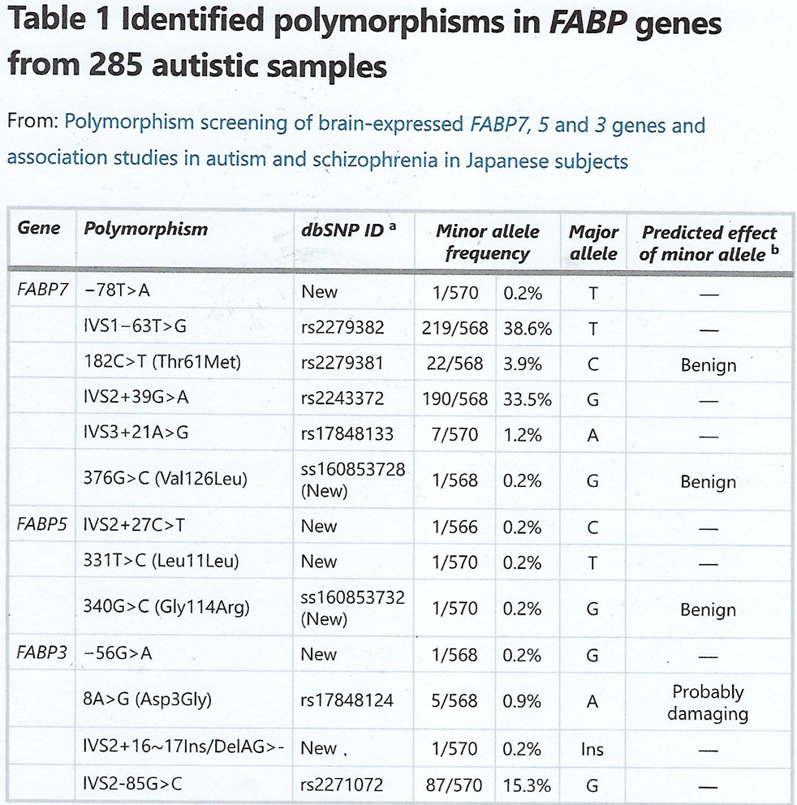
However, none of them showed significant P-values, although the two new missense SNPs (Val126Leu in FABP7 and Gly114Arg in FABP5) were not seen in over 1000 control samples. The low frequency of minor alleles from the examined SNPs, suggests that larger sample sizes are needed to exclude the possibility of type II errors, a limitation of the current study. The other caution of this study includes that age is not matched between autism and control samples.

Slide 38
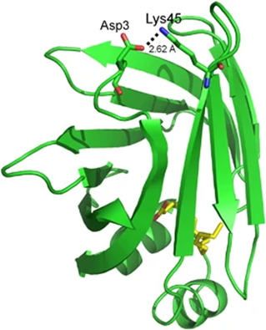
Possible impact of the missense SNPs on the structure and function of FABP proteins
SNPs that occur in a gene's coding region and result in an amino acid substitution at the coded protein corresponding region are known as missense SNPs, also called non-synonymous SNPs (nsSNPs). In most cases, this variation is neutral or has little effect on the protein function. A tool-website ‘PolyPhen’ can estimate the possible impact of an amino acid substitution on the structure and function of a protein. According to this algorithm, only the Asp3Gly mutation in FABP3 is predicted to be ‘probably damaging’ among the four missense SNPs. The possible impact of the Thr61Met mutation in FABP7 is discussed elsewhere. The crystal structure of FABP3 is known. Replacing Asp by Gly causes loss of a negative charge and breakage of a salt bridge between Asp3 and Lys45, suggesting that this missense polymorphism may affect protein stability. As FABP3 binds and transports FAs, destabilization of FABP3 could affect multiple biological processes.
The site of the missense polymorphism Asp3Gly in the FABP3 protein structure. The salt bridge between Asp3 and Lys45 is shown as a dashed line, with its distance.

Slide 39
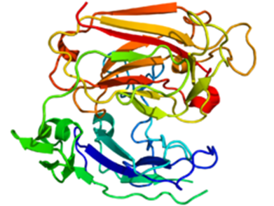
Reelin Protein & Gene
Reelin is a large secreted extracellular matrix [ECM] glycoprotein that helps regulate processes of neuronal migration and positioning in the developing brain by controlling cell–cell interactions. Besides this important role in early development, reelin continues to work in the adult brain. It modulates synaptic plasticity by enhancing the induction and maintenance of long-term potentiation [LTP]. It also stimulates dendrite and dendritic spine development and regulates the continuing migration of neuroblasts generated in adult neurogenesis sites like the sub-ventricular and sub-granular zones. It is found not only in the brain but also in the liver, thyroid & adrenal glands, Fallopian tube, breast and in comparatively lower levels across a range of anatomical regions.

Slide 40
Reelin has been suggested to be implicated in pathogenesis of several brain diseases. The expression of the protein has been found to be significantly lower in schizophrenia and psychotic bipolar disorder [BPD], but the cause of this observation remains uncertain, as studies show that psychotropic medication itself affects reelin expression. Moreover, epigenetic hypotheses aimed at explaining the changed levels of reelin expression are controversial. Total lack of reelin causes a form of lissencephaly. Reelin may also play a role in Alzheimer's disease [AD], temporal lobe epilepsy and autism.
Reelin's name comes from the abnormal reeling gait of reeler mice, which were later found to have a deficiency of this brain protein and were homozygous for mutation of the RELN gene. The primary phenotype associated with loss of reelin function is a failure of neuronal positioning throughout the developing CNS. The mice heterozygous for the reelin gene, while having little neuroanatomical defects, display the endo-phenotypic traits linked to psychotic disorders. According to one study, FABP7 binds DHA with the highest affinity among all of the FABPs.
The omega-3 Fatty Acid - DHA
Docosahexaenoic acid (DHA) is an omega-3 fatty acid that is a primary structural component of the human brain, cerebral cortex, skin, and retina. In physiological literature, it is given the name 22:6(n-3). It can be synthesized from alpha-linolenic acid [ALA] or obtained directly from maternal milk (breast milk), fatty fish, fish oil, or algae oil.

Slide 41
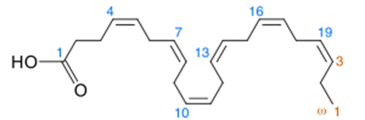
DHA's structure is a carboxylic acid (-oic acid) with a 22-carbon chain (docosa- derives from the Ancient Greek for 22) and six (hexa-) cis double bonds (-en-); with the first double bond located at the third carbon from the omega end [omega-3 FA]. Its trivial name is cervonic acid (from the Latin word cerebrum for "brain"), its shorthand name is 22:6(n−3) in the nomenclature of fatty acids.
Most of the docosahexaenoic acid in fish and multi-cellular organisms with access to cold-water oceanic foods originates from photosynthetic and heterotrophic microalgae, and becomes increasingly concentrated in organisms the further they are up the food chain. DHA manufactured using microalgae is vegetarian.
In organisms that do not eat algae containing DHA nor animal products containing DHA, DHA is instead produced internally from α-linolenic acid [ALA], a shorter omega-3 fatty acid manufactured by plants (and also occurring in animal products). Limited amounts of eicosapentaenoic and docosapentaenoic acids are possible products of α-linolenic acid metabolism in young women and men. DHA in breast milk is important for the developing infant. Rates of DHA production in women are 15% higher than in men.

Slide 42
Notch-1 Protein & gene
Notch homolog 1, translocation-associated (Drosophila), also known as NOTCH1, is a human gene encoding a single-pass trans-membrane receptor.
Notch1 gene encodes a member of the Notch family proteins. Members of this Type 1 trans-membrane protein family share structural characteristics including an extracellular domain consisting of multiple epidermal growth factor-like (EGF) repeats, and an intracellular domain consisting of multiple, different domain types. Notch family members play a role in a variety of developmental processes by controlling cell fate decisions. The Notch signaling network is an evolutionarily conserved intercellular signaling pathway that regulates interactions between physically adjacent cells. Homologues of the notch-ligands have been identified in humans. This protein is cleaved in the trans-Golgi network, and presented on the cell surface as a heterodimer. It functions as a receptor for membrane bound ligands, and may play multiple roles during development. There is evidence that activated Notch 1 and Notch 3 promote differentiation of progenitor cells into astroglia. Notch 1, when activated before birth, induces radial glia differentiation, but postnatally induces the differentiation into astrocytes. Notch-1 cascade is activated by Reelin. Notch1 and Reelin cooperate in the development of the dentate gyrus.

Slide 43
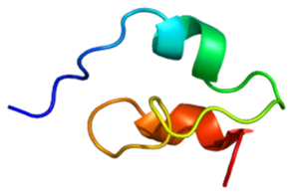
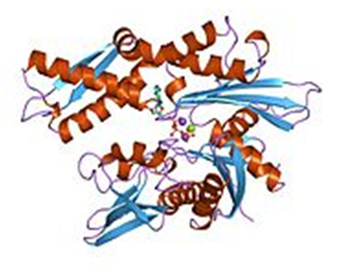
Notch-1 Protein
Heat shock protein [HSP] 70
The 70 kilodalton heat shock proteins (Hsp70s or DnaK) are a family of conserved ubiquitously expressed heat shock proteins. Proteins with similar structure exist in virtually all living organisms. Intracellularly localized Hsp70s are an important part of the cell's machinery for protein folding, performing chaperoning functions, and helping to protect cells from the adverse effects of physiological stresses. Additionally, membrane-bound Hsp70s have been identified as a potential target for cancer therapies and their extracellularly localized counterparts have been identified as having both membrane-bound and membrane-free structures.

Slide 44
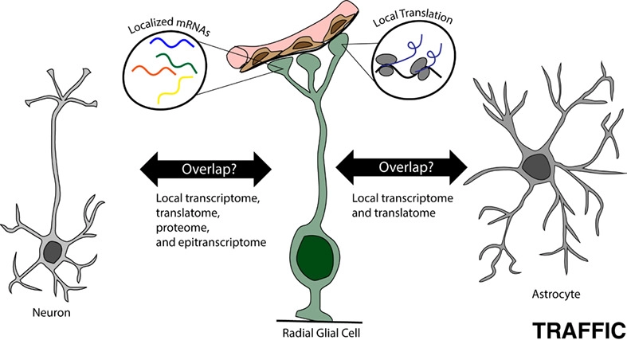
Radial glia are specialized cells in the developing nervous system of all vertebrates, and are characterized by long radial processes. These processes facilitate the best known function of radial glia: guiding the radial migration of newborn neurons from the ventricular zone to the mantle regions.

Slide 45
Cytochrome P450 enzymes & genes
Cytochromes P450 (CYPs) are a superfamily of enzymes containing heme as a cofactor that functions as mono-oxygenases. In mammals, these proteins oxidize steroids, fatty acids [FAs] & xenobiotics, and are important for the clearance of various compounds, as well as for hormone synthesis and breakdown.
In plants, these proteins are important for the biosynthesis of defensive compounds, FAs and hormones.
CYP enzymes have been identified in all kingdoms of life: animals, plants, fungi, protists, bacteria, and archaea, as well as in viruses. However, they are not omnipresent; for example, they have not been found in Escherichia coli. As of 2018, more than 300,000 distinct CYP proteins are known. CYPs are, in general, the terminal oxidase enzymes in electron transfer chains, broadly categorized as P450-containing systems. The term "P450" is derived from the spectrophotometric peak at the wavelength of the absorption maximum of the enzyme (450 nm) when it is in the reduced state and complexes with carbon monoxide. Most CYPs require a protein partner to deliver one or more electrons to reduce the iron and eventually molecular oxygen.
Metabolism of THC by Lungs, Brain & Hepatic CYPs:
CYP2C9, 2C19 and 3A4 metabolizes THC to 11-OH-THC,
CYP2C9 also turns 11-OH-THC [the psychoactive primary metabolite] to THC-COOH [the non-active secondary metabolite].

Slide 46
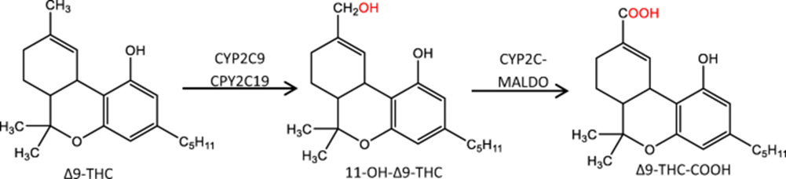
THC LEVELS DO NOT PREDICT DRIVING IMPAIRMENT (2021)
Colin Murphy, February 11, 2021
The February 5, 2021 issue of "Traffic Injury Prevention" published results from an Australian study assessing the relationship between THC levels and driving performance. Volunteers consumed vaporized cannabis samples of varying potencies containing THC, CBD and a placebo. Blood and saliva samples were collected 30 minutes after inhalation and 3.5 hours later. Researchers evaluated driving performance on a simulator. Nearly half of the participants failed to show driving impairment after 30 minutes despite showing THC levels above the per se limits, e.g., 5 ng/ml. Several participants did show impairment at the 3.5 hour mark, but their THC levels were below 5 ng/ml. The blood and oral fluid per se limits examined often failed to discriminate between impaired and unimpaired drivers. Moreover, blood and oral fluid THC concentrations were poorly correlated with driving impairment. It is almost impossible to infer how much cannabis was consumed, or when it was consumed, based solely on a given concentration of THC in any biological matrix.”

Slide 47
They reached the following conclusions:
Due to erratic and route-dependent differences in THC pharmacokinetics as well as significant inter- and intra-individual variability, blood and oral fluid THC concentrations, unlike BAC [blood alcohol concentrations] for alcohol, provide little information as to the amount of cannabis consumed or the extent to which an individual may be intoxicated. Collectively, these results suggest that the per se limits examined here do not reliably represent thresholds for impaired driving. There appears to be a poor and inconsistent relationship between magnitude of impairment and THC concentrations in biological samples, meaning that per se limits cannot reliably discriminate between impaired and unimpaired drivers. This is consistent with prior research on the topic that demonstrates that per se limits for cannabinoids are not evidence-based .In the USA, Iowa state police does not use a per se limit in Operating While Intoxicated [OWI]-drug cases. Instead, operating with “any amount” of a schedule I or II controlled substance is prohibited. This is typically established with a urine test result showing the presence of the inactive metabolite, 11-Nor-9-carboxy-Δ9-tetrahydrocannabinol, or carboxy THC (THC-COOH). Not surprising, there is no evidence that the smallest detectable amount of inactive carboxy-THC can discriminate between impaired and unimpaired drivers either.
You hear “follow the science” a lot these days. Perhaps it is time for the backdoor prohibition of THC to get a second look.

Slide 48
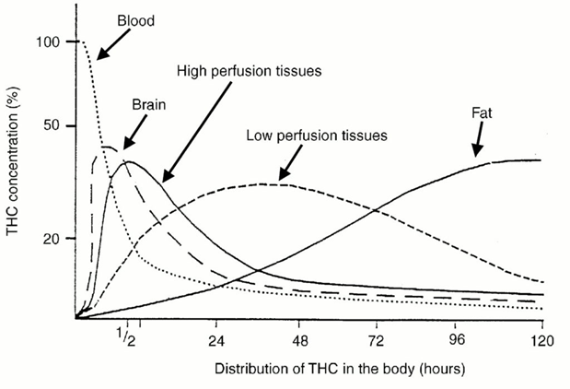
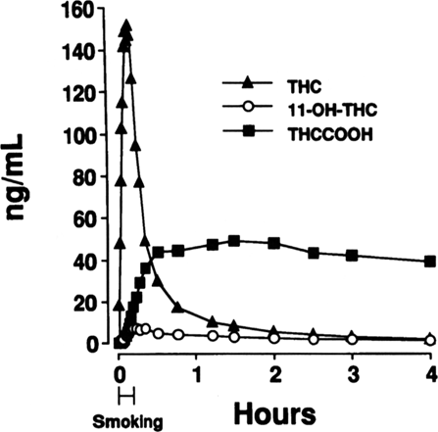
Metabolism & distribution of THC:

Slide 49
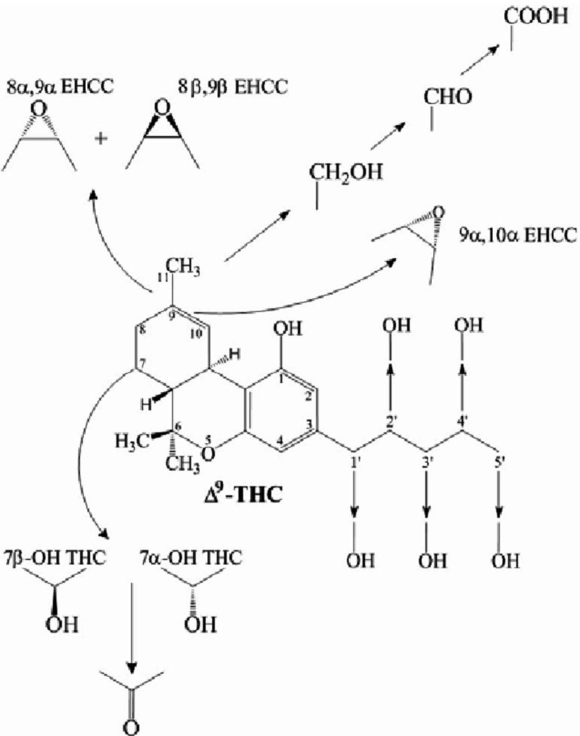
Metabolism of THC by CYP450 enzymes

Slide 50
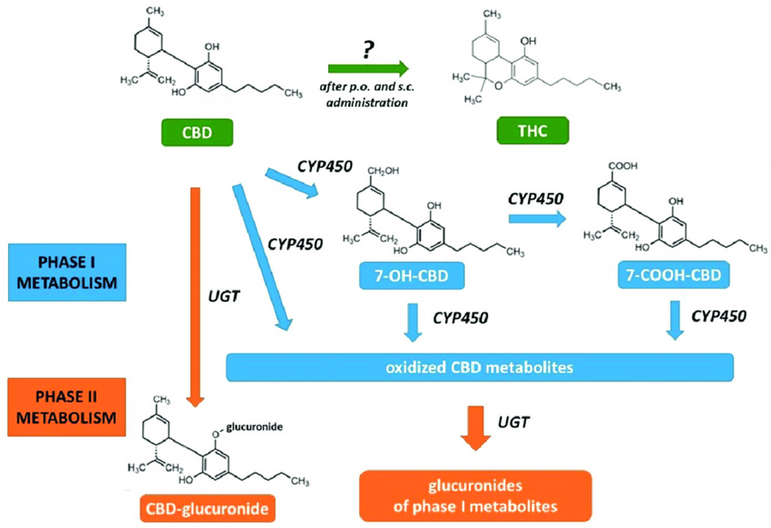
Metabolism of CBD by Hepatic CYP450
CBD is metabolized by CYP450s - first to 7-OH-CBD
and then to 7-COOH-CBD.
CBD inhibits CYP2C9 enzyme therefore, less THC is metabolized
to 11-OH-THC.

Slide 51
It has repeatedly been demonstrated that CBD is not only a substrate but also an inhibitor of CYP450 enzymes, and thus, it could interfere with the metabolism of other xenobiotics, including THC and medicinal products. Moreover, prolonged CBD administration may induce specific CYP450 isoenzymes, as it has been shown in mouse liver CYP3A and CYP2B as well as for human CYP1A1 in vitro. Also, 6α-OH-CBD was found to be an effective inducer of CYP2B. The resorcinol moiety apparently plays a pivotal role in CYP450 induction.
The CYP450-mediated metabolism of anandamide in vitro by liver microsomes isolated from mice treated with CBD (120 mg/kg i.p.) was shown to be inhibited, but the physiological significance of this finding has not been explored. The involvement of CBD in the regulation of the ECS has recently been reviewed.
During a Phase I study with healthy male subjects, potential drug–drug interactions of THC/CBD oromucosal spray (Sativex, nabiximols) in combination of CYP450 inducers and inhibitors were assessed using various dose regimens. The antibiotic rifampicin, an inducer of CYP3A4 involved in the metabolism of CBD, significantly reduced the peak plasma concentration of CBD, while the antifungal ketoconazole, a CYP3A4 inhibitor, nearly doubled the peak plasma concentration of CBD; however, the moderate CYP2C19 inhibitor omeprazole, a proton-pump inhibitor used to treat gastroesophageal reflux disease, did not significantly alter the pharmacokinetics [PK] of CBD.

Slide 52
Recently, an 8-week trial studied the interaction of the anticonvulsant drug clobazam and CBD in 13 children with refractory epilepsy. Oral CBD treatment started with 5 mg/kg per day with a weekly increase of 5 mg/kg per day up to 25 mg/kg per day. It was observed that co-administration of CBD increased clobazam plasma level by 60%, while the level of its active metabolite norclobazam increased by 500% This allowed the reduction of the initial average 1 mg/kg daily clobazam dose thereby alleviating consequential side effects. The bioactivation by demethylation of clobazam by CYP3A4 and the inactivation by hydroxylation of clobazam/norclobazam by CYP2C19. These isoenzymes are also implicated in CBD metabolism, interactions with CBD and/or its metabolites in such combination therapies should be considered.
Furthermore, CBD has been shown to interact in vitro with P-glycoprotein efflux transporters involved in multidrug resistance, and thus, it may affect the PK of anticancer drugs. Also, the placental permeability in pregnant women who consume CBD-containing preparations may also be influenced.
Could any of the pharmacological effects observed for CBD be attributed to its metabolites?
Can mutations in the genes encoding CYP-3A4, -2C6 & -2C19 make people less sensitive to CBD’s therapeutic effects?

Slide 53
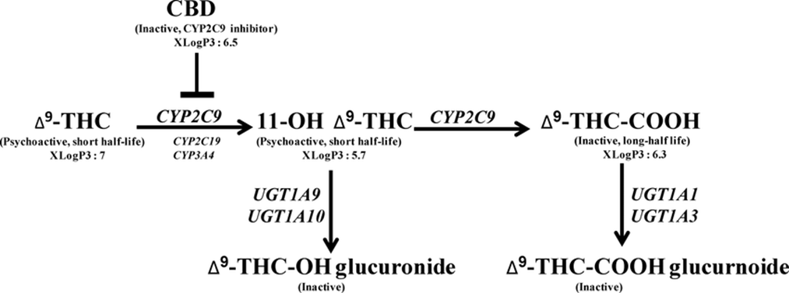
Chemical Structure & activity of CYP Proteins
Human CYPs are primarily membrane-associated proteins located either in the inner membrane of mitochondria or in the endoplasmic reticulum [ER] of cells. CYPs metabolize thousands of endogenous and exogenous chemicals. Some CYPs metabolize only one (or a very few) substrates, such as CYP19 (aromatase), while others may metabolize multiple substrates. Cytochrome P450 enzymes are present in most tissues of the body, and play important roles in hormone synthesis and breakdown (including estrogen and testosterone synthesis and metabolism), cholesterol synthesis, and vitamin D metabolism. Cytochrome P450 enzymes also function to metabolize potentially toxic compounds, including drugs and products of endogenous metabolism such as bilirubin, principally in the liver.

Slide 54
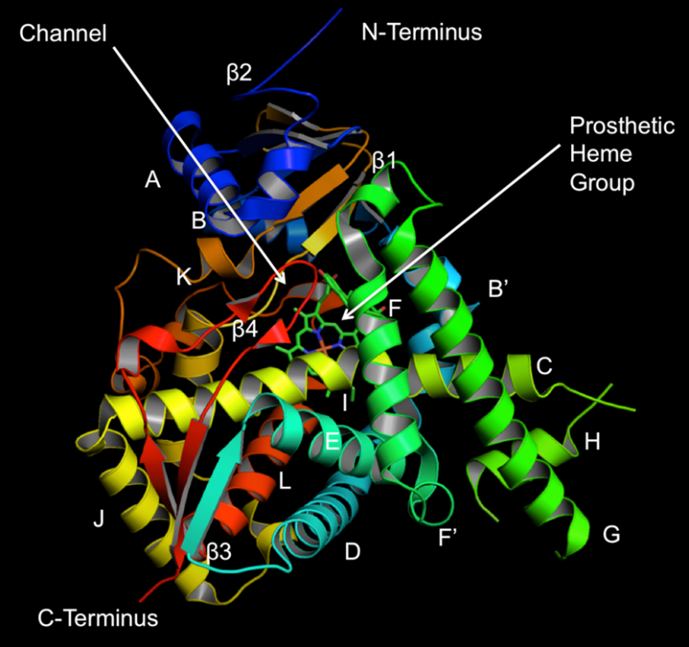
Chemical Structure of CYP51 Protein
7-Hydroxycannabidiol (7-OH-CBD) is an active metabolite of CBD, generated in the body from CBD by the action of the enzyme CYP2C19. While methods have been developed for its synthetic production, and measurement of levels in the body following consumption of CBD, its pharmacology has been relatively little studied, though it has been found to possess similar anticonvulsant effects to CBD itself, as well as lowering blood triglyceride [TG] levels. Like its precursor CBD, it is not known to exhibit any psychoactive effects on the body and is known to counter the psychoactive effects of THC if it is present at the same time.

Slide 55
CYPs are the major enzymes involved in drug metabolism, accounting for about 75% of the total metabolism. Most drugs undergo deactivation by CYPs, either directly or by facilitated excretion from the body.
Also, many substances [pro-drugs] are bioactivated by CYPs to form their active compounds like the antiplatelet drug clopidogrel and the opiate (opioid) codeine.
CYP450 genes
The Human Genome Project has identified 57 human genes coding for the various cytochrome P450 enzymes.
Aim: The present study aimed to investigate the human genetic diversity of the CYP450 superfamily in order to identify functional interethnic differences and analyze the role of CYP450 enzymes in human adaptation.
Materials & methods: A computational analysis of genetic and functional differences of the 57 CYP450 genes was performed using the Human Genome Diversity Project and HapMap data; comprising approximately 1694 individuals belonging to 62 human populations.
Results: Twenty-six CYP450 SNPs with F-statistics significantly different than the general distribution were identified. Some showed high differentiation among human populations, suggesting that functional interethnic differences may be present. Indeed, some of these are significantly associated with drug response or disease risk. Furthermore, our data highlighted that TBXAS1 and genes in CYP3A cluster may have a role in some processes of human adaptation.

Slide 56
TBXAS1
Thromboxane A synthase 1 (platelet, cytochrome P450, family 5, subfamily A), also known as TBXAS1, is an enzyme that, in humans, is encoded by the TBXAS1 gene. This gene encodes a member of the cytochrome P450 superfamily of enzymes. However, this protein is considered a member of the cytochrome P450 superfamily on the basis of sequence similarity rather than functional similarity. This endoplasmic reticulum [ER] membrane protein catalyzes the conversion of prostaglandin H2 to thromboxane A2, a potent vasoconstrictor and inducer of platelet aggregation, an agonist of Leukotriene B4 receptors (i.e. BLT2 receptors) and mediator of certain BLT2 receptor actions.
The enzyme plays a role in several pathophysiological processes including hemostasis, cardiovascular disease, and stroke.
Conclusion: Our study provided an analysis of genetic diversity of CYP450 superfamily, identifying functional differences among ethnic groups and their related clinical phenotypes.

Slide 57
CYP2C9 genes:
Warfarin is an anticoagulant, which means that it thins the blood, preventing blood clots from forming. The CYP2C9 gene polymorphisms associated with warfarin sensitivity change single protein building blocks (amino acids) in the CYP2C9 enzyme. The altered enzyme slows the metabolism of warfarin, allowing the drug to remain active in the body for a longer period of time. People with warfarin sensitivity take longer than usual to metabolize warfarin and may require lower doses of the drug than are usually prescribed.
The two most common CYP2C9 polymorphisms in people of European ancestry are known as CYP2C9*2 and CYP2C9*3. Both of these polymorphisms lead to a decrease in warfarin metabolism to such degrees that prescription doses are typically reduced by one-third and one-fifth, respectively. In individuals with African ancestry, the four most common CYP2C9 polymorphisms associated with warfarin sensitivity are known as CYP2C9*5, CYP2C9*6, CYP2C9*8, and CYP2C9*11. These polymorphisms lead to a decrease in warfarin metabolism that would necessitate a reduction in prescription doses by one-sixth. In other populations, the effects of these polymorphisms are less certain.
In rare cases in which individuals have more than one CYP2C9 polymorphisms, the enzyme activity is severely decreased and metabolism of warfarin is very slow. If people with warfarin sensitivity take the average dose of warfarin, they are at risk of an overdose, which can cause abnormal bleeding in the brain, gastrointestinal [GI] tract, or other tissues.

Slide 58
Hepatic CYP2C9 metabolizes pCBs such as CBD & THC to their biologically active metabolites. Therefore, mutations in CYP2C9 genes may affect the activity of those pCBs in the human body.
CYP2C19 genes:
The CYP2C19 enzyme plays a role in the processing or metabolizing of at least 10 percent of commonly prescribed drugs, including a drug called clopidogrel. Clopidogrel is an antiplatelet drug, which means that it prevents blood cells called platelets from sticking together (aggregating) and forming blood clots. The CYP2C19 enzyme converts the pro-drug clopidogrel to its active form. The active drug then inhibits a receptor protein known as P2RY12 that is found on the surface of platelets. During clot formation, the P2RY12 receptor protein helps platelets cluster together to form a clot in order to seal off damaged blood vessels and prevent blood loss.
Multiple variations (polymorphisms) in the CYP2C19 gene have been associated with clopidogrel resistance. The polymorphisms that are associated with clopidogrel resistance decrease the enzyme's ability to convert the drug to its active form.
The normal version of the gene, written as CYP2C19*1, provides instructions for producing a normally functioning CYP2C19 enzyme. If a person has two copies of the CYP2C19*1 version of the gene in each cell, they are able to convert clopidogrel normally. The two most common CYP2C19 gene polymorphisms associated with clopidogrel resistance (known as CYP2C19*2 and CYP2C19*3) result in the production of a nonfunctional CYP2C19 enzyme that is unable to activate clopidogrel. Individuals with clopidogrel resistance can be classified into two groups: intermediate metabolizers or poor metabolizers.

Slide 59
People who have one copy of the CYP2C19*1 version of the gene and one copy of either the CYP2C19*2 or CYP2C19*3 have a reduced ability to convert clopidogrel to its active form and are classified as intermediate metabolizers. People who have the CYP2C19*2 or CYP2C19*3 versions of the gene for both copies of the gene can convert very little or none of the drug and are classified as poor metabolizers. Because conversion of clopidogrel to its active form is impaired in people with clopidogrel resistance, the drug is unable to inhibit P2RY12 receptor function. Without active clopidogrel to interfere, the P2RY12 receptor continues to promote platelet aggregation and blood clot formation, which can lead to heart attacks, strokes, and thrombosis. It is important to note that not all individuals with CYP2C19 gene mutations have clopidogrel resistance. In addition to changes in specific genes, many other factors, including sex, age, weight, diet, and other medications, play a role in how the body reacts to clopidogrel.
Because the CYP2C19 enzyme is involved in the metabolism of many drugs, changes to the enzyme can have wide-ranging effects. Other drugs that are affected by CYP2C19 gene polymorphisms include proton pump inhibitors, used to treat stomach ulcers and other conditions; antidepressants, used to treat psychiatric disorders; anticonvulsants, used to treat seizure disorders; hypnotics and sedatives, used as sleep aids; antimalarial drugs, used to prevent malarial infections; and antiretroviral drugs, used to prevent viruses from replicating.

Slide 60
Most often, changes in the CYP2C19 gene lead to impaired metabolism of these drugs, which reduces their effectiveness. One change in the CYP2C19 gene (known as CYP2C19*17) increases the enzyme's ability to metabolize drugs. Individuals with two copies of the CYP2C19*17 polymorphism are typically classified as ultra-rapid metabolizers.
CYP3A4 genes:
Cytochrome P450 3A4 is the major enzyme responsible for food–drug interactions. Current research into mutations in CYP3A4 has been focused on a few dozen SNPs found in designated studies. They represent “the tip of an iceberg” considering the prevalence and potential outcomes of CYP3A4 mutations. The abundance of large-genome and exome-sequencing projects has opened a new avenue for the identification of many unknown mutations. By demonstrating 856 mutations existing in CYP3A4, of which one third modify the protein structure. Using a cohort of 141,456 unrelated individuals, accurate allelic frequencies of CYP3A4 mutations was calculated for seven separate ethnicities. Polymorphic CYP3A4 enzymes may be very important in explaining differences in drug efficacy and toxicity among different individuals. Mutations in the CYP3A4 gene might lead to abolished, reduced, altered or increased enzymatic activity. Exonic mutations can modify enzymatic activity. Some cases of altered metabolism due to SNPs in CYP3A4 have already been described in the literature. Despite the functional importance and clinical relevance of SNPs in CYP3A4 and possibly due to their relatively low identified frequency in the general population, polymorphism in CYP3A4 has not received the attention it deserves.

Slide 61
Seven mutations served to predict the effect of SNPs on substrate- and inhibitor-binding orientation. In the literature, CYP3A4 polymorphism divides the general population into three groups – poor, normal, and rapid metabolizers, based on intronic SNPs that modify expression levels rather than structure. Our calculations suggest an additional classification: the altered metabolizers. Some mutations proposed by our virtual model would cause a change in the binding orientation of individual ligands. These changes would be expected to decrease the probability of enzymatic oxidation due to increased distance from the heme, or lead to products that would otherwise not be evident during toxicity tests carried out as part of the drug-development process. However, as our model predicts, for most substrates CYP3A4 mutations are benign.
Modified position of a substrate in the binding pocket due to protein structural change is only one possible mechanism by which a mutation might change a protein’s activity. Impaired anchoring of the protein to the membrane, damaged substrate-leading channels, and compromised exit of the products present additional mechanisms for a mutational change in a protein’s (enzyme) activity.
The effect of every mutation is substrate-specific. Determining which combinations of substrates and mutations might modify the enzymatic activity, using traditional in vitro methods is laborious, emphasizing the need in predictive virtual tools in resolving this complex puzzle.

Slide 62
Public and professional interest in personal and precision medicine is growing rapidly. Prediction of modified drug metabolism based on individual polymorphism in CYP3A4 seems to be only a matter of time. Here, we propose that distinct ethnic groups bear unique sets of CYP3A4 SNPs. Indeed, ethnicity may serve as a first feasible step in personalized medicine, preceding the implementation of an individual DNA screen for all. Interestingly, ethnicity has one more implication for CYP3A4 drug metabolism, being a major factor in determining food choices and dietary habits. It may be suggested that therapeutic regimes should be specifically designed for each ethnic group, at least for drugs that are highly metabolized by CYP3A4. This highlights the opportunities for harnessing and integrating databases and deep learning to identify how SNPs, ethnicity, dietary compounds and drugs modify CYP3A4 activity and the success of a medical regime.
Hepatic CYP3A4 is involved in the metabolism of THC & CBD, therefore ethnic parameters and CYP3A4 gene polymorphism may affect the personal response to THC or CBD.
Anandamide membrane transporters [AMTs]
Cannabinoid transporters, often referred to as AMTs or endocannabinoid membrane transporters (EMTs), are thought to facilitate the reuptake of eCBs into cells. However, their existence as a NT transporter is controversial and no trans-membrane protein transporter or gene encoding a transporter has been identified to date. Fatty acid binding proteins [FABPs] transport AEA in humans.

Slide 63
Cannabinoid Receptor type 1
Individual and additive effects of the CNR1 and FAAH genes on brain response to marijuana cues (2010)
Neuropsychopharmacology. 2010 Mar; 35(4): 967–975.
Francesca M Filbey, et al.
As previous work has highlighted the significance of the cannabinoid receptor 1 (CNR1) and fatty acid amide hydrolase (FAAH) genes with respect to cannabis dependence (CD), this study sought to characterize the neural mechanisms that underlie these genetic effects. To this end, we collected DNA samples and fMRI data using a cue-elicited craving paradigm in thirty-seven 3-day-abstinent regular marijuana users. The participants were grouped according to their genotype on two single-nucleotide polymorphisms (SNPs) earlier associated with Cannabis Dependence phenotypes: rs2023239 in CNR1 and rs324420 in FAAH.
Between-group comparisons showed that carriers of the CNR1 rs2023239 G allele had significantly greater activity in reward-related areas of the brain, such as the orbitofrontal cortex (OFC), inferior frontal gyrus (IFG), and anterior cingulate gyrus (ACG), during exposure to marijuana cues, as compared with those with the A/A genotype for this SNP.

Slide 64
The FAAH group contrasts showed that FAAH rs324420 C homozygotes also had greater activation in widespread areas within the reward circuit, specifically in the OFC, ACG, and nucleus accumbens (NAc), as compared with the FAAH A-allele carriers. Moreover, there was a positive correlation between neural response in OFC and NAc and the total number of risk alleles (cluster-corrected p<0.05). These findings are in accord with earlier reported associations between CNR1 and FAAH and Cannabis Depandance intermediate phenotypes, and suggest that the underlying mechanism of these genetic effects may be enhanced neural response in reward areas of the brain in carriers of the CNR1 G allele and FAAH C/C genotype in response to marijuana cues.
The effect of these risk alleles in regard to CBD are still to be explored.
CB1R Genes
Cannabinoid receptor type 1 (CB1), also known as cannabinoid receptor 1 (CB1R) or CNR1, is a G protein-coupled receptor [GPCR] that in humans is encoded by the CNR1 gene. The human CB1 receptor is expressed in the peripheral nervous system [PNS] and central nervous system [CNS]. It is activated by: endocannabinoids [eCBs], a group of retrograde lipids mediator (neurotransmitters) that include anandamide [AEA] and 2-AG; plant phytocannabinoids [pCBs], such as THC which is an active ingredient of the psychoactive drug cannabis; and, synthetic analogs of THC. CB1 is antagonized by the pCB tetrahydrocannabivarin (THCV). The primary endogenous agonists of the human CB1 receptor are anandamide & 2-AG.

Slide 65
The CB1R rs2023239 receptor gene variant significantly affects the reinforcing effects of nicotine, but not cue reactivity, in human smokers (1982)
Chidera C Chukwueke, et al.
Introduction: The cannabinoid CB1 receptor (CB1R) has been shown in preclinical studies to be involved in nicotine reinforcement and relapse-like behavior. The common single nucleotide polymorphism (SNP) rs2023239 may code for an alternative CB1R protein, alter CB1R expression, and be involved in nicotine dependence. To date, no study has explored the relationship between this SNP in CB1R and specific phenotypes of nicotine dependence.
Methods: The current study investigated the influence of CB1R rs2023239 in nicotine reinforcement and craving in regular cigarette smokers. Current smokers (n = 104, cigarettes per day ≥ 10) were genetically grouped (C allele group vs. No C allele group) and underwent laboratory measures of nicotine reinforcement and smoking cue-elicited craving. Nicotine reinforcement was assessed using a forced choice paradigm, while a cue-reactivity procedure measured cue-elicited craving.
Results: These results show that smokers with the C allele variant (CC + CT genotypes) experienced a lower nicotine reinforcement effect compared to those without the C allele (TT genotype). These results were similar in both our subjective and behavioral reinforcement measures, though the subjective effects did not withstand controlling for race. There was no difference between genotype groups with respect to cue-elicited craving, suggesting a lack of influence in cue reactivity.

Slide 66
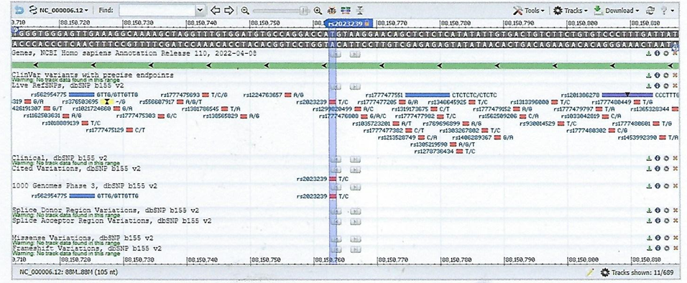
Conclusion: Taken together, these results suggest that the variation in the CB1R (rs2023239 SNP) may play a larger role in nicotine reinforcement compared to cue reactivity. This work provides impetus to further understand the physiological mechanisms that explain how CB1Rs influence nicotine dependence phenotypes.
Hypothesis: Chronic cigarette smokers are not affected by CBD treatment.
rs2023239

Slide 67
The Bivalent Rewarding and Aversive properties of Δ9-tetrahydrocannabinol are mediated through Dissociable Opioid Receptor Substrates and Neuronal Modulation Mechanisms in Distinct Striatal Sub-Regions (2019)
Scientific Reports volume 9, Article number: 9760 (2019).
Christopher Norris, et al.
The primary psychoactive compound in cannabis, THC, is capable of producing bivalent rewarding and aversive affective states through interactions with the mesolimbic system [MLS]. However, the precise mechanisms underlying the dissociable effects of THC are not currently understood. In the present study, we identify anatomically dissociable effects of THC within the rat nucleus accumbens (NAc), using an integrative combination of behavioral pharmacology and in vivo neuronal electrophysiology. We report that the rewarding vs. aversive stimulus properties of THC are both anatomically and pharmacologically dissociable within distinct anterior vs. posterior sub-regions of the NAc. While the rewarding effects of THC were dependent upon local μ-opioid receptor signaling, the aversive effects of THC were processed via a κ-opioid receptor substrate. Behaviorally, THC in the posterior NASh induced deficits in social reward and cognition whereas THC in the anterior NAc, potentiated opioid-related reward salience.

Slide 68
In vivo neuronal recordings demonstrated that THC decreased medium spiny neuron (MSN) activity in the anterior NAc and increased the power of gamma (γ) oscillations. In contrast, THC increased MSN activity states in the posterior NAc and decreased γ-oscillation power. These findings reveal critical new insights into the bi-directional neuronal and pharmacological mechanisms controlling the dissociable effects of THC in mesolimbic-mediated affective processing.
The anatomical distribution of the kappa-opioid receptors [KOR] would suggest an important role for the endogenous kappa-opioid receptor agonists in brain reward function. High levels of KOR mRNA have been detected in the ventral tegmental area [VTA], substantia nigra [SN], nucleus accumbens [NAc], caudate putamen [CP], claustrum, endoperiform nucleus, various hypothalamic nuclei, and the amygdala of the rat brain. A similar expression profile has been detected in the human brain. Overall there is a strong overlap in the expression of mRNA for the KOR and binding sites for the dynorphin-like peptides. Immunohistochemical and autoradiography studies indicate relatively high levels of KORs in the NAc shell and core, caudate putamen, claustrum, endoperiform nucleus, ventral pallidum, medial habenula, bed nucleus of the stria terminals, amygdala, and relatively low levels in the ventral tegmental area and substantia nigra. The VTA and SN have relatively high levels of KOR mRNA and low levels of KOR binding sites. Therefore, it has been suggested that the KORs are produced in the VTA and SN and then transported to the NAc and CP where they are expressed on presynaptic terminals and control the release of dopamine [DA].

Slide 69
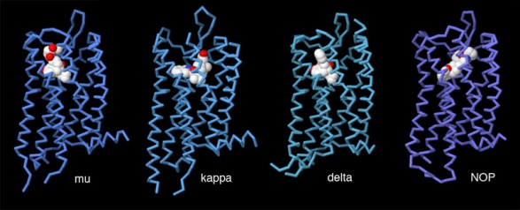
The KOR is a GPCR and its stimulation leads to the inhibition of adenylyl cyclase (AC). The KOR also plays a role in the regulation of calcium currents. The KOR is coupled to an N-type calcium channel and stimulation of it inhibits calcium currents. N-type calcium channels are expressed on presynaptic terminals and play a critical role in the release of NTs. Therefore, dynorphin-like peptides may inhibit the release of NTs by inhibiting N-type calcium channels. Furthermore, KOR agonists have been shown to stimulate inwardly rectifying (i.e., ion conductance depends on membrane potential) potassium channels. The inward rectifying potassium current is a flow of potassium ions from the outside to the inside of the cell. The potassium conductance increases when the membrane potential becomes negatively charged and the potassium conductance decreases when the membrane depolarizes. The inward rectifying potassium channels play an important role in maintaining the resting potential of neurons.

Slide 70
Mu Opioid Receptor [MOR]
The μ-opioid receptors (MOR) are a class of opioid receptors with a high affinity for enkephalins and beta-endorphin, but a low affinity for dynorphins. They are also referred to as μ(mu)-opioid peptide (MOP) receptors. The prototypical μ-opioid receptor agonist is morphine, the primary psychoactive alkaloid in opium. It is an inhibitory G-protein coupled receptor [GPCR] that activates the Gi alpha subunit, inhibiting adenylate cyclase [AC] activity, lowering cAMP levels.
Three splice variants of the μ-opioid receptor are well characterized, though RT-PCR has identified up to 10 total splice variants in humans:
μ1: More is known about the μ1 opioid receptor than the other variants.
μ2: TRIMU 5 is a selective agonist of the μ2 receptor.
Μ3: The μ3 variant is responsive to plant opiate alkaloids but not to endogenous opioid peptides. MORs can exist either pre-synoptically or post-synoptically depending upon cell types.
The μ-opioid receptors exist mostly presynapticaly in the periaqueductal gray region, and in the superficial dorsal horn of the spinal cord (specifically the substantia gelatinosa of Rolando). Other areas where they have been located include the external plexiform layer of the olfactory bulb, the nucleus accumbens [NAc], in several layers of the cerebral cortex, and in some of the nuclei of the amygdala, as well as the nucleus of the solitary tract. Some MORs are also found in the intestinal tract. Activation of these receptors inhibits peristaltic action which causes constipation, a major side effect of μ agonists.

Slide 71
Activation: of the μ-opioid receptor by an agonist such as morphine causes analgesia, sedation, slightly reduced blood pressure, itching, nausea, euphoria, decreased respiration, miosis (constricted pupils), and decreased bowel motility often leading to constipation. Some of these effects, such as analgesia, sedation, euphoria, itching and decreased respiration, tend to lessen with continued use as tolerance develops. Miosis and reduced bowel motility tend to persist; little tolerance develops to these effects. The canonical MOR1 isoform is responsible for morphine-induced analgesia, whereas the alternatively spliced MOR1D isoform (through hetero-dimerization with the gastrin-releasing peptide receptor [GRPR]) is required for morphine-induced itching.
Deactivation: As with other GPCRs, signaling by the μ-opioid receptor is terminated through several different mechanisms, which are up-regulated with chronic use, leading to rapid tachyphylaxis. The most important regulatory proteins for the MOR are the β-arrestins - arrestin beta 1 and arrestin beta 2, and the RGS proteins: RGS4, RGS9-2, RGS14, and RGSZ2.
Beta-arrestin
Arrestins (Arr) are a small family of proteins important for regulating signal transduction at GPCRs. Arrestins were first discovered as a part of a conserved two-step mechanism for regulating the activity of GPCRs in the visual rhodopsin system and in the β-adrenergic system was discovered latter.

Slide 72
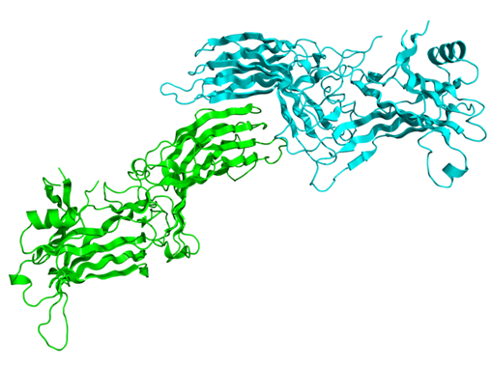
In response to a stimulus, GPCRs activate hetero-trimeric G proteins. In order to turn off this response, or adapt to a persistent stimulus, active receptors need to be desensitized. The first step in desensitization is phosphorylation of the receptor by a class of serine/threonine kinases called G protein coupled receptor kinases (GRKs). GRK phosphorylation specifically prepares the activated receptor for arrestin binding.
Arrestin binding to the receptor blocks further G protein-mediated signaling and targets receptors for internalization, and redirects signaling to alternative G protein-independent pathways, such as β-arrestin signaling.
In addition to GPCRs, arrestins bind to other classes of cell surface receptors and a variety of other signaling proteins.

Slide 73
RGS proteins:
Regulators of G protein signaling (RGS) are protein structural domains or the proteins that contain these domains, that function to activate the GTPase activity of heterotrimeric G-protein α-subunits. RGS proteins are multi-functional, GTPase-accelerating proteins that promote GTP hydrolysis by the α-subunit of heterotrimeric G proteins, thereby inactivating the G protein and rapidly switching off G protein-coupled receptor signaling pathways. Upon activation by receptors, G proteins exchange GDP for GTP, are released from the receptor, and dissociate into a free, active GTP-bound α-subunit and βγ-dimer, both of which activate downstream effectors. The response is terminated upon GTP hydrolysis by the α-subunit, which can then re-bind the βγ-dimer and the receptor. RGS proteins markedly reduce the lifespan of GTP-bound α-subunits by stabilizing the G protein transition state. Whereas receptors stimulate GTP binding, RGS proteins stimulate GTP hydrolysis. RGS proteins have been conserved in evolution. The first to be identified was Sst2 ("SuperSensiTivity to pheromone") in yeast (Saccharomyces cerevisiae). All RGS proteins contain an RGS-box (or RGS domain), which is required for activity. Some small RGS proteins are little more than an RGS domain, while others also contain additional domains that confer further functionality. RGS domains in the GPCR kinases are able to bind to Gq family α-subunits, but do not accelerate their GTP hydrolysis. Instead, GRKs appear to reduce Gq signaling by sequestering the active α-subunits away from effectors such as phospholipase C-β.

Slide 74
Long-term or high-dose use of opioids may also lead to additional mechanisms of tolerance becoming involved. This includes down-regulation of MOR gene expression, so the number of receptors presented on the cell surface is actually reduced, as opposed to the more short-term de-sensitization induced by β-arrestins or RGS proteins. Another long-term adaptation to opioid use can be up-regulation of glutamate and other pathways in the brain which can exert an opioid-opposing effect, so reduce the effects of opioid drugs by altering downstream pathways, regardless of MOR activation.
Fatal opioid overdose typically occurs due to bradypnea, hypoxemia, and decreased cardiac output (hypotension occurs due to vasodilation, and bradycardia further contributes to decreased cardiac output). A potentiation effect occurs when opioids are combined with ethanol, benzodiazepines, barbiturates, or other central depressants which can result in rapid loss of consciousness and an increased risk of fatal overdose. Substantial tolerance to respiratory depression develops quickly, and tolerant individuals can withstand larger doses. However, tolerance to respiratory depression is quickly lost during withdrawal and may be completely reversed within a week. Many overdoses occur in people who return to their previous dose after having lost their tolerance following cessation of opioids. This puts addicts who receive medical treatment for opioid addiction at great risk of overdose when they are released, as they may be particularly vulnerable to relapse. Less commonly, massive overdoses have been known to cause circulatory collapse from vasodilation and bradycardia.

Slide 75
Naloxone:
Opioid overdoses can be rapidly reversed through the use of opioid antagonists, naloxone being the most widely used example. Opioid antagonists work by binding competitively to µ-opioid receptors and displacing opioid agonists.
Naloxone, sold under the brand name “Narcan”, is a medication used to reverse the effects of opioids. It is commonly used to counter decreased breathing in opioid overdose. Naloxone may also be combined with an opioid (in the same pill), to decrease the risk of misuse through injection. Effects begin within two minutes when given intravenously, and within five minutes when injected into a muscle. The medicine can also be administered by spraying it into a person's nose. Naloxone commonly blocks the effects of opioids after 30 to 90 minutes. Administration to opioid-dependent individuals may cause symptoms of opioid withdrawal, including restlessness, agitation, nausea, vomiting, a fast heart rate, and sweating. To prevent this, small doses every few minutes can be given until the desired effect is reached. It appears to be safe in pregnancy, after having been given to a limited number of women. Naloxone is a non-selective and competitive opioid receptor antagonist. It works by reversing the depression of the central nervous system [CNS].
Interestingly, naloxone was found to be useful in the treatment of people that got addicted to synthetic cannabinoids such as: Hebrew University’s HU-210, John W Huffman’s JWH-018 and Charles Pfizer’s CP-47,497 & CP-55,940.

Slide 76
Can Naloxone Be Used to Treat Synthetic Cannabinoid Overdose (2017) ?
Biol Psychiatry. 2017 Apr 1; 81(7): e51–e52.
Jermaine D. Jones, et al.
Synthetic cannabinoids, commonly known as K2, Nice-Guy or Spice, have emerged as a recreational drug and an inexpensive alternative to cannabis. Currently, there is no antidote for synthetic cannabinoid overdose/ over-intoxication, and clinical care typically only includes symptom management. However, naloxone, a drug used to treat opioid overdose, might prove beneficial. Naloxone is a nonselective opioid antagonist increasingly used by medical personnel to reverse overdose due to the use of opioid analgesics and heroin. Why might an opioid receptor antagonist affect a drug that acts on the cannabinoid receptor? Studies show that opioid and cannabinoid receptors are co-localized in multiple brain regions where they may exist as heterodimeric systems. Both receptors also have cross-modulatory pharmacologic effects, including cross-agonism, -antagonism, -sensitization, and -tolerance. Accordingly, several studies suggest that opioid receptor antagonists might counter the effects of very potent cannabinoid agonists. In April 2015, synthetic cannabinoid-related emergency department visits increased dramatically in New York City. In response, the New York City Department of Health and Mental Hygiene conducted a public health investigation to gain a better understanding of the circumstances, symptoms, and severity of synthetic cannabinoid overdose. The co-occurrence of symptoms such as loss of alertness, unconsciousness may further demonstrate the interrelatedness of endogenous opioid and cannabinoid systems and may add credibility to the potential utility of naloxone in cases of synthetic cannabinoid overdose.

Slide 77
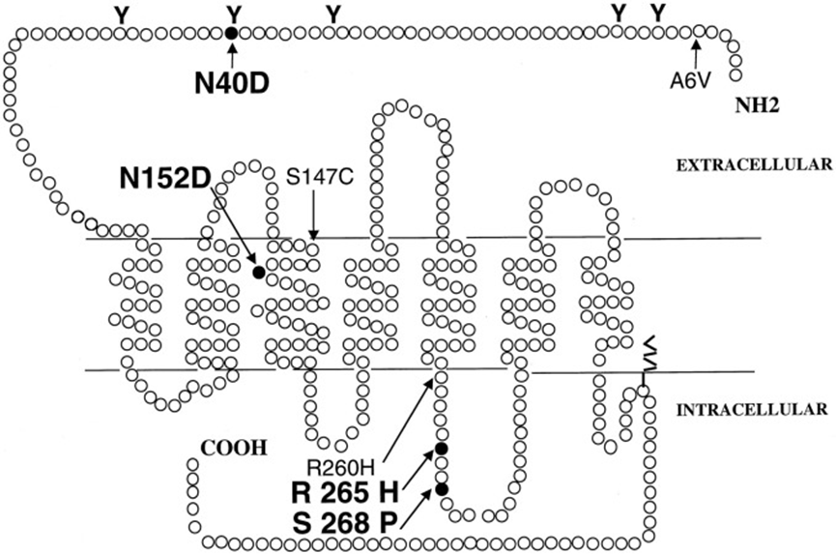
Site-directed mutagenesis of amino acid residues of hMOR
A schematic representation of the putative seven transmembrane domain topology of the receptor is shown. The single-letter amino acid code is used, and numbers next to mutated residues refer to their positions within the hMOR protein sequence. Polymorphisms that affect protein sequence are indicated, and mutations examined in this study are highlighted (bold letters, black circle). The N40D and A6V variants are most frequent.

Slide 78
MOR Gene – OPRK1
This gene encodes an opioid receptor, which is a member of the 7 transmembrane-spanning GPCR family. It functions as a receptor for endogenous ligands, as well as a receptor for various synthetic opioids. Ligand binding results in inhibition of adenylate cyclase [AC] activity and neurotransmitter [NT] release. This opioid receptor plays a role in the perception of pain and mediating the hypolocomotor, analgesic and aversive actions of synthetic opioids. Variations in this gene have also been associated with alcohol dependence and opioid addiction. Alternatively spliced transcript variants encoding different isoforms have been found for this gene. A recent study provided evidence for translational read-through in this gene, and expression of an additional C-terminally extended isoform via the use of an alternative in-frame translation termination codon.
Kappa Opioid Receptor [KOR]
The κ-opioid receptor or KOR is a GPCR that in humans is encoded by the OPRK1 gene. The KOR is coupled to the G protein Gi/G0. These effects include: altering nociception, consciousness, motor control, and mood. Dys-regulation of this receptor system has been implicated in alcohol and drug addiction. The KOR is a type of opioid receptor that binds the opioid peptide dynorphin as the primary endogenous ligand (naturally occurring in the body). In addition to dynorphin, a variety of natural alkaloids, terpenes and synthetic ligands bind to the receptor. The KOR may provide a natural addiction control mechanism, and therefore, drugs that target this receptor may have therapeutic potential in the treatment of addiction. There is evidence that distribution and/or function of this receptor may differ between sexes.

Slide 79
Natural KOR agonists:
Mentha spp.
Menthol - Found in numerous species of mint, (including peppermint, spearmint, and watermint), the naturally-occurring compound menthol is a weak KOR agonist owing to its antinociceptive, or pain blocking, effects in rats. In addition, mints can desensitize a region through the activation of TRPM8 receptors (the 'cold'/menthol receptor). Menthol is a monoterpenoid, made synthetically or obtained from the oils of corn mint, peppermint, or other mints. The main form of menthol occurring in nature is (−)-menthol, which is assigned the (1R,2S,5R) configuration. Menthol has local anesthetic and counterirritant qualities, and it is widely used to relieve minor throat irritation. Menthol also acts as a weak κ-opioid receptor agonist.
Salvia divinorum:
The key compound in Salvia divinorum, salvinorin A, is known as a powerful, short-acting KOR agonist.
Salvinorin A is a trans-neoclerodane diterpenoid with the chemical formula C23H28O8. Unlike other known opioid-receptor ligands, salvinorin A is not an alkaloid, as it does not contain a basic nitrogen atom. Salvinorin A has no action at the 5-HT2A serotonin receptor, the principal molecular target responsible for the actions of 'classical' psychedelics such as LSD and mescaline.

Slide 80
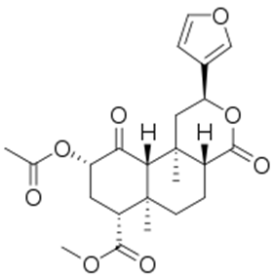
Salvinorin A is the main active psychotropic molecule in Salvia divinorum. Salvinorin A is considered a dissociative hallucinogen.
Salvinorin is a trans-neoclerodane diterpenoid. It acts as a kappa opioid receptor agonist and is the first known compound acting on this receptor that is not an alkaloid.
Ibogaine:
Used for the treatment of addiction in limited countries, ibogaine has become an icon of addiction management among certain underground circles. Despite its lack of addictive properties, ibogaine is listed as a Schedule I compound in the US because it is a psychoactive substance, hence it is considered illegal to possess under any circumstances. Ibogaine is also a KOR agonist and this property may contribute to the drug's anti-addictive efficacy.
Ibogaine is a naturally occurring psychoactive substance found in plants in the family Apocynaceae such as Tabernanthe iboga, Voacanga africana, and Tabernaemontana undulata. It is a psychedelic with dissociative properties.

Slide 81
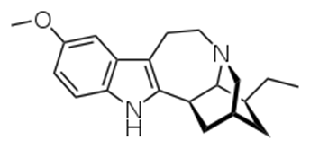
Ibogaine is an indole alkaloid that is obtained either by extraction from the iboga plant or by semi-synthesis from the precursor compound voacangine, another plant alkaloid.
The psychoactivity of the root bark of the iboga tree, from which ibogaine is extracted, was first discovered by the Pygmy tribes of Central Africa, who passed the knowledge to the Bwiti tribe of Gabon. French explorers in turn learned of it from the Bwiti tribe and brought ibogaine back to Europe, where it was subsequently marketed in France as a stimulant under the trade name “Lambarène”. Ibogaine-containing preparations are used for medicinal and ritual purposes within African spiritual traditions of the Bwiti. Although ibogaine's anti-addictive properties were first widely promoted in 1962 by Howard Lotsof, its Western medical use predates that by at least a century.
Ibogaine is obtained either by extraction from the iboga plant or by semi-synthesis from the precursor compound voacangine.
Back to Norris’s study (2019):

Slide 82
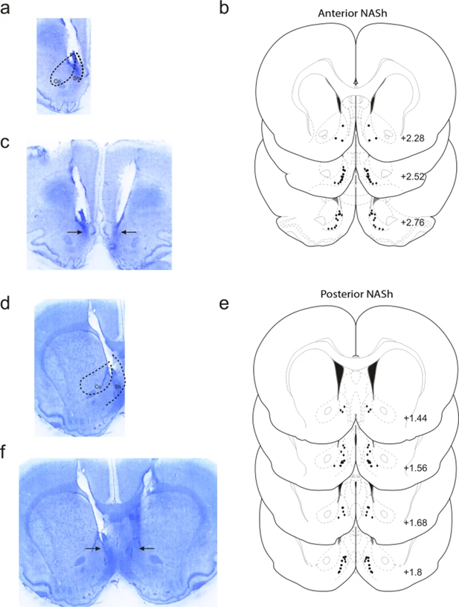
Histological analysis of intra-Nucleus Accumbens Shell [NASh] microinjection sites
(a) Microphotograph of representative injector placement within the anterior portion of the NASh.
(b) Schematic representation of select intra-anterior-NASh injector locations; ● = 100 ng THC group, ◆ = 100 ng THC + 1 µg CYP.
(c) Microphotograph of representative intra-anterior-NASh bilateral cannulae placements.
d) Microphotograph of representative injector placement within the posterior portion of the NASh.
(e) Schematic representation of select intra-posterior-NASh injector locations; ● = 100 ng THC group, ◆ = 100 ng THC + 1 µg CYP.
(f) Microphotograph of representative intra-posterior-NASh bilateral cannulae placements.
∆-9 tetrahydrocannabinol (THC), the primary psychoactive component of cannabis, strongly modulates affective processing via interactions with the mesolimbic circuitry. THC can produce both rewarding and aversive effects in humans and other animals and strongly modulates the mesolimbic DA system. For example, acute THC administration in the rodent NAc strongly activates VTA DAergic neuronal activity and systemic THC administration directly activates VTA DA neurons. In humans, chronic cannabis use has been shown to induce salience sensitization to cues associated with cannabis administration, via sensitization of the mesolimbic system.

Slide 83
Nevertheless, the precise neuroanatomical and pharmacological mechanisms by which THC may produce rewarding, dependence-producing effects vs. neuropsychiatric side-effects are not currently understood. The primary pharmacological targets of THC, the CB1Rs, are widely distributed throughout the brain, including the mesolimbic circuitry. Substantial evidence implicates the NAc as an important area for THC’s effects on cognitive and affective processing. For example, systemic THC causes opioid receptor (OR)- dependent DA efflux in the NAc and chronic THC exposure alters synaptic plasticity within the NAc. Importantly, the NAc is involved in both reward and aversion processing, particularly the medial shell sub-region (NASh), which is implicated in motivational salience, the processing of emotional stimuli, reinforcement, and addiction.
The accumbens is a highly complex limbic structure involved in processing both reward and aversion-related behaviors. Previous evidence has identified the anterior pole of the NASh as a region containing high concentrations of µ-opioid receptors. Thus, stimulation of the anterior NASh with a µ-opioid receptor (µOR/MOR) agonist produces reward while stimulation of the posterior NASh with a κ-opioid (KOR) agonist, produces aversion. In addition, there is significant co-localization of CB1Rs and different ORs within the NASh region.

Slide 84
Given that THC serves as a partial CB1 receptor agonist, this evidence may suggest that the differential affective stimulus effects of THC might depends upon differential activation of anatomically distinct OR subtypes, within the mammalian NAc. At the neuronal level, medium spiny neuron (MSN) activity states are functionally linked to reward and aversion processing, with reward states characterized by decreased MSN activity levels, and aversive states associated with increased activity. Additionally, neuronal population activity within the NAc -- specifically γ-oscillations, are associated with the processing of reward-related information and disturbances in γ-oscillations are linked to various neuropsychiatric disturbances, including schizophrenia-related affective dys-regulation.
In the present study, we investigated the effects of direct micro-infusions of THC on reward and aversion conditioning, social behavior and neuronal activity states within the NASh. Using a combination of behavioral assays and in vivo neuronal electrophysiology, we report that THC infused into the anterior NASh produces µ-opioid receptor [MOR] dependent reward, potentiates morphine reward salience, decreases medium spiny neuron activity and increases the power of high frequency γ-oscillations. In contrast, THC in the posterior NASh produces KOR dependent aversion, impairs social recognition, increases MSN activity and decreases the power of high frequency γ-oscillations. These findings reveal novel dissociable and distinct mechanisms for the bivalent motivational effects of THC directly in the NAc.

Slide 85
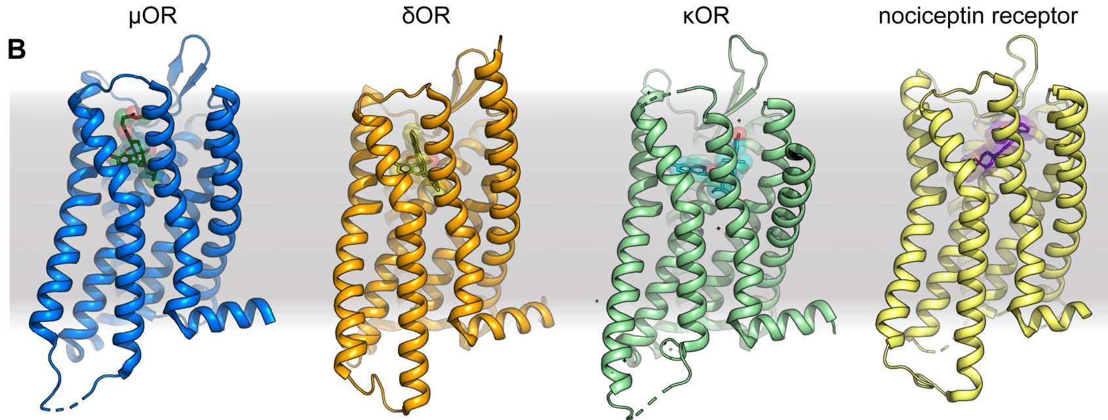
Gamma oscillations are rhythmic fluctuations in local field potentials (LFPs) that span a broad range of frequencies (∼25–100 Hz). Gamma oscillations are prominent across multiple brain regions including the hippocampus, where they are believed to play a role in attention and memory operations.
Hypothesis: People, in whom the posterior NASh is activated by THC, and that are greatly affected by KOR specific agonists (such as: morphine, menthol, salvinorin A & ibogaine) should be careful from cannabis containing high levels of THC. People, in whom the anterior NASh is activated by THC, and that are sensitive to MOR specific agonists (such as: dermorphine) are less vulnerable to THC.
Which group cannot feel any effect of CBD treatment?

Slide 86
Interrelations between ECS & Opioid systems
Interactions of the opioid and cannabinoid systems in reward: Insights from knockout studies (2015)
Front. Pharmacol., 05 February 2015
Katia Befort
The opioid system consists of three main receptors, mu, delta, and kappa, which are activated by endogenous opioid peptides (enkephalins, endorphins, and dynorphins). The endogenous cannabinoid system comprises lipid neuromodulators (endocannabinoids [eCBs]), enzymes for their synthesis and their degradation and two cannabinoid receptors CB1 and CB2. These systems play a major role in the control of pain as well as in mood regulation, reward processing and the development of addiction. Both opioid and cannabinoid receptors are coupled to G proteins and are expressed throughout the brain reinforcement circuitry. Extending classical pharmacology, research using genetically modified mice has provided important progress in the identification of the specific contribution of each component of these endogenous systems in vivo on reward process. This review will summarize available genetic tools and our present knowledge on the consequences of gene knockout [KO] on reinforced behaviors in both systems, with a focus on their potential interactions. A better understanding of opioid–cannabinoid interactions may provide novel strategies for therapies in addicted individuals.

Slide 87
Drug abuse often leads to a complex pharmaco-dependent state which is defined by the term addiction. Addiction is considered as a neuropsychiatric disease. It develops from an initial recreational drug use, evolves toward compulsive drug-seeking behavior and excessive drug-intake with the appearance of negative emotional states such as anxiety or irritability when the drug is not accessible, and uncontrolled intake reaching a stage where the drug interferes with daily activities, despite the emergence of adverse consequences. This pathological process develops in 15–30% of casual drug users and several factors may explain individual’s vulnerability to addiction, including genetic, psychological and environmental factors. Among illicit drugs, opiate and cannabinoid derivatives are highly abused in Europe. Morphine-like opiates are powerful analgesics and currently represent the major therapeutic remedies for the treatment of severe pain. They are also abused for their recreational euphoric effects. In Europe, 1.3 million people are addicted to heroin. Cannabis is the most worldwide consumed drug of abuse, with THC being the most abundant active constituent found in the various preparations of the drug. More than 73 million European citizens have used cannabis in the last year and it is estimated that about 7% of cannabis users has become dependent on this drug. There is also a high prevalence of users who seek treatment for dependence on it. Interestingly, new derivatives of these abused drugs are invading the market, notably through internet. Fentanyl derivatives as new opioid drugs and synthetic cannabimimetics, also known as “K2”, "Nice-guy" or “spice,” are becoming more and more popular. These abusive substances interact with two neuromodulator systems, the opioid and the endocannabinoid systems [ECS].

Slide 88
The Opioid System: The opioid system consists of endogenous opioid peptides (enkephalins, endorphins, and dynorphins) from precursors (Penk, Pdyn, and Pomc) which activate three opioid receptors, namely mu, delta, and kappa. The three membrane receptors are GPCR with coupling to Gi/Go proteins. Opioid receptors and endogenous opioid peptides are largely expressed throughout the nervous system, noticeably within areas of the neuro-circuitry of addiction associated with reward, motivation, or learning and stress. Besides its key role in many aspects of addiction, the opioid system also plays a part in a diverse range of physiological functions including nociception, mood control, eating behavior, or cognitive processes.
The Endocannabinoid System [ECS]: A neuromodulatory system consisting of two well characterized trans-membrane receptors coupled to G protein (Gi/Go), CB1, and CB2. The endogenous ligands are lipid neuromodulators, the main ones being AEA and 2-AG. Both are synthesized from phospholipid precursors and act locally as retrograde regulators of synaptic transmission throughout the CNS. These lipids are released by postsynaptic neurons and mainly activate presynaptic cannabinoid receptors to transiently or persistently suppress NT release from both excitatory and inhibitory synapses. Multiple pathways are involved in AEA biosynthesis. The ECS plays a key role in energy balance, modulation of pain response, with processing of central and peripheral pain signals, learning and memory, reward and emotions. It has also been shown to be involved in neurogenesis and play a neuroprotective role in some pathological conditions.

Slide 89
Distribution of the two receptors in the central and peripheral system is rather different. Indeed, CB1 is highly abundant in the CNS in areas involved in reward, regulation of appetite and nociception while CB2 was initially described as a peripheral receptor. Recent studies have proposed a low but significant expression of CB2 in several brain structures including striatum, hippocampus, thalamus and ventral tegmental area neurons. Very limited data is available for the involvement of CB2 receptor in central function but growing evidence suggest a role in addictive processes, with an implication in cocaine, nicotine, or ethanol effects. Interestingly, other non-CB1 and non-CB2 receptors have been proposed to interact with eCBs like the orphan GPCR - GPR55 or a channel vanilloid TRPV1 recognizing capsaicin. These interactions could potentially explain some pharmacology of cannabis that cannot be accounted for by CB1 and CB2 activation.
Many NT systems are involved when addiction develops, and both opioid and ECS are major players in addictive disorders. In addition to their specific ligands, both systems have also been implicated in the action mechanism of several other addictive drugs, like ethanol, nicotine, or psycho-stimulants. The ECS has been known to interact with other systems like dopaminergic, adenosinergic and opioid. The two systems share neuroanatomical, neurochemical, and pharmacological characteristics. The existence of a specific opioid–cannabinoid interaction in the modulation of neurochemical effects as well as behavioral responses associated with reward and relapse have been demonstrated by pharmacological and genetic approaches. Molecular interactions between receptors have been shown with co-localization or hetero-dimerization data mainly for CB1 and delta or mu opioid receptors within spinal cord & striatum.

Slide 90
No effective therapeutic approaches for cannabis dependence are currently available and opioid addiction therapies are not fully satisfying for all patients. Further studies are therefore needed to clarify the mechanistic basis of interaction of the two systems. Antibodies or bivalent ligands represent interesting therapeutic targets. In addition, dual enkephalinase inhibitors and cannabinoid catabolic enzyme inhibitors have been proposed as attractive therapeutic targets to treat pain. Such bi-functional compounds may also be relevant as promising strategies for alleviating dependence.
Substantial progress has been made in understanding the cellular and molecular mechanisms of prolonged use of cannabinoid or opioid drugs. In addition to their direct role in reward, interaction between opioid and cannabinoid neuromodulator systems has been proposed to explain some aspects of vulnerability to addiction and, in this perspective, recent attention has been focused on yet another critical level, epigenetics. These molecular processes, including methylation of DNA, post-translational modifications of histones and regulation by microRNA, regulate gene expression and are crucial in long-term adaptations induced by drugs. Recent studies have shown a direct association between THC-induced Penk up-regulation through reduction of histone H3 lysine 9 pattern of methylation and increased heroin self-administration [SA].

Slide 91
Adolescent THC-exposure also resulted in altered heroin SA in the subsequent generation of rats, an effect associated with changes in mRNA expression of cannabinoid, DA, and glutamatergic receptor genes in the striatum, suggesting adaptations to long-term drug effect and germ line transmission, most likely involving epigenetic changes. How these neuromodulator systems are dependent on various internal and external environmental factors, and therefore are involved in epigenetics and whether one system influences the epigenetic machinery to control the other system, are unresolved questions for upcoming studies. Future investigation in this field will be necessary to better delineate the neurobiological mechanisms underlying these neuro-adaptations.
Epigenetics is the study of heritable phenotype changes that do not involve alterations in the DNA sequence. Epigenetics most often involves changes that affect gene activity and expression, but the term can also be used to describe any heritable phenotypic change. Such effects on cellular and physiological phenotypic traits may result from external or environmental factors, or be part of normal development. The term also refers to the changes themselves: functionally relevant changes to the genome that do not involve a change in the nucleotide sequence. Examples of mechanisms that produce such changes are DNA methylation and histone modification, each of which alters how genes are expressed without altering the underlying DNA sequence.

Slide 92
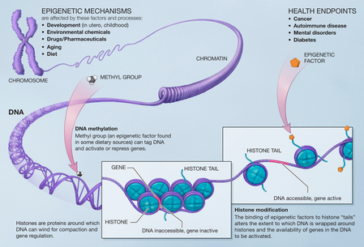
Gene expression can be controlled through the action of repressor proteins that attach to silencer regions of the DNA. These epigenetic changes may last through cell divisions for the duration of the cell's life, and may also last for multiple generations, even though they do not involve changes in the underlying DNA sequence of the organism; instead, non-genetic factors cause the organism's genes to behave (or "express themselves") differently.

Slide 93
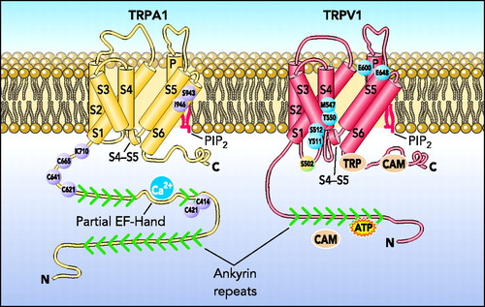
Transient potential receptor Vanilloid1 [TRPV1]
The transient receptor potential cation channel subfamily V member 1, also known as the capsaicin receptor and the vanilloid receptor 1, is a protein that, in humans, is encoded by the TRPV1 gene. It was the first isolated member of the TRPV receptor proteins. The function of TRPV1 is detection and regulation of body temperature. In addition, TRPV1 provides a sensation of scalding heat and pain (nociception). In primary afferent sensory neurons, it cooperates with TRPA1 (a chemical irritant receptor) to mediate the detection of noxious environmental stimuli.

Slide 94
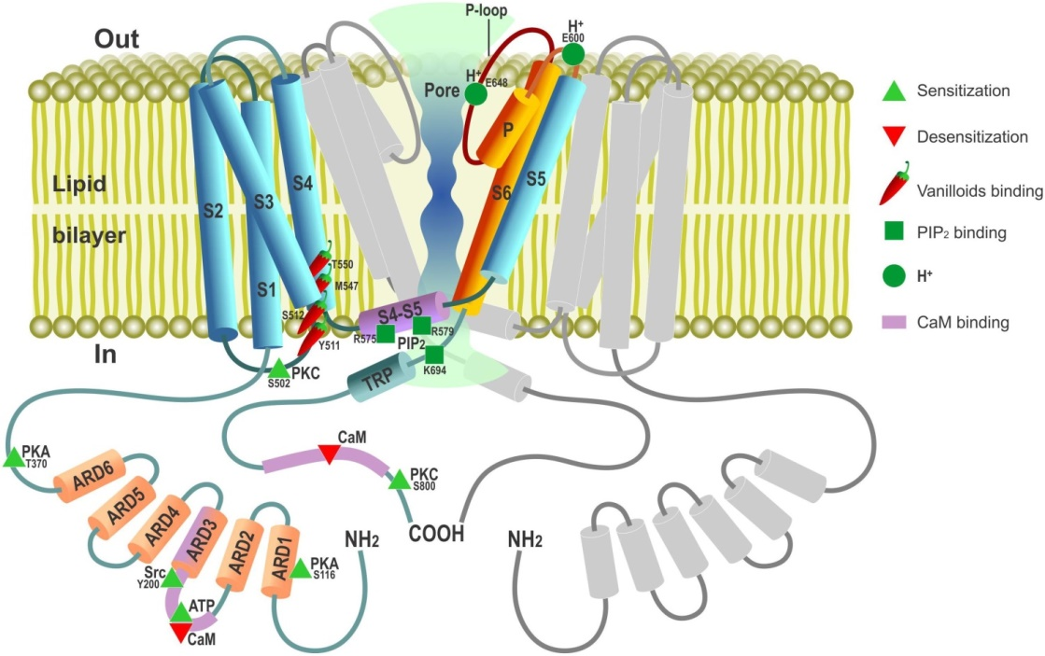
TRPV1 is an element of or mechanism used by the mammalian somatosensory system. It is a nonselective cation channel that may be activated by a wide variety of exogenous and endogenous physical and chemical stimuli. The best-known activators of TRPV1 are: temperature greater than 43 °C (109 °F); acidic conditions; capsaicin (the irritating compound in hot chili peppers); and allyl isothiocyanate, the pungent compound in mustard and wasabi. The activation of TRPV1 leads to a painful, burning sensation. Its endogenous activators include: the endocannabinoid anandamide [AEA], N-oleyl-dopamine and N-arachidonoyl-dopamine. TRPV1 receptors are found mainly in the nociceptive neurons of the peripheral nervous system [PNS], but they have also been described in many other tissues, including the central nervous system [CNS]. TRPV1 is involved in the transmission and modulation of pain (nociception), as well as the integration of diverse painful stimuli.

Slide 95
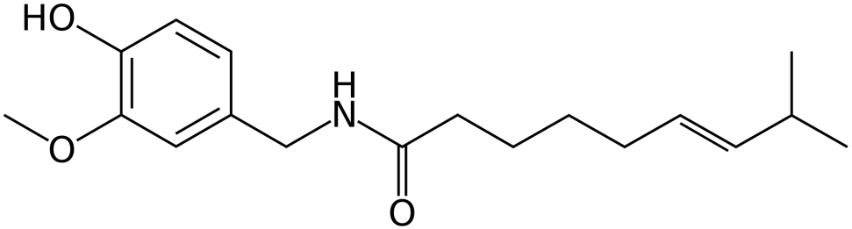
TRPV1 is activated by numerous agonists from natural sources. Agonists such as capsaicin and resiniferatoxin activate TRPV1 and, upon prolonged application, cause TRPV1 activity to decrease (desensitization), leading to alleviation of pain via the subsequent decrease in the TRPV1 mediated release of inflammatory molecules following exposures to noxious stimuli. Agonists can be applied locally to the painful area in various forms, generally as a patch or an ointment. Novel preparations containing higher capsaicin concentration (up to 10%) are under clinical trials. Eight percent capsaicin patches have recently become available for clinical use, with supporting evidence demonstrating that a 30-minute treatment can provide up to 3 months analgesia by causing regression of TRPV1-containing neurons in the skin. Currently, these treatments must be re-administered on a regular schedule in order to maintain their analgesic effects. Capsaicin (8-methyl-N-vanillyl-6-nonenamide) is an active component of chili peppers, which are plants belonging to the genus Capsicum. It is a chemical irritant for mammals, and produces a sensation of burning in any tissue with which it comes into contact. Pure capsaicin is a hydrophobic, colorless, highly pungent, crystalline to waxy solid compound.

Slide 96
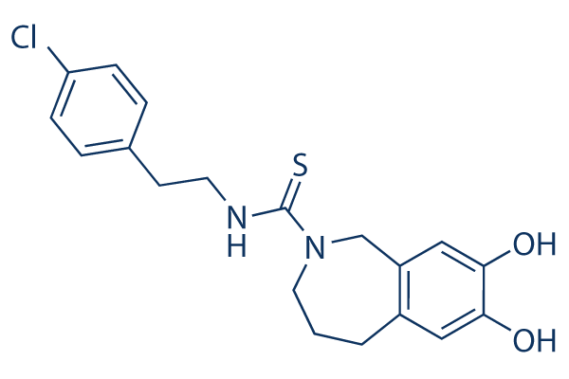
TRPV1 Ligands:
Cannabinoid ligands:
Cannabidiol (CBD) – agonist, Cannabigerol (CBG) – agonist,
Tetrahydrocannabivarin (THCV) - agonist
Cannabigerovarin (CBGV) – agonist.
N-Acyl amides:
N-Acyl Amides that activate ECS receptors include:
Anandamide (AEA), N-Arachidonoyl dopamine, N-Oleoyl dopamine
N-Arachidonoyl taurine, N-Docosahexaenoyl ethanolamine,
N-Docosahexaenoyl GABA, N-Docosahexaenoyl aspartic acid,
N-Docosahexaenoyl glycine, N-Docosahexaenoyl serine, N-Arachidonoyl GABA & N-Linoleyl GABA.
Antagonists block TRPV1 activity, thus reducing pain. Identified antagonists include the competitive antagonist capsazepine and the non-competitive antagonist ruthenium red.
These agents could be useful when applied systemically. TRPV1 antagonists have shown efficacy in reducing nociception from inflammatory and neuropathic pain models in rats. In humans, drugs acting at TRPV1 receptors could be used to treat neuropathic pain associated with multiple sclerosis [MS], chemotherapy, or amputation, as well as pain associated with the inflammatory response of damaged tissue, such as in osteoarthritis.

Slide 97
TRPV1 is expressed at high levels in the CNS and has been proposed as a target for treatment not only of pain but also for other conditions such as anxiety. Furthermore, TRPV1 appears to mediate long-term synaptic depression (LTD) in the hippocampus. LTD has been linked to a decrease in the ability to make new memories, unlike its opposite long-term potentiation (LTP), which aids in memory formation. A dynamic pattern of LTD and LTP occurring at many synapses provides a code for memory formation. Long-term depression and subsequent pruning of synapses with reduced activity is an important aspect of memory formation. In rat brain slices, activation of TRPV1 with heat or capsaicin induced LTD while capsazepine blocked capsaicin's ability to induce LTD. In the brainstem (solitary tract nucleus), TRPV1 controls the asynchronous and spontaneous release of glutamate [Glu] from un-myelinated cranial visceral afferents - release processes that are active at normal temperatures and hence quite distinct from TRPV1 responses in painful heat. Hence, there may be therapeutic potential in modulating TRPV1 in the CNS, perhaps as a treatment for epilepsy.
Epilepsy is a common condition that affects the brain and causes frequent seizures. Seizures are bursts of electrical activity in the brain that temporarily affect how it works. They can cause a wide range of symptoms. Epilepsy can start at any age, but usually starts either in childhood or in people over 60.

Slide 98

TRPV1 genes
Sequence variations (SNP ID), with clinical significance:
rs1567672200 5 110 Uncertain Significance
(TRPV1):c.63C>A (p.Cys21Ter) NONSENSE
rs199539626 5 110 Likely Benign
(TRPV1):c.1835C>T (p.Thr612Met) MISSENSE
rs199600911 5 110 Likely Benign
(TRPV1):c.1372G>A (p.Val458Met( MISSENSE
rs200283801 5 110 Likely Benign
(TRPV1):c.897G>A (p.Thr299Met) SYNONYMOUS
rs200640999 5 110 Likely Benign
(TRPV1):c.576C>T (p.Asn192Met) SYNONYMOUS
dbSNP identifiers (rs#s) for variants without clinical significance for TRPV1 Gene.
All consequence types are included: molecular consequences (missense, synonymous),
and location-based (intron, upstream).
rs1446650356, rs2074729496, rs1429855171, rs1371670962 & rs2074729676.

Slide 99
TRPV1 belongs to the diverse transient receptor potential family of cation channels. It was first characterized in primary afferent fibers as a receptor for capsaicin. Peripheral TRPV1 has a very well-described role in nociception. However, TRPV1 is now recognized to have a broader distribution and function, with supraspinal/ brain TRPV1 known to modulate pain processing. Recently, studies employing histological, genetic and pharmacological approaches have provided evidence that supraspinal TRPV1 also modulates brain neurobiology and behaviors related to anxiety, depression and schizophrenia. Key brain regions involved in TRPV1-mediated modulation of pain and affect include the periaqueductal grey, hippocampus and medial prefrontal cortex [PFC]. Thus, TRPV1 in the brain is emerging as an important molecular substrate which is dually implicated in both pain and psychiatric disorders, and represents a novel therapeutic target for these conditions and their comorbidity.

Slide 100
Effect of CBD on TRPV1
CBD Effects on TRPV1 Signaling Pathways in Cultured DRG Neurons (2020)
j. of Pain Research, 11 September 2020, Volume 2020:13 Pages 2269—2278.
Uma Anand, et al.
Introduction: Cannabidiol (CBD) is reported to produce pain relief, but the clinically relevant cellular and molecular mechanisms remain uncertain. The TRPV1 receptor integrates noxious stimuli and plays a key role in pain signaling. Hence, we conducted in vitro studies, to elucidate the efficacy and mechanisms of CBD for inhibiting neuronal hypersensitivity in cultured rat sensory neurons, following activation of TRPV1.
Methods: Adult rat dorsal root ganglion (DRG) neurons were cultured and supplemented with the neurotrophic factors NGF and GDNF, in an established model of neuronal hypersensitivity. Neurons were stimulated with CBD at 1, 10, 100 nMol/L and 1, 10 and 50 μMol/L, 48 h after plating. In separate experiments, DRG neurons were also stimulated with capsaicin with or without CBD (1 nMol/L to 10 μMol/L), in a functional calcium imaging assay. The effects of the adenylyl cyclase [AC] activator forskolin and the calcineurin inhibitor cyclosporin were determined. We also measured forskolin-stimulated cAMP levels, without and after treatment with CBD, using a homogenous time-resolved fluorescence (HTRF) assay.

Slide 101
Results: DRG neurons treated with 10 and 50 μMol/L CBD showed calcium influx, but not at lower doses. Neurons treated with capsaicin demonstrated robust calcium influx, which was dose-dependently reduced in the presence of low dose CBD (IC50 = 100 nMol/L). The inhibition or desensitization by CBD was reversed in the presence of forskolin and cyclosporin. Forskolin-stimulated cAMP levels were significantly reduced in CBD treated neurons.
Conclusion: CBD at low doses corresponding to plasma concentrations observed physiologically inhibits or desensitizes neuronal TRPV1 signaling by inhibiting the adenylyl cyclase – cAMP pathway, which is essential for maintaining TRPV1 phosphorylation and sensitization.
CBD also facilitated calcineurin-mediated TRPV1 inhibition.
These mechanisms may underlie nociception desensitization and the therapeutic effect of CBD in animal models and patients with acute and chronic pain.
Apart from the effects of CBD signaling via a range of receptors including CB1, CB2, GPR55, TRPV2, TRPA1, TRPM8, 5-HT1a as well as the α3 and α1 glycine receptors, other effects of CBD have been described recently. These include non-selective inhibition of voltage-dependent sodium currents, diminished action potential firing frequency via GPCRs, and restoration of the excitability of inhibitory interneurons in a mouse model of Dravet syndrome.

Slide 102
Genetic findings may be very unpredictable:
The case of Cannabis-induced Psychosis:
Genetic variation underlying psychosis-inducing effects of cannabis: critical review and future directions (2012)
Jeroen Decoster et al
Curr. Pharm. Des., 2012; 18(32):5015-23.
Cannabis use is associated with an increased risk for psychotic disorder, yet most cannabis users do not develop psychosis, suggesting that other factors are also involved. This paper reviews the available evidence suggesting that differential sensitivity to the psychosis-inducing effects of cannabis may be related to underlying genetic liability. There is robust evidence that persons at psychometric risk for psychosis are most vulnerable to display psychotic symptoms subsequent to the use of cannabis. Multiple studies have also found that persons at familial risk for psychosis have an increased sensitivity to the effects of cannabis. Together, these findings support the concept of a biological interaction between cannabis use and one's underlying genetic vulnerability. At the molecular-genetic level, however, few (if any) interactions have been consistently replicated, although a reported interaction with variation in AKT1 is promising and deserves further follow-up. The apparent lack of consistent replication can be ascribed to problems of initial gene selection, statistical power, a bias towards positive results and insufficient attempts at true replication, leading to the conclusion that increased sample sizes, greater density of genetic markers and a stronger focus on true replication are necessary. The major challenge for molecular-genetic gene-environment interaction research will be to combine the agnostic detection of disorder-associated genetic variants from genome-wide studies with the hypothesis-based approach from epidemiological and neurobiological studies.

Slide 103
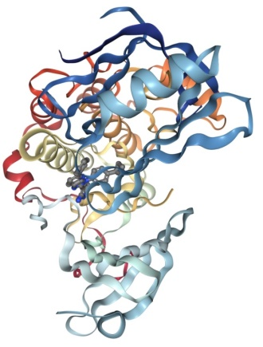
AKT1 enzyme and its genes
RAC(Rho family)-alpha serine/threonine-protein kinase is an enzyme that in humans is encoded by the AKT1 gene. This enzyme belongs to the AKT subfamily of serine/threonine kinases that contain SH2 (Src homology 2-like) protein domains. It is commonly referred to as PKB, or by both names as "Akt/PKB".
The serine-threonine protein kinase AKT1 is catalytically inactive in serum-starved primary and immortalized fibroblasts. AKT1 and the related AKT2 are activated by platelet-derived growth factor [PDGF]. The activation is rapid and specific, and it is abrogated by mutations in the pleckstrin homology domain of AKT1. It was shown that the activation occurs through phosphatidylinositol 3-kinase. In the developing nervous system AKT is a critical mediator of growth factor-induced neuronal survival. Survival factors can suppress apoptosis in a transcription-independent manner by activating the serine/threonine kinase AKT1, which then phosphorylates and inactivates components of the apoptotic machinery. Mice lacking Akt1 display a 25% reduction in body mass, indicating that Akt1 is critical for transmitting growth-promoting signals, most likely via the IGF1 receptor. Mice lacking Akt1 are also resistant to cancer: They experience considerable delay in tumor growth initiated by the large T antigen or the Neu oncogene. A single-nucleotide polymorphism [SNP] in this gene causes Proteus syndrome.

Slide 104
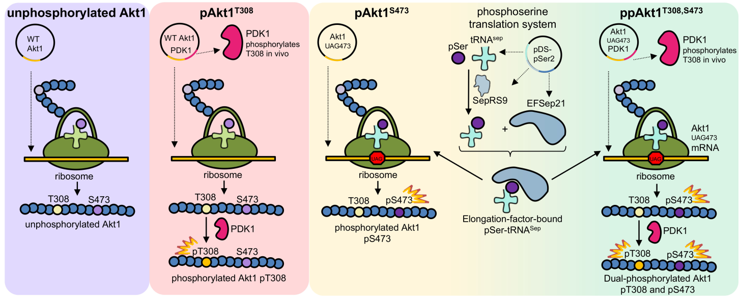
AKT1 Structure & Functions
AKT1 genes and the response to THC:
Inhibition of AKT1 activity by phosphorylation:
AKT1 genes polymorphism: rs2494732 is linked to schizophrenia, cognition problems and acute psychosis as a result of THC ingestion.
In these people, THC affects midbrain & striatal functions.
People that carry this SNP should not ingest THC at all.

Slide 105
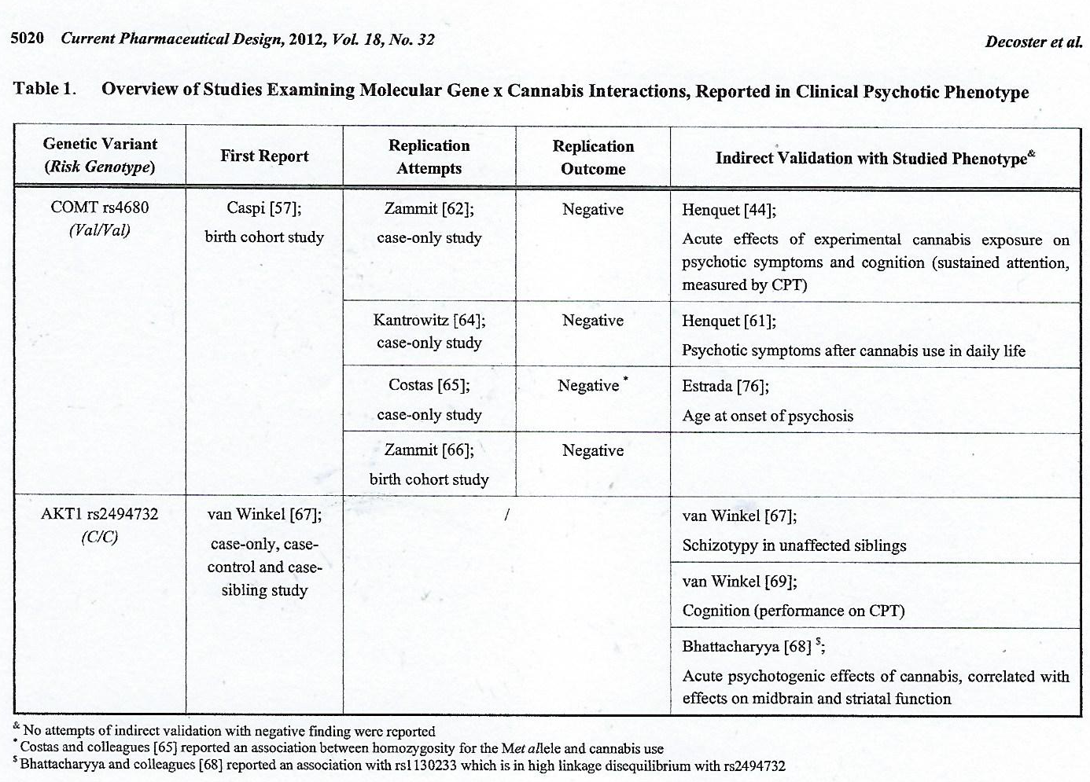
COMT gene polymorphism: rs4680 is linked to psychosis in youngsters, cognition problems and psychosis as a result of cannabis use.
People that carry this SNP should not ingest any THC.

Slide 106
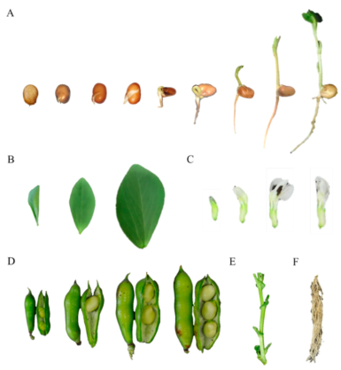
COMT protein & its genes
Catechol-O-methyltransferase (COMT; EC 2.1.1.6) is one of several enzymes that degrade catecholamines [CAs] (NTs such as dopamine [DA], epinephrine [E], and norepinephrine [NE]), catecholestrogens, and various drugs and substances having a catechol structure. In humans, COMT protein is encoded by the COMT gene. Two isoforms of COMT are produced: the soluble short form (S-COMT) and the membrane bound long form (MB-COMT). As the regulation of CAs is impaired in a number of medical conditions, several pharmaceutical drugs target COMT to alter its activity and therefore the availability of CAs. COMT was first discovered by the biochemist Julius Axelrod in 1957. COMT is involved in the inactivation of the CA NTs (dopamine, epinephrine, and norepinephrine). The enzyme introduces a methyl group to the CA, which is donated by S-adenosyl methionine (SAM). Any compound having a catechol structure, like catecholestrogens & catechol-containing flavonoids, are also substrates of COMT.
Levodopa, a precursor of CAs, is an important substrate of COMT. COMT inhibitors, like entacapone, save levodopa from COMT and prolong the action of levodopa. Entacapone is a widely used adjunct drug of levodopa therapy. When given with an inhibitor of dopa decarboxylase (carbidopa or benserazide), levodopa is optimally saved. This "triple therapy" is becoming a standard in the treatment of Parkinson's disease. Fava bean sprouts contain natural L-DOPA.

Slide 107
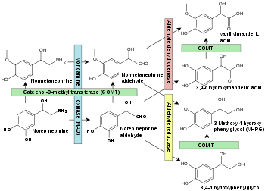
Norepinephrine degradation: Catechol-O-methyltransferase [COMT] is shown in green boxes.
Specific reactions catalyzed by COMT include:
Dopamine [DA] → 3-Methoxytyramine
DOPAC → HVA (homovanillic acid)
Norepinephrine [NE] → Normetanephrine
Epinephrine [E] → Metanephrine

Slide 108
In the brain, COMT-dependent DA degradation is of particular importance in brain regions with low expression of the presynaptic dopamine transporter (DAT), such as the prefrontal cortex. (In the PFC, DA is also removed by presynaptic norepinephrine transporters (NET) and degraded by monoamine oxidase [MAO].) Controversy exists about the predominance and orientation of membrane bound COMT in the CNS, that is, whether this COMT process is active intracellularly in postsynaptic neurons and glia, or oriented outward on the membrane, acting extra-cellularly on synaptic and extra-synaptic DA.
Soluble COMT can also be found extra-cellularly, although extracellular COMT plays a less significant role in the CNS than it does peripherally. Despite its importance in neurons, COMT is actually primarily expressed in the liver.
The COMT protein is coded by the gene COMT. The gene is associated with allelic variants. The best-studied is Val158Met. Others are rs737865 and rs165599 that have been studied for association with personality traits, response to antidepressant medications, and psychosis risk associated with Alzheimer's disease. COMT has been studied as a potential gene in the pathogenesis of schizophrenia; however meta-analyses find no association between the risk of schizophrenia and a number of polymorphisms, including Val158Met.

Slide 109
The Val158Met polymorphism
A functional single-nucleotide polymorphism (a common normal variant) of the gene for COMT results in a valine to methionine mutation at position 158 (Val158Met) rs4680. In vitro, the homozygous Val variant metabolizes DA at up to four times the rate of its methionine counterpart. However, in vivo the Met variant is overexpressed in the brain, resulting in a 40% decrease (rather than 75% decrease) in functional enzyme activity. The lower rates of catabolism for the Met allele, results in higher synaptic DA levels, following NT release, ultimately increasing dopaminergic stimulation of the postsynaptic neuron. Given the preferential role of COMT in prefrontal DA degradation, the Val158Met polymorphism is thought to exert its effects on cognition by modulating DA signaling in the frontal lobes.
The gene variant has been shown to affect cognitive tasks broadly related to executive function, such as set shifting, response inhibition, abstract thought, and the acquisition of rules or task structure.
Comparable effects on similar cognitive tasks, the frontal lobes, and the neurotransmitter DA have also all been linked to schizophrenia. It has been proposed that an inherited variant of COMT is one of the genetic factors that may predispose someone to developing schizophrenia later in life.

Slide 110
A non-synonymous SNP rs4680 was found to be associated with depressed factor of Positive and Negative Syndrome Scale (PANSS) and efficiency of emotion in Schizophrenia subjects. It is increasingly recognized that allelic variation at the COMT gene are also relevant for emotional processing, as they seem to influence the interaction between prefrontal and limbic regions. Research conducted lately, has demonstrated an effect of COMT both in patients with bipolar disorder [BPD] and in their relatives.The COMT Val158Met polymorphism also has a pleiotropic effect on emotional processing. The polymorphism has been shown to affect ratings of subjective well-being. When 621 women were measured with experience sample monitoring, which is similar to mood assessment as response to beeping watched, the Met/Met form confers double the subjective mental sensation of well-being from a wide variety of daily events. The ability to experience reward increased with the number of Met alleles. Also, the effect of different genotype was greater for events that were felt as more pleasant. The effect size of genotypic moderation was quite large: Subjects with the Val/Val genotype generated almost similar amounts of subjective well-being from a very pleasant event as Met/Met subjects did from a 'bit pleasant event'. Genetic variation with functional impact on cortical DA tone has a strong influence on reward experience in the flow of daily life. In one study participants with the Met/Met phenotype described an increase of positive affect twice as high in amplitude as participants with the Val/Val phenotype following very pleasant or pleasant events.
One review found that those with Val/Val tended to be more extroverted, more novelty seeking and less neurotic than those with the Met/Met allele.
Hypothesis: The Val/Val subjects cannot feel the therapeutic effects of CBD. The Met/Met subjects will get improvement of symptoms from many mental & physical disorders as a result of CBD ingestion.

Slide 111
The interaction between cannabis use and the Val158Met polymorphism of the COMT gene in psychosis: A trans-diagnostic meta – analysis (2018)
Feb 14; 13(2): e0192658 PLoS One,
Thomas Stephanus et al.
Background: Neither environmental nor genetic factors are sufficient to predict the trans-diagnostic expression of psychosis. Therefore, analysis of gene-environment interactions may be productive.
Objective: A meta-analysis was performed using papers investigating the interaction between cannabis use and catechol-O-methyl transferase (COMT) polymorphism Val158Met (COMTVal158Met).
Study eligibility criteria: All observational studies assessing the interaction between COMTVal158Met and cannabis with any psychosis or psychotic symptoms measure as an outcome.
Study appraisal and synthesis methods: A meta-analysis was performed using the Meta-analysis of Observational Studies in Epidemiology guidelines and forest plots were generated. Thirteen articles met the selection criteria: 7 clinical studies using a case-only design, 3 clinical studies with a dichotomous outcome, and 3 studies analyzing a continuous outcome of psychotic symptoms below the threshold of psychotic disorder. The three study types were analyzed separately. Validity of the included studies was assessed using "A Cochrane Risk of Bias Assessment Tool: for Non-Randomized Studies of Interventions".
Results: For case-only studies, a significant interaction was found between cannabis use and COMTVal158Met, with an OR of 1.45 (95% Confidence Interval = 1.05-2.00; Met/Met as the risk genotype).

Slide 112
However, there was no evidence for interaction in either the studies including dichotomous outcomes (B = -0.51, 95% Confidence Interval -1.72, 0.70) or the studies including continuous outcomes (B = -0.04 95% Confidence Interval -0.16-0.08).
Limitation: A substantial part of the included studies used the case-only design, which has lower validity and tends to overestimate true effects.
Conclusion: The interaction term between cannabis use and COMTVal158Met was only statistically significant in the case-only studies, but not in studies using other clinical or non-clinical psychosis outcomes. Future additional high quality studies might change current perspectives, yet currently evidence for the interaction remains unconvincing.

Slide 113
Polymorphism of the AKT1 gene:
rs2494732
rs2494732 is a SNP in the AKT1 gene, encoding one of three serine/threonine-protein kinases regulating numerous processes such as cell survival, growth and angiogenesis. Medical conditions that may be linked to the rarer (minor) rs2494732(C) allele include drug response, schizophrenia, and drug-related psychoses, in particular, cannabis-related psychosis.
A study of 442 healthy, once-a-month cannabis users between the ages of 16-23 to see if AKT1 variants influenced acute psychosis response concluded that the number of rs2494732(C) alleles predicted (p = 0.015) acute psychotic response to cannabis. Basically, the more copies someone had of this SNP, the more likely they were to have mind-altering symptoms while stoned. Other factors studied, including gender, ethnicity, and years of cannabis use, did not predict whether they would have these (transient) symptoms. Note that this side-effect (psychosis or paranoia) was infrequent in an absolute sense regardless of genotype.

Slide 114
A case-control study of 489 first-episode psychosis patients concluded that while rs2494732 was not associated with an increased risk of a psychotic disorder, with lifetime cannabis use, or with frequency of use, there was a significant association between psychosis and cannabis use. rs2494732(C;C) individuals with a history of cannabis use had an increased likelihood of a psychotic disorder (odds ratio 2.18, CI: 1.1 - 4.3) when compared with users who were (T;T) carriers. The interaction between the rs2494732 genotype and frequency of use was also somewhat significant (likelihood ratio = 13.39; p = .010). Among daily users, (C;C) carriers had a 7x increase in the odds of psychosis compared with (T;T) carriers (odds ratio 7.23, CI: 1.37 - 38.12).
Among (likely Japanese) 120 first-episode neuroleptic-naive schizophrenics treated with risperidone genotyped for 30 variants in misc. dopamine and serotonin receptors two SNPs in DRD2 (rs1799989 and rs1800497) and two SNPs in AKT1 (rs3803300 and rs2494732) were significant predictors of treatment response to risperidone.
The ancestral allele is C in the dbSNP database.
rs3803300
Patients with the CC genotype and schizophrenia may have a decrease response to risperidone as compared to patients with the CT or TT genotype.
Patients with the CT genotype and schizophrenia may have an increased response to risperidone as compared to patients with the TT genotype.
Patients with the TT genotype and schizophrenia may have a decreased response to risperidone as compared to patients with the CT genotype.

Slide 115
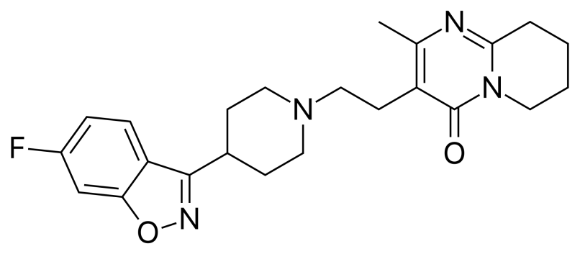
Risperidone
Risperidone, is an atypical antipsychotic used to treat schizophrenia and bipolar disorder. It is taken either by mouth or by injection (subcutaneous or intramuscular). The injectable versions are long-acting and last for 2-4 weeks.
Common side effects include movement problems, sleepiness, dizziness, trouble seeing, constipation, and increased weight. Serious side effects may include the potentially permanent movement disorder tardive dyskinesia, as well as neuroleptic malignant syndrome, an increased risk of suicide, and high blood sugar levels. In older people with psychosis as a result of dementia, it may increase the risk of death. Its mechanism of action is believed to be related to its action as a dopamine and serotonin antagonist.

Slide 116
AKT1 and genetic vulnerability to bipolar disorder [BD] (2020)
Psychiatry Research Volume 284, February 2020, 112677.
Vincent Millischer et al.
AKT1 encodes a serine/threonine kinase and is implicated in lithium signaling. Genetic variations of AKT1 have been associated with bipolar disorder (BPD). Here, we were not able to replicate previously reported associations.
Genome wide association data did not reveal any signal for BPD in the AKT1 region. AKT1 encodes a serine/threonine kinase that has as one of its best-known substrates glycogen synthase kinase-3 (GSK3), a primary target for lithium.

Slide 117
GSK3
Glycogen synthase kinase 3 (GSK-3) is a serine/threonine protein kinase that mediates the addition of phosphate molecules onto serine and threonine amino acid residues. First discovered in 1980 as a regulatory kinase for its namesake, glycogen synthase (GS), GSK-3 has since been identified as a protein kinase for over 100 different proteins in a variety of different pathways. In mammals, including humans, GSK-3 exists in two isozymes encoded by two homologous genes GSK-3α (GSK3A) and GSK-3β (GSK3B). GSK-3 has been the subject of much research since it has been implicated in a number of diseases, including type 2 diabetes, Alzheimer's disease, inflammation, cancer, addiction and bipolar disorder.
Glycogen synthase kinase inhibitors are different chemotypes and have variable mechanisms of action; they may be cations, from natural sources, synthetic ATP and non-ATP competitive inhibitors and substrate-competitive inhibitors. GSK3 is a bi-lobar architecture with N-terminal and C-terminal, the N-terminal is responsible for ATP binding and C-terminal which is called as activation loop mediates the kinase activity. Tyrosine located at the C-terminal it essential for full GSK3 activity.

Slide 118
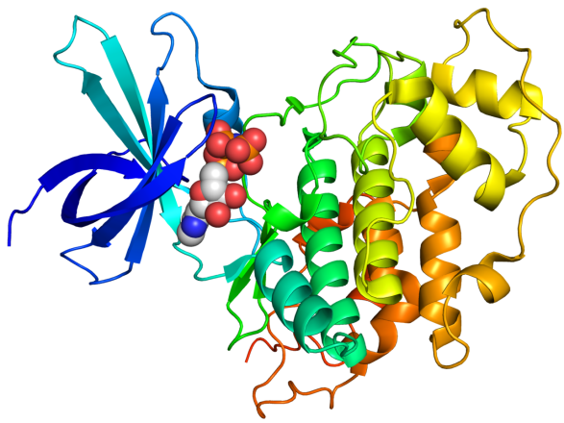
Benefits of GSK-3β inhibitors:
In diabetes, GSK-3β inhibitors increase insulin sensitivity, glycogen synthesis, and glucose metabolism in skeletal muscles, and reduce obesity by affecting the adipogenesis process. GSK-3β is also over expressed in several types of cancers, like colorectal, ovarian, and prostate cancer. GSK-3β inhibitors also aid in the treatment of Alzheimer's disease, stroke, and mood disorders, including bipolar disorder.
Lithium which is used in the treatment of bipolar disorder was the first natural GSK-3 inhibitor discovered. It inhibits GSK-3 directly by competition with magnesium ions and indirectly by phosphorylation and auto-regulation of serine. Lithium has been found to have insulin-like effects on glucose metabolism, including stimulation of glycogen synthesis in fat cells, skin, and muscles, increasing glucose uptake, and activation of GS activity. Also, it has shown therapeutic benefit in Alzheimer's and other neurodegenerative diseases such as epileptic neuro-degeneration.

Slide 119

AKT1 has been previously been implicated as a vulnerability gene for bipolar disorder (BD). We aimed to associate genetic variants in the AKT1 gene with subgroups of BD. BD patients from a Swedish cohort (N = 831) were phenotyped in regards to their psychotic episodes according to mood-congruence in depression and manias, and compared to controls (N = 1,496). All participants were genotyped for SNPs in AKT1 previously implicated to have a role: rs3730358, rs1130214 and rs3803300. None of the effects reported in earlier studies were statistically significant, including the association between rs3803300 and BD without any psychotic symptoms, rs3803300 and mood-congruent psychosis, rs3803300 and the combined groups, as well as the association between the haplotypes formed by rs3730358 and rs1130214 and risk for BD. In a Bayesian analysis, all Bayes’ Factors using default priors supported the null hypothesis in the replication set by a factor of between 5 and 1300 times. Analysis of genome wide association data did not reveal any association between BD.
AKT1 gene polymorphism: rs 3803300

Slide 120
Dopamine Transporter [DAT] protein and its genes
The dopamine transporter (also dopamine active transporter, DAT, SLC6A3) is a membrane-spanning protein that pumps the neurotransmitter DA out of the synaptic cleft back into cytosol. In the cytosol, other transporters sequester the DA into vesicles for storage and later release. DA reuptake via DAT provides the primary mechanism through which DA is cleared from synapses, although there may be an exception in the prefrontal cortex [PFC], where evidence points to a possibly larger role of the norepinephrine transporter [NET].
DAT is implicated in a number of DA-related disorders, including attention deficit hyperactivity disorder [ADHD], bipolar disorder [BD], clinical depression, alcoholism, eating disorder, and substance use disorder [SUD]. The gene that encodes the DAT protein consists of 15 coding exons, and is roughly 64 Kbp long. Evidence for the associations between DAT and DA related disorders has come from a type of genetic polymorphism, known as a VNTR, in the DAT gene (DAT1), which influences the amount of protein expressed.
The gene for DAT, known as DAT1, is located on chromosome 5p15. The protein encoding region of the gene is over 64 kb long and comprises 15 coding segments or exons. This gene has a variable number tandem repeat (VNTR) at the 3’ end (rs28363170) and another in the intron 8 region. Differences in the VNTR have been shown to affect the basal level of expression of the transporter; consequently, researchers have looked for associations with DA related disorders.

Slide 121
Nurr1
Nurr1, a nuclear receptor that regulates many DA related genes, can bind the promoter region of this gene and induce expression. This promoter may also be the target of the transcription factor Sp-1.
While transcription factors control which cells express DAT, functional regulation of this protein is largely accomplished by kinases. MAPK, CAMKII, PKA, and PKC can modulate the rate at which the transporter moves DA or cause the internalization of DAT. Co-localized TAAR1 is an important regulator of the DA transporter that, when activated, phosphorylates DAT through protein kinase A (PKA) and protein kinase C (PKC) signaling. Phosphorylation by either protein kinase can result in DAT internalization (non-competitive reuptake inhibition), but PKC-mediated phosphorylation alone induces reverse transporter function (DA efflux). Dopamine autoreceptors also regulate DAT by directly opposing the effect of TAAR1 activation.
The human DA transporter (hDAT) contains a high affinity extracellular zinc binding site which, upon zinc binding, inhibits DA reuptake and amplifies amphetamine-induced dopamine efflux in vitro. In contrast, the human serotonin transporter (hSERT) and human norepinephrine transporter (hNET) do not contain zinc binding sites. Zinc supplementation may reduce the minimum effective dose of amphetamine when it is used for the treatment of attention deficit hyperactivity disorder [ADHD].

Slide 122
Biological role and disorders: The rate at which DAT removes DA from the synapse can have a profound effect on the amount of DA in the cell. This is best evidenced by the severe cognitive deficits, motor abnormalities, and hyperactivity of mice with no DA transporters. These characteristics have striking similarities to the symptoms of human ADHD.
Differences in the functional VNTR have been identified as risk factors for BD and ADHD. Data has emerged that suggests there is also an association with stronger withdrawal symptoms from alcoholism, although this is a point of controversy.
An allele of the DAT gene with normal protein levels is associated with non-smoking behavior and ease of quitting. Additionally, male adolescents particularly those in high-risk families (ones marked by a disengaged mother and absence of maternal affection) who carry the 10-allele VNTR repeat show a statistically significant affinity for antisocial peers.
Increased activity of DAT is associated with several different disorders, including clinical depression.
Mutations in DAT have been shown to cause DAT deficiency syndrome, an autosomal recessive movement disorder characterized by progressively worsening dystonia and parkinsonism.
Pharmacology: The DA transporter is the target of substrates, DA releasers, transport inhibitors and allosteric modulators.

Slide 123
Cocaine blocks DAT by binding directly to the transporter and reducing the rate of transport. Cocaine is a powerful psychostimulant and known to be one of the most widely abused substances. Cocaine is a nonselective, reuptake inhibitor of the norepinephrine [NE], serotonin [5-HT], and dopamine [DA] transporters. This thwarts the absorption of these chemicals into the presynaptic terminal and allows a large concentration of dopamine, serotonin and norepinephrine to build up in the synaptic cleft. The potential for cocaine addiction is thought to be a result of its effects on DA transporters in the CNS, while it has been suggested that the life-threatening cardiovascular effects of cocaine may involve the inhibition of NETs at sympathetic and CNS autonomic synapses.
Amphetamines have an effect on NE levels similar to that of cocaine in that they both increase NE levels in the brain. Amphetamine-like drugs are substrates for monoamine [MA] transporters, include NET, that cause a reversal in the direction of neurotransmitter transport. Amphetamines cause a large accumulation of extracellular NE. High levels of NE in the brain account for most of the profound effects of amphetamines, including alertness and anorectic, locomotor and sympathomimetic effects. However, the effects that amphetamines have on the brain are slower but last longer than the effects cocaine has on the brain.
MDMA (3,4-Methylenedioxymethamphetamine or "ecstasy") is an amphetamine with wide recreational use. A study reported that the NET inhibitor reboxetine reduced the stimulant effects of MDMA in humans, demonstrating the crucial role NET has in the cardiovascular and stimulant-like effects of MDMA.
Amphetamine enters the presynaptic neuron directly through the neuronal membrane, competing for reuptake with DA. Once inside, it binds to TAAR1 or enters synaptic vesicles through VMAT2. When amphetamine binds to TAAR1, it reduces the firing rate of the postsynaptic neuron and triggers protein kinase A and protein kinase C signaling, resulting in DAT phosphorylation. Phosphorylated DAT then either operates in reverse or withdraws into the presynaptic neuron and ceases transport. When amphetamine enters the synaptic vesicles through VMAT2, DA is released into the cytosol. Amphetamine also produces DA efflux through a second TAAR1-independent mechanism involving CAMKIIα-mediated phosphorylation of the transporter, which putatively arises from the activation of DAT-coupled L-type calcium channels by amphetamine. The dopaminergic mechanisms of each drug are believed to underlie the pleasurable feelings elicited by these substances.

Slide 124
Trace amine-associated receptor TAAR1
TAAR1 is a trace amine-associated receptor (TAAR) protein that in humans is encoded by the TAAR1 gene. TAAR1 is an intracellular amine-activated Gs-coupled and Gq-coupled GPCR that is primarily expressed in several peripheral organs and cells (stomach, small intestine, duodenum, and white blood cells), astrocytes, and in the intracellular milieu within the presynaptic plasma membrane (axon terminal) of monoamine [MA] neurons in the CNS. TAAR1 is one of six functional human trace amine-associated receptors, which are so named for their ability to bind endogenous amines that occur in tissues at trace concentrations. TAAR1 plays a significant role in regulating neurotransmission in dopamine, norepinephrine, and serotonin neurons in the CNS; it also affects immune system and neuro-immune system function through different mechanisms. TAAR1 is a high-affinity receptor for amphetamine, methamphetamine, dopamine, and trace amines which mediates some of their cellular effects in monoamine neurons within the CNS. The primary endogenous ligands of the human TAAR1 (hTAAR1) receptor, by rank order of potency, are: tyramine > β-phenethylamine > dopamine = octopamine.

Slide 125

Mode of action of Amphetamine

Slide 126
Amphetamine enters the presynaptic neuron across the neuronal membrane or through DAT. Once inside, it binds to TAAR1 or enters synaptic vesicles through VMAT2. When amphetamine enters synaptic vesicles through VMAT2, it collapses the vesicular pH gradient, which in turn causes DA to be released into the cytosol (light tan-colored area) through VMAT2. When amphetamine binds to TAAR1, it reduces the firing rate of the DA neuron via potassium channels and activates protein kinase A (PKA) and protein kinase C (PKC), which subsequently phosphorylates DAT. PKA-phosphorylation causes DAT to withdraw into the presynaptic neuron (internalize) and cease transport. PKC-phosphorylated DAT may either operate in reverse or, like PKA-phosphorylated DAT, internalize and cease transport. Amphetamine is also known to increase intracellular calcium, an effect which is associated with DAT phosphorylation through a CAMKIIα-dependent pathway, in turn producing dopamine efflux.

Slide 127
Vesicular MA transporter [VMAT2]
The vesicular monoamine transporter 2 (VMAT2) also known as solute carrier family 18 member 2 (SLC18A2) is a protein that in humans is encoded by the SLC18A2 gene. VMAT2 is an integral membrane protein that transports monoamines—particularly NTs such as dopamine, norepinephrine, serotonin, and histamine—from cellular cytosol into synaptic vesicles. In nigro-striatal pathway and mesolimbic pathway dopamine-releasing neurons, VMAT2 function is also necessary for the vesicular release of the neurotransmitter gamma amino butyric acid [GABA].
VMAT2 is believed to possess at least two distinct binding sites, which are characterized by tetrabenazine (TBZ) and reserpine binding to the transporter. Amphetamine (TBZ site) and methamphetamine (reserpine site) bind at distinct sites on VMAT2 to inhibit its function. VMAT2 inhibitors like tetrabenazine and reserpine reduce the concentration of monoamine NTs in the synaptic cleft by inhibiting uptake through VMAT2. The inhibition of VMAT2 uptake by these drugs prevents the storage of NTs in synaptic vesicles and reduces the quantity of NTs that are released through exocytosis. Although many substituted amphetamines induce the release of NTs from vesicles through VMAT2 while inhibiting uptake through VMAT2, they facilitate the release of monoamine NTs into the synaptic cleft by simultaneously reversing the direction of transport through the primary plasma membrane transport proteins for monoamines (ithe dopamine transporter, norepinephrine transporter, and serotonin transporter) in monoamine neurons. Other VMAT2 inhibitors such as GZ-793A inhibit the reinforcing effects of methamphetamine, but without producing stimulant or reinforcing effects themselves.

Slide 128
Calcium/calmodulin-dependent kinase [CAMKII-alpha]
Calcium/calmodulin-dependent protein kinase type II subunit alpha (CAMKIIα), a.k.a. Ca2+/calmodulin-dependent protein kinase II alpha, is one subunit of CamKII, a protein kinase (an enzyme which phosphorylates proteins) that in humans is encoded by the CAMK2A gene. The product of the CAMK2A gene is an enzyme that belongs to the serine/threonine-specific protein kinase family, as well as the Ca2+/calmodulin-dependent protein kinase II subfamily. Ca2+ signaling is crucial for several aspects of synaptic plasticity at glutamatergic synapses. This enzyme is composed of four different chains: alpha, beta, gamma, and delta. The alpha chain encoded by this gene is required for hippocampal long-term potentiation (LTP) and spatial learning. In addition to its calcium-calmodulin (CaM)-dependent activity, this protein can undergo auto-phosphorylation, resulting in CaM-independent activity. Two transcript variants encoding distinct isoforms have been identified for this gene. According to a 2018 study, the recessive mutation of CAMK2A in humans cause a syndrome of severe intellectual disability with growth retardation.

Slide 129
The effect of interactions between genetics and Cannabis use on neurocognition. A review - Cannabis affects neurocognition during acute and regular cannabis use (2018) .
Progress in Neuro-Psychopharmacology and Biological Psychiatry
Volume 82, 2 March 2018, Pages 95-10.
Cosker E. et al
Highlights: COMT, AKT1 and DBH modulate acute effects of cannabis.
COMT, AKT1, CNR1 and 5-HTTLPR influence the effects of regular cannabis use.
Background: Cannabis is one of the most widely-used drugs in industrialized countries. It is now well established that cannabis use impacts neurocognition. In the intoxication period time, episodic memory, working memory and attention are impacted and impulsivity is increased. The long-term effects of cannabis use tend to be similar. Various internal factors, such as sex differences, modulate this impact. It is unclear whether genetic variations can also influence the impact of cannabis on neurocognition. We set out to examine the impact of genetic variations on neurocognition in cannabis users.
Methods: We conducted a search via the PubMed, Web of Science & ScienceDirect databases to identify studies measuring neurocognition & assessing genotypes in the context of cannabis use.
Results: We included 13 articles. We found that working memory, verbal and visual memory and sustained attention are more impacted during intoxication in subjects with the Val COMT allele. COMT gene could also modulate sustained attention in regular use. The CNR1, AKT1, DBH and 5-HTT/SLC6A4 genes may also modulate effects.
Conclusions: Most of these genes are linked to schizophrenia. A fuller understanding of their impact on the effects of cannabis on neurocognition would thus help elucidate the mechanisms linking cannabis and psychosis. However, evidence is still scant, and more research is needed.

Slide 130
Catechol-O-methyltransferase [COMT]
The COMT gene provides instructions for making an enzyme called catechol-O-methyltransferase. Two versions of this enzyme are made from the gene. The longer form, called membrane-bound catechol-O-methyltransferase (MB-COMT), is chiefly produced by nerve cells in the brain. Other tissues, including the liver, kidneys, and blood, produce a shorter form of the enzyme called soluble catechol-O-methyltransferase (S-COMT). This form of the enzyme helps control the levels of certain hormones. In the brain, COMT helps break down certain chemical messengers called neurotransmitters [NTs]. These chemicals conduct signals from one nerve cell to another. COMT is particularly important in an area at the front of the brain called the prefrontal cortex [PFC], which organizes and coordinates information from other parts of the brain. This region is involved with personality, planning, inhibition of behaviors, abstract thinking, emotion, and working (short-term) memory. To function efficiently, the PFC requires signaling by NTs such as dopamine [DA] and norepinephrine [NE]. COMT helps maintain appropriate levels of these NTs in this part of the brain.

Slide 131
Dopamine beta-hydroxylase [DBH]
The protein encoded by this gene is an oxidoreductase belonging to the copper type II, ascorbate-dependent monooxygenase family. The encoded protein, expressed in neuroscretory vesicles and chromaffin granules of the adrenal medulla, catalyzes the conversion of dopamine to norepinephrine, which functions as both a hormone and as the main NT of the sympathetic nervous system. The enzyme encoded by this gene exists in both soluble and membrane-bound forms, depending on the absence or presence, respectively, of a signal peptide. Mutations in this gene cause DBH deficiency in human patients, characterized by deficits in autonomic and cardiovascular function, including hypotension and ptosis. Polymorphisms in this gene may play a role in a variety of psychiatric disorders.
A single nucleotide polymorphism at DBH, possibly associated with ADHD, associates with lower plasma DBH activity and is in linkage disequilibrium with two putative functional SNP.
Biol Psychiatry. 2006 Nov 15; 60(10):1034-8.
Yilang Tang et al.
The DBH gene regulates plasma DA beta-hydroxylase activity (pDbetaH). Two single nucleotide polymorphisms (SNPs), -1021C-->T (rs1611115; SNP1) and +1603C-->T (rs6271; SNP3), independently influence pDBH. Another SNP, commonly known as DBH Taq1A (rs2519152; SNP2) is associated with attention-deficit/hyperactivity disorder (ADHD) in some studies. We tested whether 1) SNP2 associates with pDBH; and 2) whether linkage disequilibrium (LD) between SNP2 and the other SNPs explains that association. Plasma DBH activity and genotypes at the SNPs were determined in Caucasian subjects (n = 418). Associations to pDBH were examined using analyses of variance (ANOVAs) and LD among the SNPs using estimation maximization.
Conclusions: 1) SNP2 associates with pDBH; 2) SNP2 shows LD with SNP1 and SNP3; 3) most of the association between SNP2 and pDBH simply reflects that LD; however, 4) SNP2 also appears to exert a small independent effect on pDBH, suggesting that SNP2, or another variant in LD with it, uniquely influences pDBH.

Slide 132
5-HTTLPR – Serotonin Transporter
5-HTTLPR (serotonin-transporter-linked promoter region) is a degenerate repeat polymorphic region in SLC6A4, the gene that codes for the serotonin transporter. Since the polymorphism was identified in the middle of the 1990s, it has been extensively investigated, e.g., in connection with neuropsychiatric disorders. A 2006 scientific article stated that "over 300 behavioral, psychiatric, pharmacogenetic and other medical genetics papers" had analyzed the polymorphism. It is often discussed as an example of gene-environment interaction.
The polymorphism occurs in the promoter region of the gene. Researchers commonly report it with two variations in humans: A short ("s") and a long ("l"), but it can be subdivided further. The short (s)- and long (l)- alleles have been thought to be related to stress and psychiatric disorders. In connection with the region are two single nucleotide polymorphisms (SNPs): rs25531 and rs25532.
One study published in 2000 found 14 allelic variants (14-A, 14-B, 14-C, 14-D, 15, 16-A, 16-B, 16-C, 16-D, 16-E, 16-F, 19, 20 and 22) in a group of around 200 Japanese and Europeans. The difference between 16-A and 16-D and between 14-A and 14-D is the rs25531 SNP.

Slide 133
Some studies have found that long allele results in higher serotonin transporter mRNA transcription in human cell lines. The higher level may be due to the A-allele of rs25531, such that subjects with the long-rs25531(A) allelic combination (sometimes written LA) have higher levels while long-rs25531(G) carriers have levels more similar to short-allele carriers. Newer studies examining the effects of genotype may compare the LA/LA genotype against all other genotypes. The allele frequency of this polymorphism seems to vary considerably across populations, with a higher frequency of the long allele in Europe and lower frequency in Asia. It is argued that the population variation in the allele frequency is more likely due to neutral evolutionary processes than natural selection. In the early 1990s it has been speculated that the polymorphism might be related to affective disorders, and an initial study found such a link. However, another large European study found no such link. A decade later two studies found that 5-HTT polymorphism influences depressive responses to life stress; an example of gene-environment interaction (GxE) not considered in the previous studies. Earlier, two 2009 meta-analyses found no overall GxE effect, while a 2011 meta-analysis, demonstrated a positive result.
5-HTTLPR may be related to personality traits: Two 2004 meta-analyses found 26 research studies investigating the polymorphism in relation to anxiety-related traits. The initial and classic 1996 study found s-allele carriers to have on average slightly higher neuroticism score with the NEO PI-R personality questionnaire, and this result was replicated by the group with new data. In a study published in 2009, authors found that individuals homozygous for the long allele of 5-HTTLPR paid more attention on average to positive affective pictures while selectively avoiding negative affective pictures presented alongside the positive pictures compared to their heterozygous and short-allele-homozygous peers. This biased attention of positive emotional stimuli suggests they may tend to be more optimistic.

Slide 134

Other research indicates carriers of the short 5-HTTLPR allele have difficulty disengaging attention from emotional stimuli compared to long allele homozygotes. Another study published in 2009 using an eye tracking assessment of information processing found that short 5-HTTLPR allele carriers displayed an eye gaze bias to view positive scenes and avoid negative scenes, while long allele homozygotes viewed the emotion scenes in a more even-handed fashion. This research suggests that short 5-HTTLPR allele carriers may be more sensitive to emotional information in the environment than long allele homozygotes. Another research group has given evidence for a modest association between shyness and the long form in grade school children. This is, however, just a single report and the link is not investigated as intensively as for the anxiety-related traits.
Cannabinoid receptor type 1 protein and its gene CNR1
Cannabinoid receptor type 1 (CB1), also known as cannabinoid receptor 1, is a G protein-coupled receptor [GPCR] that in humans is encoded by the CNR1 gene. The human CB1 receptor is expressed in the central nervous system [CNS] and peripheral nervous system [PNS]. It is activated by: endocannabinoids [eCBs], a group of retrograde neurotransmitters that include anandamide [AEA] and 2-arachidonoylglycerol (2-AG); plant phytocannabinoids [pCBs], such as the compound THC which is an active ingredient of the psychoactive drug cannabis; and, synthetic analogs of THC (such as HU-210). CB1 is antagonized by the pCBS: Cannabigerol [CBG] & tetrahydrocannabivarin (THCV). CBN have unspecific binding efficacy to both cannabinoid receptors. CBD is an allosteric modulator of the central cannabinoid receptor. The CB1 receptor is expressed pre-synaptically at both glutaminergic and GABAergic interneurons and, in effect, acts as a neuromodulator to inhibit release of glutamate and GABA. Repeated administration of receptor agonists may result in receptor internalization and/or a reduction in receptor protein signaling.
The CB1 receptor is encoded by the gene CNR1, located on human chromosome 6. Two transcript variants encoding different isoforms have been described for this gene. CNR1 orthologs have been identified in most mammals.

Slide 135


Cnr1 is widely expressed in all major regions of the postnatal day 14 mouse brain, but is conspicuously absent in much of the thalamus.

Slide 136
Cannabis Addiction Linked to Genetic Variants
April 24, 2019
Genetic Predisposition to Cannabis Addiction
A study in human volunteers has found that some individuals may be genetically more predisposed to cannabis addiction than others. The research team linked specific variants in the cannabinoid receptor 1 (CNR1) gene and in the fatty acid amide hydrolase (FAAH) gene with behavioral measures of addiction predisposition, or endophenotypes, which are typical of cannabis use disorders (CUD).
“We were interested in asking whether these genetic markers could predict addiction-related responses after inhaling doses of cannabis, such as how much our attention is drawn to cannabis-related pictures,” said lead researcher Chandni Hindocha, PhD. The researchers report on their studies in Addiction Biology, in a paper titled, “Acute effects of cannabinoids on addiction endophenotypes are moderated by genes encoding the CB1 receptor and FAAH enzyme.”
About 9% of people who start using cannabis will develop CUD, the authors wrote. Problematic use of drugs is influenced by both environmental and genetic factors, which in the case of cannabis may include genetic differences in the body’s ECS] on which the drug acts. As attitudes towards cannabis use are becoming generally more relaxed, the imperative to investigate differences in vulnerability and resilience to the harmful effects of the drug is increasingly evident. “This is particularly important because cannabis currently stands poised to join alcohol and tobacco as a legal drug across the globe, meaning rates of CUDs may also rise.” The main psychoactive component in cannabis is THC, which activates the CB1R, which is encoded by the CNR1 gene. The second most abundant cannabinoid found in cannabis plants is cannabidiol (CBD), but this component doesn’t have psychoactive effects, and in fact has psychopharmacologically opposing effects to THC. Importantly, CBD may actually protect against the development of CUD and the psychotic-like effects of THC, so the ratio of THC to CBD in cannabis is particularly important, the researchers stated.

Slide 137
The relative amount of THC in cannabis has been increasing over the last two decades, in parallel with higher rates of treatment requests for CUD. As well as acting on CB1R, CBD also increases inhibition of the FAAH, an enzyme that is involved in eCB signaling, which indirectly regulates the activity of CB1R. FAAH inhibition is a mechanism that is currently being investigated as a treatment of CUD in humans. Previous studies have linked variations in the CNR1 gene with addiction to cannabis, alcohol, nicotine, and cocaine, and possibly with CUD endophenotypes, such as reward-related brain activity when individuals are exposed to cannabis cues. Genetic influences may, therefore, alter other mechanisms related to CUD—such as craving, satiation, and drug-cue salience.The team devised an experiment to investigate whether any of three genetic variations in the genes encoding CB1R and FAAH impacted on individuals’ responses to acute cannabinoid administration. Forty-eight volunteers who were carriers of the genetic variations were enrolled, and each took a controlled dose of cannabis compounds using a vaporizer. After four sessions the participants were given either a controlled dose of THC, CBD, a combination of CBD + THC, or placebo. The researchers then assessed measures of three different endophenotypes of CUD while the participants were under the influence. These included cue salience—effectively how far the participants’ attention was biased towards images containing cannabis-related stimuli, compared with very closely matched images that contained food-related stimuli. Participants also filled in a short questionnaire to assess cannabis craving, and were tested for satiety using the Bodily Symptoms Scale.
While the results highlighted differences to drug cue salience and state satiety for all three genetic variants, participants who carried one of the single nucleotide polymorphism (SNP) variants in the CB1R gene tended to want more cannabis after having used it, and continuing to be drawn to the cannabis-related imagery while under the influence of their administered inhaled dose. The finding suggests that people with this genetic marker could be more prone to cannabis addiction.
"We report for the first time that the genes that code for the CB1 receptor and FAAH enzyme are implicated in the acute CUD related response to acute consumption of cannabinoids,” the authors stated. “This was found for the salience of appetitive cues and state satiety but not for craving. These results have important pharmacogenetic implications in regard to recreational users of cannabis who may be more vulnerable to the effects of THC and who may, therefore, be at greater risk of transitioning into CUD".

Slide 138

“We hope that our findings could lead to the development of a test that could inform clinicians who are considering prescribing a cannabis-derived medication, as we learn more about which genes affect how people react to cannabis,” Dr. Hindocha said. “Our findings have the potential to inform precision medicine targeting the rising clinical need for treatment of CUD,” In parallel with Hindocha et al.’s publication in Addiction Biology, a separate UCL team has published the results of studies indicating that CBD can help to offset the degree of psychoactive actions of THC. “We have now found that CBD appears to buffer the user against some of the acute effects of THC on the brain,” commented Matt Wall, PhD, at UCL’s Clinical Psychopharmacology Unit, who is lead author of the work, which is published in the Journal of Psychopharmacology (“Dissociable effects of cannabis with and without cannabidiol on the human brain’s resting-state functional connectivity“).
As well as generating the cannabis-related “high,” THC can also affect memory, and produce effects that increase anxiety and cause psychotic-like behavior, while studies have suggested that CBD has opposite effects to THC, and is anti-psychotic, and potentially anxiolytic. There is increasing concern, however, that today’s cannabis strains contain high levels of THC, and only minimal, if any counterbalancing CBD. “This high-strength cannabis (often referred to as ‘skunk’) is popular with users, but is also hypothesized to be responsible for the dramatic increase in reporting of cannabis-related health issues in recent years; most notably addiction, and cannabis-induced psychosis,” the researchers noted.

Slide 139
They reasoned that the potentially opposing psychological and pharmacological effects of CBD might render cannabis that contains higher levels of CBD a safer option than low-CBD cannabis, on the basis that “CBD may buffer the user against the main negative effects of THC.” To investigate more directly the effects on the brain of cannabis with different levels of THC and CBD, Wall’s team used functional magnetic resonance imaging (fMRI) technology to monitor brain activity at rest in 17 participants who had taken strains of cannabis equivalent to those used commonly in society today. Two of the strains had equal levels of THC, but while one also had high levels of CBD, the other, known as "skunk", contained only negligible levels of CBD. A third, placebo contained neither compound.
The imaging results showed that the low-CBD cannabis impaired functional connectivity in the brain’s default mode (notably in the posterior cingulate cortex) and salience networks. In contrast, the high-CBD strain wasn’t associated with large disruption to these brain areas.
Disruption to functional connectivity in the posterior cingulate was also linked with the degree of how “high” the participants felt after taking cannabis, and this was, again, dampened by high CBD levels. The researchers say their findings add weight to the suggestion that cannabis strains with greater CBD content may be less harmful, which suggests that it may be prudent to regulate the CBD content of cannabis in countries where the drug is legal. “If CBD can restore disruption to the salience network, this could be a neuroprotective mechanism to explain its potential to treat disorders of salience such as psychosis and addiction,” added senior study author Val Curran, PhD, professor of psychopharmacology at the UCL Clinical Psychopharmacology Unit.

Slide 140
Salience (also called saliency) is that property by which something stands out. Salient events are an attention mechanism by which organisms learn and survive; those organisms can focus their limited perceptual and cognitive resources on the pertinent (that is, salient) subset of the sensory data available to them.
Saliency typically arises from contrasts between items and their neighborhood. They might be represented, for example, by a red dot surrounded by white dots, or by a flickering message indicator of an answering machine, or a loud noise in an otherwise quiet environment. Saliency detection is often studied in the context of the visual system, but similar mechanisms operate in other sensory systems. Just what is salient can be influenced by training: for example, for human subjects particular letters can become salient by training. When attention deployment is driven by salient stimuli, it is considered to be bottom-up, memory-free, and reactive. Conversely, attention can also be guided by top-down, memory-dependent, or anticipatory mechanisms, such as when looking ahead of moving objects or sideways before crossing streets. Humans and other animals have difficulty paying attention to more than one item simultaneously, so they are faced with the challenge of continuously integrating and prioritizing different bottom-up and top-down influences.

Slide 141
A frequent polymorphism in the coding exon of the human cannabinoid receptor (CNR1) gene (1999)
Mol. Cell Probes 1999 Aug; 13(4):321-3.
D Gadzicki et al.
The central cannabinoid receptor (CB1) mediates the pharmacological activities of cannabis, the endogenous agonist anandamide and several synthetic agonists. The cloning of the human cannabinoid receptor (CNR1) gene facilitates molecular genetic studies in disorders like Gilles de la Tourette syndrome (GTS), obsessive compulsive disorder (OCD), Parkinsons disease [PD], Alzheimers disease [AD] or other neuro-psychiatric or neurological diseases, which may be predisposed or influenced by mutations or variants in the CNR1 gene.
We detected a frequent silent mutation (1359G-->A) in codon 453 (Thr) of the CNR1 gene that turned out to be a common polymorphism in the German population. Allele frequencies of this polymorphism are 0.76 and 0.24, respectively. We developed a simple and rapid polymerase chain reaction (PCR)-based assay by artificial creation of a Msp I restriction site in amplified wild-type DNA (G-allele), which is destroyed by the silent mutation (A-allele). The intragenic CNR1 polymorphism 1359(G/A) should be useful for association studies in neuropsychiatric disorders which may be related to anandamide metabolism disturbances.
CBD protects cannabis users from negative effects of THC.

Slide 142
Does the 1359(G/A) mutation in CB1R gene affect the activity of CBD in humans?
Association of polymorphisms of the cannabinoid receptor (CNR1) and fatty acid amide hydrolase (FAAH) genes with heroin addiction: impact of long repeats of CNR1 (2010)
D Proudnikov, et al
The Pharmacogenomics Journal volume 10, pages 232–242 (2010).
Alterations in expression of a cannabinoid receptor (CNR1), and of fatty acid amide hydrolase (FAAH) that degrades endogenous ligands of CB1, may contribute to the development of addiction. The 385C>A in the FAAH gene and six polymorphisms of CNR1 were genotyped in former heroin addicts and control subjects (247 Caucasians, 161 Hispanics, 179 African Americans and 19 Asians). In Caucasians, long repeats (⩾14) of 18087–18131(TAA) ₈₋₁₇ were associated with heroin addiction (P=0.0102). Across three ethnicities combined, a highly significant association of long repeats with heroin addiction was found (z=3.322, P=0.0009). Point-wise significant associations of allele 1359A (P=0.006) and genotype 1359(AA) (P=0.034) with protection from heroin addiction were found in Caucasians. Also in Caucasians, the genotype pattern, 1359G>A and −6274A>T, was significantly associated with heroin addiction experiment wise (P=0.0244). No association of FAAH 385C>A with heroin addiction was found in any group studied.
The rsID number is a unique label ("rs" followed by a number) used by researchers and databases to identify a specific SNP (Single Nucleotide Polymorphism). It stands for Reference SNP cluster ID and is the naming convention used for most SNPs.
The CNR1 genes are on chromosome 6, FAAH on chromosome 1, FOXP2 on 7, CHRNA2 on 8.

Slide 143


Effects of THC & CBD on Transcription Factors [TFs]
CBD and THC have different effects on anti-inflammatory pathways in lipopolysaccharide (LPS)-treated BV-2 [microglial {MG}] cells. CBD reduces the activity of the NF-κB pathway and up-regulates the activation of the STAT3 transcription factor. However, both CBD and THC decrease the activation of the LPS-induced STAT1 TF, a key player in IFNβ-dependent pro-inflammatory processes.
Signal transducer and activator of transcription 3 (STAT3) is a transcription factor which in humans is encoded by the STAT3 gene. It is a member of the STAT protein family. STAT3 mediates the expression of a variety of genes in response to cell stimuli, and thus plays a key role in many cellular processes such as cell growth and apoptosis. In response to cytokines and growth factors, STAT3 is phosphorylated by receptor-associated Janus kinases (JAK), forms homo- or hetero-dimers, and translocates to the cell nucleus where it acts as a transcription activator.

Slide 144

A. Location of the polymorphisms of CNR1 gene selected for these studies in chromosome 6. *Transcription factor binding sites shown in bold arrows; a Numbering of the polymorphism position starts with the first nucleotide of AUG initiation codon as 1; bases that belong to the coding region have positive values; nt, nucleotides.
B. Location of the polymorphism 385C > A of FAAH gene selected for these studies in chromosome 1.

Slide 145
Uncovering genetic roots of marijuana use disorder (2020)
Jim Dryden
•October 21, 2020
As more states legalize marijuana use, an international team of researchers led by scientists at Washington University School of Medicine in St. Louis has identified two regions in our DNA — one newly identified and a second that replicates a past finding — that appear to contribute to one’s risk of becoming dependent on marijuana.
A large study exploring possible genetic influences on cannabis use disorder has identified two regions in our DNA that appear to contribute to one’s risk of becoming dependent on marijuana.
The findings — published Oct. 20 in Lancet Psychiatry — stem from the research of an international team.
The researchers analyzed DNA and other data from almost 21,000 people diagnosed with cannabis use disorder [CUD] and another 360,000 who did not have that diagnosis. They found an association with cannabis use disorder in a region of DNA near the FOXP2 gene on chromosome 7, a gene previously linked to language development and to risk-taking behavior. They also implicated a region on chromosome 8. The CHRNA2 gene in that region had been linked to cannabis use disorder in prior studies. It also has been linked to nicotine addiction.

Slide 146
It has been estimated that up to 20% of those who use cannabis will develop problems,” said senior investigator Arpana Agrawal, PhD, a professor of psychiatry. “When we think about why some people who use cannabis develop problems with it, about 50% of that risk is due to genetics. We identified two variants – there are likely to be many, many more genes. While the variants that we found are not currently useful in letting someone know about their personal risk, the genetic pathways might lead to better treatments for cannabis addiction in the future.”
Using data from the Adolescent Brain Cognitive Development (ABCD) Study, the researchers also found that children with higher genetic susceptibility for serious problems with marijuana had a slightly lower volume of white matter in their brains on average, and that was the case before any use of the drug. That suggests some people may be vulnerable to CUD long before they ever try their first joint.
The researchers also identified behavioral factors linked to problems with marijuana via their genetic overlap, such as risk-taking behavior, schizophrenia and lower levels of educational attainment.
Although it’s impossible to develop cannabis use disorder if one never uses cannabis, Agrawal noted, the data suggest that the genetic factors that may influence some people to begin using marijuana differ from the genes that relate to problems with the drug.

Slide 147
The relationship between education, marijuana use, and problems with marijuana is particularly interesting because genetic predisposition for using the drug is correlated with higher educational attainment, but genetic liability for problematic use is linked to less education” said first author Emma C. Johnson, PhD. “Certainly, one has to first use cannabis to develop problems, but the genetic influences on initiating use appear to be somewhat different from the genetic factors that contribute to the development of serious problems. It also is possible that those who use cannabis occasionally but don’t develop addiction may be genetically predisposed to other protective influences, such as more years of education.”
With recreational or medical use of cannabis now legal in 44 states, the researchers said it is likely some people in those states may develop serious problems. As legal marijuana use rises, it’s likely some individuals will be at risk for problems. Although many consider marijuana to be less addictive than other drugs, our findings clearly confirm that people can become dependent on cannabis and that cannabis use disorder has genetic and biological underpinnings.

Slide 148
FOXP2 protein and genes
Forkhead box protein P2 (FOXP2) is a protein that, in humans, is encoded by the FOXP2 gene. FOXP2 is a member of the forkhead box family of transcription factors, proteins that regulate gene expression by binding to DNA. It is expressed in the brain, heart, lungs and digestive system.
FOXP2 is found in many vertebrates, where it plays an important role in mimicry in birds (such as birdsong) and echolocation in bats. FOXP2 is also required for the proper development of speech and language in humans. In humans, mutations in FOXP2 cause the severe speech and language disorder developmental verbal dyspraxia. Studies of the gene in mice and songbirds indicate that it is necessary for vocal imitation and the related motor learning. Outside the brain, FOXP2 has also been implicated in development of other tissues such as the lung and digestive system.
Initially identified in 1998 as the genetic cause of a speech disorder in a British family designated the KE family, FOXP2 was the first gene discovered to be associated with speech and language and was subsequently dubbed "the language gene". However, other genes are necessary for human language development, and a 2018 analysis confirmed that there was no evidence of recent positive evolutionary selection of FOXP2 in humans.

Slide 149
The FOXP2 gene has been implicated in several cognitive functions including; general brain development, language, and synaptic plasticity. The FOXP2 gene region acts as a transcription factor for the forkhead box P2 protein. Transcription factors affect other regions, and the forkhead box P2 protein has been suggested to also act as a transcription factor [TF] for hundreds of genes. This prolific involvement opens the possibility that the FOXP2 gene is much more extensive than originally thought. Other targets of transcription have been researched without correlation to FOXP2. Specifically, FOXP2 has been investigated in correlation with autism and dyslexia, however with no mutation was discovered as the cause. One well identified target is language. Although some research disagrees with this correlation, the majority of research shows that a mutated FOXP2 causes the observed deficiency.
There is some evidence that the linguistic impairments associated with a mutation of the FOXP2 gene are not simply the result of a fundamental deficit in motor control. Brain imaging of affected individuals indicates functional abnormalities in language-related cortical and basal ganglia regions, demonstrating that the problems extend beyond the motor system.

Slide 150

Mutations in FOXP2 are among several (26 genes plus 2 inter-genic) loci which correlate to ADHD diagnosis in adults – clinical ADHD is an umbrella label for a heterogeneous group of genetic and neurological phenomena which may result from FOXP2 mutations or other causes.
A 2020 genome-wide association study (GWAS) implicates single-nucleotide polymorphisms (SNPs) of FOXP2 in susceptibility to cannabis use disorder [Ref# 32].
The FOXP2 gene is located on the long (q) arm of chromosome 7, at position 31.

Slide 151

CHRNA2 protein & genes
Nicotinic acetylcholine receptors (nAChRs) are ligand-gated ion channels formed by a pentameric arrangement of alpha and beta subunits to create distinct muscle and neuronal receptors. Neuronal receptors are found throughout the peripheral and central nervous system where they are involved in fast synaptic transmission. This gene encodes an alpha subunit that is widely expressed in the brain. The proposed structure for nAChR subunits is a conserved N-terminal extracellular domain followed by three conserved transmembrane domains, a variable cytoplasmic loop, a fourth conserved transmembrane domain, and a short C-terminal extracellular region. Mutations in this gene cause autosomal dominant nocturnal frontal lobe epilepsy type 4. Single nucleotide polymorphisms (SNPs) in this gene have been associated with nicotine dependence.
Neuronal acetylcholine receptor subunit alpha-2, also known as nAChRα2, is a protein that in humans is encoded by the CHRNA2 gene. The protein encoded by this gene is a subunit of certain nicotinic acetylcholine receptors (nAchR). Knockout of this gene in mice potentiates nicotine-modulated behaviors. Using two different genetically modified mutant mouse lines (Chrna2L9'S/L9'S and Chrna2KO), findings highlight that α2* nAChRs influence hippocampus-dependent learning and memory and CA1 synaptic plasticity in adolescent mice.

Slide 152


Mutation I279N is located in the first transmembrane domain of CHRNA2.
Alignments of the amino acid sequences of a series of α and β nAChR subunits illustrate the high degree of conservation observed in the 279 residue and the uniqueness of the point mutation I279N.
Putative structure of the nAChR and position of the mutation I279N. This structure is based on high-resolution electron microscopy and protein homology model.

Slide 153
Genetic basis of cannabis use: a systematic review (2021)
Alannah Hillmer et al.
BMC Medical Genomics volume 14, Article number: 203 (2021)
Background: With the increase in cannabis use rates, cannabis use disorder [CUD] is being reported as one of the most common drug use disorders globally. Cannabis use has several known physical, psychological, and social adverse events, such as altered judgment, poor educational outcomes, and respiratory symptoms. The propensity for taking cannabis and the development of a CUD may be genetically influenced. Heritability estimates suggest a genetic basis for cannabis use, and several genome-wide association studies (GWASs) have identified possible regions of association, albeit with inconsistent findings.
Methods: This systematic review incorporates articles that have performed a GWAS investigating cannabis use or cannabis use disorder. MEDLINE, Web of Science, EMBASE, CINAHL, GWAS Catalog, GWAS Central, and NIH Database of Genotype and Phenotype were searched using a comprehensive search strategy. All studies were screened in duplicate, and the quality of evidence was assessed using the quality of genetic association studies (Q-Genie) tool. All studies underwent qualitative synthesis; however, quantitative analysis was not feasible.
Results: Our search identified 5984 articles. Six studies met our eligibility criteria and were included in this review. All six studies reported results that met our significance threshold of p ≤ 1.0 × 10–7. In total 96 genetic variants were identified. While meta-analysis was not possible, this review identified the following genes: ANKFN1, INTS7, PI4K2B, CSMD1, CST7, ACSS1, and SCN9A, to be associated with cannabis use. These regions were previously reported in different mental health conditions, however not in relation to cannabis use.

Slide 154
Rationale: Over the past two decades cannabis use and dependence are estimated to have increased, with CUD reported as one of the most common drug use disorders globally. In Canada, it has been reported that nearly 17 percent of Canadians aged 15 years and older reported using cannabis between October and December of 2019, an increase from 14 percent between January to March of 2018. Concerningly, cannabis has been associated with substantial adverse effects. Like other drugs, cannabis can result in cravings, dependence, and drug-seeking behavior. During intoxication, cannabis can interfere with memory, motor coordination, altered judgment, and at higher doses, paranoia or psychosis. Further, repeated use of cannabis can have long lasting effects, including altered brain development, poor education outcome, cognitive impairment, diminished life satisfaction and achievement, poor professional and social achievements, symptoms of chronic bronchitis and increased risk of chronic psychotic disorders.
Heritability estimates for cannabis use initiation varied from 30 to 59% for problematic cannabis use, suggesting a genetic component exists. GWAS meta-analyses have identified possible regions of association on chromosome 3 for lifetime cannabis use (CADM2),
chromosome 10 for CUD (rs77300175),
chromosome 16 for age of first cannabis use (ATP2C2).

Slide 155



There were five GWAS meta-analyses identified, three of these were statistically significant. Johnson et al., 2020 identified two loci: a novel chromosome 7 locus (FOXP2) and a locus (CHRNA2) previously identified in chromosome 8.
Agrawal et al., 2018 reported on a novel locus on chromosome 10, which is within a regulatory domain. Sherva et al., 2016 reported statistically significant findings in three regions (rs143244591, in the solute carrier family 35 member G1 gene (SLC35G1); and in the CUB and Sushi multiple domains 1 gene (CSMD1).
Moreover, candidate gene studies have detected some significant associations with cannabis use on the CNR1, GABRA2, FAAH, and ABCB1 genes, but as with GWASs, replication of these associations has been inconsistent.
FOXP2 Protein
Anti-nACh-alpha2 Antibody
Anti-SLC35G1 Ab

Slide 156
CSMD1
CSMD1 CUB and Sushi multiple domains 1 is a protein that in humans is encoded by the CSMD1 gene.
Structure
CSMD1 contains 14 N-terminal CUB domains that are separated from each other by a Sushi domains followed by an additional 15 tandem Sushi domain segment.
Function
Based on analogy to other proteins that contain Sushi domains, it is believed that the gene product of CSMD1 functions as a Complement control protein.
Clinical significance
It is a potential tumor suppressor, the deletion of which may result in head and neck carcinomas behaving more aggressively. CSMD1 protein expression was found to be reduced in patients with invasive breast cancer. Functional studies showed that CSMD1 reduction causes cells to transform to a cancer form by increasing their ability to divide, migrate and invade. In a three dimensional model of breast ducts, reduced CSMD1 expression failed breast duct formation.
Certain CSMD1 genetic variants have been found to show an association with risk of developing schizophrenia, consistent with emerging evidence that some forms of schizophrenia may result from dys-regulated complement activation in the CNS resulting in excessive synaptic pruning.

Slide 157
ATP binding cassette subfamily B member 1 (ABCB1)
The membrane-associated protein encoded by this gene is a member of the superfamily of ATP-binding cassette (ABC) transporters. ABC proteins transport various molecules across extra- and intra-cellular membranes. ABC genes are divided into seven distinct subfamilies (ABC1, MDR/TAP, MRP, ALD, OABP, GCN20, White). This protein is a member of the MDR/TAP subfamily. Members of the MDR/TAP subfamily are involved in multidrug resistance. The protein encoded by this gene is an ATP-dependent drug efflux pump for xenobiotic compounds with broad substrate specificity. It is responsible for decreased drug accumulation in multidrug-resistant cells and often mediates the development of resistance to anticancer drugs. This protein also functions as a transporter in the blood-brain barrier. Mutations in this gene are associated with colchicine resistance and Inflammatory bowel disease [IBD]. Alternative splicing and the use of alternative promoters results in multiple transcript variants.
Cell adhesion molecule (CADM2) & Gene
This gene encodes a member of the synaptic cell adhesion molecule 1 (SynCAM) family which belongs to the immunoglobulin (Ig) superfamily. The encoded protein has three Ig-like domains and a cytosolic protein 4.1 binding site near the C-terminus. Proteins belonging to the protein 4.1 family crosslink spectrin and interact with other cytoskeletal proteins. Multiple transcript variants encoding different isoforms have been found for this gene.
CADM2 is a Protein Coding gene. Diseases associated with CADM2 include Hyaline Fibromatosis Syndrome. Among its related pathways are cell junction organization and Type 2 papillary renal cell carcinoma. An important paralog of this gene is CADM3.

Slide 158

CADM2 gene mutations are associated with CUD.
ATPase Secretory Pathway Ca2+ Transporting 2 (ATP2C2) Gene
Enables P-type calcium transporter activity and P-type manganese transporter activity. Predicted to be involved in calcium ion transmembrane transport; cellular calcium ion homeostasis; and manganese ion transport. Predicted to act upstream of or within mammary gland epithelium development; positive regulation of calcium ion import; and protein localization to plasma membrane. Predicted to be located in trans-Golgi network membrane. Predicted to be active in Golgi membrane; endoplasmic reticulum [ER]; and plasma membrane. Predicted to be integral component of membrane.
Diseases associated with ATP2C2 include Specific Language Impairment and Dyslexia. Among its related pathways are Vitamin D receptor pathway and Ion channel transport. Gene Ontology (GO) annotations related to this gene include nucleotide binding and P-type calcium transporter activity. An important paralog of this gene is ATP2C1.

Slide 159

ATP-driven pump supplies the Golgi apparatus with Ca(2+) and Mn(2+) ions, both essential cofactors for processing and trafficking of newly synthesized proteins in the secretory pathway. Within a catalytic cycle, ATP2C2 acquires Ca(2+) or Mn(2+) ions on the cytoplasmic side of the membrane and delivers them to the lumenal side. The transfer of ions across the membrane is coupled to ATP hydrolysis and is associated with a transient phosphorylation that shifts the pump conformation from inward-facing to outward-facing state. At the basolateral membrane of mammary epithelial cells, ATP2C2 interacts with Ca(2+) channel ORAI1 and mediates Ca(2+) entry independently of the Ca(2+) content of endoplasmic reticulum [ER] or Golgi stores. ATP2C2 may facilitate trans-epithelial transport of large quantities of Ca(2+) for milk secretion via activation of Ca(2+) influx channels at the plasma membrane and active Ca(2+) transport at the Golgi apparatus.
Orai1 interacts with STIM1

Slide 160


ATP2C2 gene
Rs143244591 SNP in chromosome #3. Alleles: G>A & G>T.
Rs1409568 SNP in chromosome #10. Allele: T>C.

Slide 161

rs1409568
Regional association plot of chromosome 10 SNPs (centered at rs1409568±500 kb) associated with cannabis dependence cases status (N=2080) compared with cannabis exposed controls (N=6435).

Slide 162
A regulatory variant of CHRM3 is associated with cannabis-induced hallucinations in European Americans (2019)
Nature Research, November 2019 Translational Psychiatry 9(1):309.
Zhongshan Cheng et al.
Cannabis, the most widely used illicit drug, can induce hallucinations. Our understanding of the biology of cannabis-induced hallucinations (Ca-HL) is limited. We used the Semi-Structured Assessment for Drug Dependence and Alcoholism (SSADDA) to identify Ca-HL among long-term cannabis users (used cannabis ≥1 year and ≥100 times). A genome-wide association study (GWAS) was conducted by analyzing European Americans (EAs) and African Americans (AAs) in Yale-Penn 1 and 2 cohorts individually, then meta-analyzing the two cohorts within population. In the meta-analysis of Yale-Penn EAs (n = 1917), one genome-wide significant (GWS) signal emerged at the CHRM3 locus, represented by rs115455482 (P = 1.66 × 10−10), rs74722579 (P = 2.81 × 10−9), and rs1938228 (P = 1.57 × 10−8); signals were GWS in Yale-Penn 1 EAs (n = 1092) and nominally significant in Yale-Penn 2 EAs (n = 825). Two SNPs, rs115455482 and rs74722579, were available from the Collaborative Study on the Genetics of Alcoholism data (COGA; 3630 long-term cannabis users). The signals did not replicate, but when meta-analyzing Yale-Penn and COGA EAs, the two SNPs’ association signals were increased (meta-P-values 1.32 × 10−10 and 2.60 × 10−9, respectively; n = 4291). There were no significant findings in AAs, but in the AA meta-analysis (n = 3624), nominal significance was seen for rs74722579. The rs115455482*T risk allele was associated with lower CHRM3 expression in the thalamus. CHRM3 was co-expressed with three psychosis risk genes (GABAG2, CHRNA4, and HRH3) in the thalamus and other human brain tissues and mouse GABAergic neurons. This work provides strong evidence for the association of CHRM3 with Ca-HL and provides insight into the potential involvement of thalamus for this trait.

Slide 163
Cholinergic receptor Muscarinic-3 (CHRM3) Gene
The muscarinic cholinergic receptors belong to a larger family of G protein-coupled receptors. The functional diversity of these receptors is defined by the binding of acetylcholine and includes cellular responses such as adenylate cyclase [AC] inhibition, phosphoinositide degeneration, and potassium channel mediation. Muscarinic receptors influence many effects of acetylcholine in the central and peripheral nervous system. The muscarinic cholinergic receptor 3 controls smooth muscle contraction and its stimulation causes secretion of glandular tissue. Alternative promoter use and alternative splicing results in multiple transcript variants that have different tissue specificities.
CHRM3 is a Protein Coding gene. Diseases associated with CHRM3 include Prune Belly Syndrome and Cholinergic Urticaria. Among its related pathways are CAMKK2 pathway and Integration of energy metabolism. Gene Ontology (GO) annotations related to this gene include GPCR activity and obsolete drug binding. An important paralog of this gene is CHRM5.
Muscarinic receptors are widely distributed throughout the body and control distinct functions according to location and subtype (M1 - M5). They are predominantly expressed in the parasympathetic nervous system where they exert both inhibitory and excitatory effects.
Back to Hillmer's research (2021):
GWASs provide a ‘hypothesis-free’ method of identifying novel variant-trait associations, leading to the discovery of novel biological mechanisms and diverse clinical applications. As such, in this systematic review, we will summarize GWAS findings relevant to cannabis use or CUD outcomes and discuss future directions.
Objectives: The main goal of this systematic review is to identify genetic variants from GWASs associated with cannabis use.

Slide 164
Primary objectives of this systematic review include the following:
1. Identify genetic variants associated with current cannabis use. Current cannabis use is defined by either self-report or positive urine drug screens within 1 month of the study being conducted.
2. Identify genetic variants associated with lifetime cannabis use. Lifetime cannabis use is defined by any self-reported or positive urine drug screens of cannabis use within one’s lifetime.
3. Identify genetic variants associated with CUD. CUD is defined by any diagnostic and classification systems used to diagnose CUD or questionnaires validated to assess CUD.
Secondary objectives of this systematic review include the following:
Identify genetic variants associated with the adverse outcomes of cannabis use, including psychiatric (cognitive impairment, psychotic symptoms, depression, anxiety, suicidal behavior) and non-psychiatric (chronic bronchitis, lung infections, chronic cough, increased risk of motor vehicle accidents).

Slide 165
Adenosine transporter = ENT-1
Equilibrative nucleoside transporter 1 (ENT1) is a protein that in humans is encoded by the SLC29A1 gene. Multiple alternatively spliced variants, encoding the same protein, have been found for this gene. Expressed on red blood cell surfaces, these variants make up the Augustine blood group system. This gene is a member of the ENT family. The gene encodes a transmembrane glycoprotein that localizes to the plasma and mitochondrial membranes and mediates the cellular uptake of nucleosides from the surrounding medium. The protein is categorized as an equilibrative (as opposed to concentrative) transporter that is sensitive to inhibition by nitrobenzylmercaptopurine ribonucleoside (NBMPR). Nucleoside transporters are required for nucleotide synthesis in cells that lack de novo nucleoside synthesis pathways. Mutations in this gene have been associated with H syndrome, pigmented hypertrichosis with insulin dependent diabetes and Faisalabad histiocytosis.
Alleles of this gene make up the Augustine blood group system. Some of the four known variants are highly immunogenic and antibodies against them can cause acute hemolytic transfusion reaction and hemolytic disease of the fetus and newborn.
The gene encoding this protein is located on the short arm of chromosome 6 at 6p21.2-p21.1. It is 14,647 bases in length. The encoded protein has 456 AA residues with 11 predicted transmembrane domains. The predicted molecular weight is 50.219 kiloDaltons. The protein is post translationally glycosylated and expressed in all tissue with the apparent exception of skeletal muscle. The highest levels are found in the liver, heart, testis, spleen, lung, kidney and brain. Because of its central role in adenosine signaling, it is the target of adenosine reuptake inhibitors (AdoRI), several of which are used clinically. CBD inhibits ENT-1 activity causing elevation of adenosine levels in the brain that helps treat insomnia.

Slide 166

Structure of ENT-1 in complex with adenosine reuptake inhibitors.

Slide 167

CBD Enantiomers
Enantiomeric cannabidiol derivatives: synthesis and binding to cannabinoid receptors (2005)
Organic & Biomolecular Chemistry, Issue 6, 2005.
Lumír O. Hanuš, Susanna Tchilibon, Datta E. Ponde, Aviva Breuer, Ester Frideb and Raphael Mechoulam
(−)-Cannabidiol (CBD) is a major, non-psychotropic constituent of cannabis. It has been shown to cause numerous physiological effects of therapeutic importance. We have reported that CBD derivatives in both enantiomeric series are of pharmaceutical interest. Here we describe the syntheses of the major CBD metabolites, (−)-7-hydroxy-CBD and (−)-CBD-7-oic acid and their dimethylheptyl (DMH) homologs, as well as of the corresponding compounds in the enantiomeric (+)-CBD series. The starting materials were the respective CBD enantiomers and their DMH homologs. The binding of these compounds to the CB1 and CB2 cannabinoid receptors are compared. Surprisingly, contrary to the compounds in the (−) series, which do not bind to the receptors, most of the derivatives in the (+) series bind to the CB1 receptor in the low nanomole [nM] range. Some of these compounds also bind weakly to the CB2 receptor.
Our R&D team of Verum Viridi Group B.V. will focus on studying the therapeutic effects of the synthetic (+)CBD enantiomer.

Slide 168

The nucleus accumbens (NAc)
A region in the basal forebrain rostral to the preoptic area of the hypothalamus.
The NAc and the olfactory tubercle collectively form the ventral striatum. The ventral striatum and dorsal striatum collectively form the striatum, which is the main component of the basal ganglia. The dopaminergic neurons of the mesolimbic pathway project onto the GABAergic medium spiny neurons of the NAc and olfactory tubercle. Each cerebral hemisphere has its own NAc, which can be divided into two structures: the core and the shell. These substructures have different morphology and functions.
Different NAc sub-regions (core vs shell) and neuron subpopulations within each region (D1-type vs D2-type medium spiny neurons) are responsible for different cognitive functions. As a whole, the NAc has a significant role in the cognitive processing of motivation, aversion, reward (i.e., incentive salience, pleasure, and positive reinforcement), and reinforcement learning (e.g., Pavlovian-instrumental transfer). The NAc has a significant role in addiction. In addition, part of the NAc core is centrally involved in the induction of slow-wave sleep [SWS]. The NAc plays a lesser role in processing fear (a form of aversion), impulsivity, and the placebo effect. It is involved in the encoding of new motor programs as well.

Slide 169

Cyclin dependent kinase 5 [CDK5]
Cyclin dependent kinase 5 is an enzyme that is encoded by the Cdk5 gene. It was discovered 15 years ago and it is saliently expressed in post-mitotic CNS.
The molecule belongs to the cyclin-dependent kinase family. Kinases are enzymes that catalyze reactions of phosphorylation, a process that allows the substrate to gain a phosphate group donated by an organic compound known as ATP. Phosphorylations are of vital importance during glycolysis, therefore, making kinases an essential part of the cell due to their role in the metabolism, cell signaling and many other processes. Cdk5 is a proline-directed serine/threonine kinase, which was first identified as a CDK family member due to its similar structure to CDC2/CDK1 in humans, a protein that plays a crucial role in the regulation of the cell cycle.
Cyclin-dependent kinases [CDKs] are the families of protein kinases first discovered for their role in regulating the cell cycle. They are also involved in regulating transcription, mRNA processing, and the differentiation of nerve cells.

Slide 170
The gene Cdk5 contains 12 exons in a region that contains around 5000 nucleotides (5kb). Cdk5 protein has 292 amino acids and presents both α-helix and β strand structures.
Even though Cdk5 has a similar structure to other CDKs its activators are highly specific (CDK5R1 and CDK5R2). Some investigations have reported that the active states of protein kinases structurally differ from each other in order to preserve the geometry of its machinery, so that catalytic output works properly. Cdk5 belongs to the eukaryotic protein kinases (ePKs). A crystal structure of the catalytic domain of cAMP-dependent protein kinase showed that it holds 2 lobes: On one hand, it has the small lobe, an N-terminal arranged as an antiparallel β-sheet structure, furthermore, it contains nucleotide motifs as a way to orient the nucleotide for phospho-transfer. On the other hand, the large lobe, a C-terminal, helical shaped, which helps to identify the substrate and includes crucial residues for the phospho-transfer.
Physiological roles:
Pain: Recently Cdk5 has emerged as an essential kinase in sensory pathways. Recent reports suggest its necessity in pain signaling. As a matter of fact, CDK5 is required for proper development of the brain and to be activated, it must associate with CDK5R1 or CDK5R2. Unlike other cyclin dependent kinases, CDK5 does not also require phosphorylation on the T loop, therefore, binding with the activator is sufficient to activate the kinase.
Neurons: Cdk5 is abundant and mainly expressed in neurons where it phosphorylates protein polymers with a high molecular weight called neurofilaments, and microtubule-associated protein tau, which are abundant in the CNS. The enzyme is involved in many aspects of neuronal development and functions.

Slide 171


The main role of Cdk5 when it comes to neurons is to assure proper neuronal migration. Neurons will send out both dendrites and axons to form connections with other neurons in order to transmit information and Cdk5 regulates this process. In order to perform, Cdk5 needs to be activated by p35 (these 3 amino acids, Asp-259, Asn-266 and Ser-270, are involved in the formation of hydrogen bonds with Cdk5) or p39 (the isoform of p35), which are two of its neuron-specific regulatory subunits.
Cyclin-dependent kinase 5 activator 1 is an enzyme that in humans
is encoded by the CDK5R1 gene.

Slide 172
The protein encoded by this gene (p35) is a neuron-specific activator of cyclin-dependent kinase 5 (CDK5); the activation of CDK5 is required for proper development of the CNS. The p35 form of this protein is proteolytically cleaved by calpain, generating a p25 form. The cleavage of p35 into p25 results in relocalization of the protein from the cell periphery to nuclear and perinuclear regions. P25 deregulates CDK5 activity by prolonging its activation and changing its cellular location. The p25 form accumulates in the brain neurons of patients with Alzheimer's disease [AD]. This accumulation correlates with an increase in CDK5 kinase activity, and may lead to aberrantly phosphorylated forms of the microtubule-associated protein tau, which contributes to AD.
In melanocytic cells CDK5R1 gene expression may be regulated by MITF.
The level of expression of p35 and p39 are related to the activity of the enzyme: if there is a high activity of Cdk5 during the brain development, there will be a high expression of its activators. When studies were conducted on mice without p35 and p39, the results were the same as the ones observed on mice without Cdk5: there were clear disruptions of the laminar structures in the cerebral cortex, the olfactory bulb, the hippocampus and the cerebellum. The proper development and functionality of these areas fully depends on Cdk5, which relies on the correct expression of p35 and p39. Also, Cdk5 collaborates with Reelin signaling in order to assure the proper neuronal migration in the developing brain.

Slide 173
Cdk5 is not only implicated in neuronal migration, the enzyme will also help manage neurite extension, synapse formation and synaptic transmission. It is also worth noting that Cdk5 also regulates the process of apoptosis, which is necessary in order to assure that the neural connections that are formed are correct. Moreover, due to the fact that Cdk5 also intervenes in the regulation of synaptic plasticity, it is implicated in the processes of learning and memory formation, as well as the creation of drug addiction.
On top of that, Cdk5 modulates actin-cytoskeleton dynamics by phosporilating Pak1 and filamin 1, and regulates the microtubules by also phosphorylating tau, MAP1B, doublecortin, Nudel and CRMPs, which are all microtubule-associated proteins. A non-proper expression of Cdk5 will generate defects in these substrates that can lead to multiple illnesses. For example, a defect on filamin 1 in humans provokes periventricular heterotopia; and a defect on Lis1 and doublecortins will cause lissencephaly type 1. As a matter of fact, four members of a consanguineous Israeli Muslim family that suffered from lissencephaly-7 with cerebellar hypoplasia, had a splice site mutation in the Cdk5 gene.

Slide 174
Drug abuse: Cdk5 has been proved to be directly linked with drug abuse. We know that drugs act in the reward system, reaching their action by disturbing the intracellular signal transduction pathways. Cdk5 is involved in those neuro-signals. The addiction to drugs is a clear consequence of a neuronal dependent experience and behavioral plasticity. When the consumption of drugs becomes a repetitive habit, it modifies several components of dopamine [DA] signaling, changes in gene expression, and changes in the neuronal circuitry of dopaminoceptive neurons. Taking the example of cocaine, the effects of it are caused by CREB (cAMP Response Element Binding), which leads to a transient burst in immediate early gene expression in the striatum, and also from ΔFosB (which accumulates and persists in striatal neurons when the consumption of the drug is regular). Many studies have revealed that the overexpression of ΔFosB due to drug abuse is the cause of an upregulation of Cdk5 (because it is a downstream of ΔFosB in the striatum, including the nucleus accumbens [NAc).
It has been discovered that with the exposure to drugs such as cocaine and with the excessive presence of ΔFosB, the amount of Cdk5 increases. This is due to those 2 factors up-regulating p35 which activates the production of the Cdk5 protein.

Slide 175
It has also been demonstrated that this enzyme has an important place in DA neurotransmission regulation. Indeed, Cdk5 is able to modify the DA system by phosphorylating DARPP-32. We know that the nucleus accumbens is related to drug addictions. As a consequence of the increasing quantity of Cdk5, there is also a rise in the number of dendritic branch points and spines, both the medium spiny neurons in the NAc and pyramidal neurons in the medial prefrontal cortex [PFC]. The relation of CDK5 to drug abuse and more specifically to the reward system, which is triggered by the consumption of drugs is obvious.
Cdk5 is a transitional state to the overexposure to drugs as cocaine. It can be explained by the increased expression of Cdk5 in NAc, PFC and VTA only when it comes to frequent cocaine doses significantly close in time. Further analyzing the relationship between Cdk5 proportion and drug effects, it has been shown that there are significant differences depending on the dose and the frequency of the consumption of the drug. For instance, if the frequency of the cocaine dose is really spread in time or concentrated in a single and long period of time, the cocaine effects will be present even though the production of Cdk5 in the NAc, in the ventral tegmental area and PFC will not increase. However, when it comes to frequent doses significantly close in time, the effects of cocaine aren’t displayed despite the enhanced proportion of Cdk5. Those differences can be explained with the fact that Cdk5 is a transitional state to the overexposure to drugs as cocaine.

Slide 176

DARPP-32
Dopamine and cAMP-regulated phosphoprotein of relative molecular mass 32,000 Da (DARPP-32) is a cytosolic protein that is phosphorylated by cAMP-dependent protein kinase (PKA) in response to the activation of the adenylyl-cyclase-coupled D1-dopamine receptor. It is also known as PPP1R1B (protein phosphatase 1, regulatory subunit 1B) because it is a potent inhibitor of protein phosphatase 1 (PP1). DARPP-32 was considered a good marker for neurons containing D1 receptor one of the main targets of dopamine, although it can be regulated by many other extracellular messengers, such as glutamate. DARPP-32 is highly enriched in striatal medium-sized spiny neurons with a dense dopamine- and glutamate- innervation. The activation of dopaminergic and glutamatergic receptors regulates the phosphorylation of DARPP-32, but with opposite molecular mechanisms. Thus, the stimulation of dopamine D1 receptor enhances the phosphorylation by PKA of Thr-34 site in DARPP-32, which acts as a strong PP1 inhibitor, whereas the activation of the NMDA receptor promotes the elevation of intracellular calcium, inducing dephosphorylation of DARPP-32 and reducing its PP1 inhibitory activity.

Slide 177
All this information should now be focused on finding a therapeutic use for Cdk5, which can reduce the feeling of reward when we use drugs regularly. First of all, it has been proved that Cdk5 antagonist, after a long time using it, works as an inhibitor of the growth of spiny dendrites in the NAc neurons. This way, we could treat addictions. Secondly, it could be used as a way to diagnose drug abuse, if we decide to monitor the amount of Cdk5 in the patient. This is possible because Cdk5 is only produced as a reward for using drugs but not as a mediator or natural reward.
Memory: Thanks to an experiment with mice, a relation between memory and Cdk5 was demonstrated. On one hand, mice did not show fear integrated by a previous activity when Cdk5 was inactivated. On the other hand, when the enzyme activity was increased in the hippocampus -where memories are stored- the fear reappeared.
Remodeling of the actin cytoskeleton in the brain: During embryogenesis, Cdk5 is essential for brain development as it is crucial for the regulation of the cytoskeleton that in turn is important for remodeling in the brain. Several neuronal processes: pain signaling, drug addiction, behavioral changes, the formation of memories and learning, related to the development of the brain, derive from rapid modifications in cytoskeleton. A negative remodeling of neuronal cytoskeleton will be associated with a loss of synapses and neurodegeneration in brain diseases, where the Cdk5 activity is deregulated. Therefore, most part of Cdk5 substrates are related to the actin skeleton. Othe proteins have been identified: ephexin1, p27, Mst3, CaMKv, kalirin-7, RasGRF2, Pak1, WAVE1, neurabin-1, TrkB, 5-HT6R, talin, drebrin, synapsin I, synapsin III, CRMP1, GKAP, SPAR, PSD-95, and LRRK2.

Slide 178
Circadian clock regulation: The mammalian circadian clock is controlled by Cdk5 with the phosphorylation of PER2. In the laboratory, Cdk5 was blocked in the SCN (suprachiasmatic nuclei, a master oscillator of the circadian system), consequently the free-running period in mice was reduced. During the diurnal period, the PER2 (at serine residue 394) was phosphorylated by the Cdk5, thus, the Cryptochrome 1 (CRY1) could easily interact with it and the PER2-CRY1 complex went into the nucleus. The molecular circadian cycle and period are properly established thanks to the task of the Cdk5 as a nuclear driver of these proteins.
Regulator of cell apoptosis and cell survival: Cdk5 is involved in numerous cellular functions such as cell mobility survival, apoptosis, and gene regulation. The plasma membrane, cytosol and perinuclear region are the locations where Cdk5/p35 activators are found. Nevertheless, Cdk5 can also be activated by cyclin I, this regulator causes an increase in the expression of BCl-2 family proteins, which are associated with anti-apoptotic functions.
PER2 is a member of the Period family of genes and is expressed in a circadian pattern in the suprachiasmatic nucleus, the primary circadian pacemaker in the mammalian brain. Genes in this family encode components of the circadian clock, which regulates the daily rhythms of locomotor activity, metabolism, and behavior.

Slide 179
Circadian expression of these genes and their encoded proteins in the suprachiasmatic nucleus. Human PER2 is involved in sleep disorder and cancer formation. Lowered PER2 expression is common in many tumors cells within the body, suggesting PER2 is integral for proper function and decreased levels promotes tumor progression. PER2 contains glucocorticoid response elements (GREs) and a GRE within the core clock gene PER2 is continuously occupied during rhythmic expression and essential for glucocorticoid regulation of PER2 in vivo. Mice with a genomic deletion spanning this GRE, expressed elevated leptin levels and were protected from glucose intolerance and insulin resistance on glucocorticoid treatment but not from muscle wasting. PER2 is an integral component of a particular glucocorticoid regulatory pathway and glucocorticoid regulation of the peripheral clock is selectively required for some actions of glucocorticoids.
PER2 expression in mice is increased by exposure to 13000 lumens of intense daylight such as Sunshine while decreasing Troponin levels in equal opposite amounts. PER2 in turn enhances oxygen-efficient glycolysis and hence provides cardioprotection from ischemia. Therefore, it is speculated that strong light may reduce the risk of heart attacks and decrease the damage after experiencing one. Moreover, PER2 has protective functions in liver diseases, as it antagonizes hepatitis C viral replication.
.

Slide 180
Cdk5 and the ECS
CB1R regulates CDK5 signaling and epigenetically controls Rac1 expression contributing to neurobehavioral abnormalities in mice postnatally exposed to ethanol (2019)
Neuropsychopharmacology. 2019 Feb; 44 (3):514-525.
Vikram Joshi et al.
Fetal alcohol spectrum disorders (FASD) represent a wide array of defects that arise from ethanol exposure during development. In the current report, we aimed to further evaluate the cannabinoid receptor type 1 (CB1R)-mediated mechanisms in a postnatal ethanol-exposed animal model. We report that the exposure of postnatal day 7 mice to ethanol generates p25, a CDK5-activating peptide, in a time- and CB1R-dependent manner in the hippocampus and neocortex brain regions. Pharmacological inhibition of CDK5 activity before ethanol exposure prevented accumulation of cleaved caspase-3 (CC3) and hyperphosphorylated tau (PHF1) (a marker for neurodegeneration) in neonatal mice and reversed cAMP response element-binding protein (CREB) activation and activity-regulated cytoskeleton-associated protein (Arc) expression. We also found that postnatal ethanol exposure caused a loss of RhoGTPase-related, Rac1, gene expression in a CB1R and CDK5 activity-dependent manner, which persisted to adulthood. Our epigenetic analysis of the Rac1 gene promoter suggested that persistent suppression of Rac1 expression is mediated by enhanced histone H3 lysine 9 dimethylation (H3K9me2), a repressive chromatin state, via G9a recruitment. The inhibition of CDK5/p25 activity before postnatal ethanol exposure rescued CREB activation, Arc, chromatin remodeling and Rac1 expression, spatial memory, and long-term potentiation (LTP) abnormalities in adult mice. Together, these findings propose that the postnatal ethanol-induced CB1R-mediated activation of CDK5 suppresses Arc and Rac1 expression in the mouse brain and is responsible for persistent synaptic plasticity and learning and memory defects in adult mice. This CB1R-mediated activation of CDK5 signaling during active synaptic development may slow down the maturation of synaptic circuits and may cause neurobehavioral defects.

Slide 181

ΔFosB
Protein fosB, also known as FosB and G0/G1 switch regulatory protein 3 (G0S3), is a protein that in humans is encoded by the FBJ murine osteosarcoma viral oncogene homolog B (FOSB) gene.
The FOS gene family consists of four members: FOS, FOSB, FOSL1, and FOSL2. These genes encode leucine zipper proteins that can dimerize with proteins of the JUN family (c-Jun, JunD), thereby forming the transcription factor complex AP-1. As such, the FOS proteins have been implicated as regulators of cell proliferation, differentiation, and transformation. FosB and its truncated splice variants, ΔFosB and further truncated Δ2ΔFosB, are all involved in osteosclerosis, although Δ2ΔFosB lacks a known transactivation domain, in turn preventing it from affecting transcription through the AP-1 complex.
Structure of AP-1 complex (c-Fos/c-Jun)

Slide 182
The ΔFosB splice variant has been identified as playing a central, crucial role in the development and maintenance of addiction. ΔFosB overexpression (i.e., an abnormally and excessively high level of ΔFosB expression which produces a pronounced gene-related phenotype) triggers the development of addiction-related neuroplasticity throughout the reward system and produces a behavioral phenotype that is characteristic of an addiction. ΔFosB differs from the full length FosB and further truncated Δ2ΔFosB in its capacity to produce these effects, as only accumbal ΔFosB overexpression is associated with pathological responses to drugs.
ΔFosB is a truncated splice variant of the FOSB gene. ΔFosB has been implicated as a critical factor in the development of virtually all forms of behavioral and drug addictions. In the brain's reward system, it is linked to changes in a number of other gene products, such as CREB and sirtuins. In the body, ΔFosB regulates the commitment of mesenchymal precursor cells to the adipocyte or osteoblast lineage.
In the nucleus accumbens [NAc], ΔFosB functions as a "sustained molecular switch" and "master control protein" in the development of an addiction. In other words, once "turned on" (sufficiently overexpressed) ΔFosB triggers a series of transcription events that ultimately produce an addictive state (i.e., compulsive reward-seeking involving a particular stimulus); this state is sustained for months after cessation of drug use due to the abnormal and exceptionally long half-life of ΔFosB isoforms. ΔFosB expression in D1-type NAc medium spiny neurons directly and positively regulates drug self-administration and reward sensitization through positive reinforcement while decreasing sensitivity to aversion. Based upon the accumulated evidence, a medical review from late 2014 argued that accumbal ΔFosB expression can be used as an addiction biomarker and that the degree of accumbal ΔFosB induction by a drug is a metric for how addictive it is relative to others.

Slide 183

Role of ΔFosB in addiction
Role of ΔFosB as a molecular switch

Slide 184

Signaling events in the brain's reward center are induced by chronic high-dose exposure to psychostimulants (like amphetamine, methamphetamine, and phenethylamine) increase the concentration of synaptic DA. Following presynaptic DA and glutamate [Glu] co-release by such psychostimulants, postsynaptic receptors for these NTs trigger internal signaling events through a cAMP-dependent pathway and a calcium-dependent pathway that ultimately result in increased CREB phosphorylation. Phosphorylated CREB increases levels of ΔFosB, which in turn represses the c-Fos gene with the help of co-repressors; c-Fos repression acts as a molecular switch that enables the accumulation of ΔFosB in the neuron. A highly stable (phosphorylated) form of ΔFosB, one that persists in neurons for 1–2 months, slowly accumulates following repeated high-dose exposure to stimulants through this process. ΔFosB functions as “a master control proteins" that produces addiction-related structural changes in the brain, and upon sufficient accumulation, with the help of its downstream targets (e.g., nuclear factor kappa B [NF-kB), it induces an addictive state.

Slide 185
Canonical ΔFosB interactions
a) Domain structure of ΔFosB, FosB, and JunD. BR, basic region; L-Zip, leucine zipper; TAD, transactivation domain;
b) ΔFosB and JunD bZIP domains broken down into heptad repeats. Residues at the d-, e-, and g-positions of heptads H1 through H5, and the cysteines are shown in color (aliphatic, brown; polar & neutral, cyan; basic, blue; acidic, red; cysteine, yellow). On the left, a cartoon representation indicates the basic region (dark blue), leucine zipper (red and cyan, respectively), and C-terminal residues (green);
c) The ΔFosB/JunD bZIP heterodimer bound to DNA. The ruler indicates the heptad repeats. The leucine zipper region of ΔFosB is shown in red, and that of JunD in cyan; the DNA-binding regions are shown in blue. The C-terminal residues are shown in green. Leucine side chains at the d-position are shown in yellow;
d) Helical wheel diagram showing the heptad composition and interactions. ‘N’ indicates the N-terminus of the helix;
e) Example of a canonical d-position leucine interaction in the ΔFosB/JunD bZIP coiled coil shown in the structure and
f) schematically.

Slide 186
Chronic addictive drug use causes alterations in gene expression in the mesocorticolimbic projection, which arise through transcriptional and epigenetic mechanisms. The most important TFs that produce these alterations are ΔFosB, cyclic adenosine monophosphate (cAMP) response element binding protein (CREB), and nuclear factor kappa B (NF-κB). ΔFosB is the most significant biomolecular mechanism in addiction because the overexpression of ΔFosB in the D1-type medium spiny neurons in the NAc is necessary and sufficient for many of the neural adaptations and behavioral effects (expression-dependent increases in drug self-administration and reward sensitization) seen in drug addiction.
ΔFosB overexpression has been implicated in addictions to alcohol (ethanol), cannabinoids, cocaine, methylphenidate, nicotine, opioids, phencyclidine, propofol, and substituted amphetamines, among others. ΔJunD, a TF, and G9a, a histone methyltransferase, both oppose the function of ΔFosB and inhibit increases in its expression. Increases in NAc ΔJunD expression (via viral vector-mediated gene transfer) or G9a expression (via pharmacological means) reduces, or can even block, many of the neural and behavioral alterations seen in chronic drug abuse (the alterations mediated by ΔFosB). Repression of c-Fos by ΔFosB, which consequently further induces expression of ΔFosB, forms a positive feedback loop that serves to indefinitely perpetuate the addictive state.

Slide 187
ΔFosB also plays an important role in regulating behavioral responses to natural rewards, such as palatable food, sex, and exercise. Natural rewards, similar to drugs of abuse, induce gene expression of ΔFosB in the NAc, and chronic acquisition of these rewards can result in a similar pathological addictive state through ΔFosB overexpression. Consequently, ΔFosB is the key mechanism involved in addictions to natural rewards (behavioral addictions) as well; in particular, ΔFosB in the NAc is critical for the reinforcing effects of sexual reward. Research on the interaction between natural and drug rewards suggests that dopaminergic psychostimulants (e.g., amphetamine) and sexual behavior act on similar biomolecular mechanisms to induce ΔFosB in the NAc and possess bidirectional reward cross-sensitization effects that are mediated through ΔFosB. This phenomenon is notable since, in humans, a DA dysregulation syndrome, characterized by drug-induced compulsive engagement in natural rewards (sexual activity, shopping, and gambling), has also been observed in some individuals taking dopaminergic medications.
ΔFosB inhibitors (drugs or treatments that oppose its action or reduce its expression) may be an effective treatment for addiction. Current medical reviews of research involving lab animals have identified a drug class – class I histone deacetylase [HDAC] inhibitors– that indirectly inhibits the function and further increases in the expression of accumbal ΔFosB by inducing G9a expression in the NAc after prolonged use. These reviews and subsequent preliminary evidence which used oral administration or intraperitoneal administration of the sodium salt of butyric acid or other class I HDAC inhibitors for an extended period indicate that these drugs have efficacy in reducing addictive behavior in lab animals that have developed addictions to ethanol, psychostimulants (amphetamine and cocaine), nicotine, and opiates; however, as of August 2015, few clinical trials involving humans with addiction and any HDAC class I inhibitors have been conducted to test for treatment efficacy in humans or identify an optimal dosing regimen.

Slide 188
CBD as a treatment for opioid addiction:
Although cannabis has been demonized as a gateway to more dangerous substances, Hurd has found that it might actually contain an effective antidote for potentially deadly addictions. After observing that rats with a heroin addiction were less likely to seek out the opioid when treated with CBD, she began to investigate whether CBD might have the same effect on people with an opioid dependency. On the basis of an encouraging pilot study, Hurd and her team conducted a randomized controlled trial in 42 abstinent heroin users, who had avoided taking the drug for up to three months after years of routine or heavy use. The researchers then exposed the participants to drug paraphernalia and videos that showed heroin use — cues that normally provoke strong cravings in people with a dependency — and then measured participant-reported responses and physiological indicators of stress and anxiety. Cue-induced craving is associated with increased cortisol levels and increased heart-rate, and CBD reduced those. Participants receiving CBD also reported lower levels of drug craving and anxiety relative to placebo group, and Hurd notes that the beneficial effects persisted for a week after the final administration of CBD. CBD was recently found to reduce the synthesis of the releasing factor CRF in the hypothalamus therefore, the release of cortisol from the adrenal glands is reduced.

Slide 189
A difficult delivery of CBD
Despite its promise, CBD’s impact as a drug has been mixed. Importantly, it is relatively safe. The side effects most commonly associated with a high dose of "Epidiolex" include digestive problems, rash and drowsiness, as well as the potential for liver damage in patients taking certain other medications. Patients who are receiving valproic acid to treat seizures or migraines might be at an elevated risk. But in many of the CBD trials conducted so far — particularly in the realm of antipsychotic drugs, which are known for their strong side effects — CBD has proved more tolerable than existing alternatives. This is important because people typically require large doses of the drug to experience a clinical benefit — in many studies, the doses used are as high as 1 gram or more. This is because CBD is poorly absorbed by the body, with most of every dose being excreted before it can take effect. If you take it orally, the bioavailability is in the range of 4–6%. If you take it after a fatty meal, you can get that up to 16–20%. Zuardi notes that his group routinely observes a bell-shaped dose–response curve for CBD. For example, whereas 300 milligrams of CBD might reduce a person’s anxiety, the same person might not get any relief from a dose of either 100 or 900 milligrams. To complicate matters further, this sweet spot for CBD dosing can differ not only between symptoms, but also between patients. This is one of several reasons why researchers caution against self-medication with CBD products. CBD is available in shops worldwide, but the legality of such sales varies widely. In Canada, selling cannabis and its derivatives is legal, whereas the European Union authorizes the sale of CBD derived from hemp (low-THC varieties of cannabis) but not from marijuana (high-THC cannabis). In the United States, the latest Farm Bill, which was enacted in 2018, potentially legalizes the production of CBD from hemp under certain conditions. Regardless of the legal situation at the federal level, CBD commercialization remains something of a free-for-all in the United States — individual states are making their own laws, and the FDA has taken only limited action to enforce federal laws on CBD.

Slide 190
DOES CBD AFFECT EVERYONE THE SAME?
Cannabidiol and other cannabinoids are known to be non-toxic, with no known fatal overdose levels ever reported. The previously mentioned study from 2011 indicated that chronic use and high doses up to 1,500 mg/day of CBD are reportedly well tolerated in humans. The Department of Health and Human Services states, ‘no signs of toxicity or serious side effects have been observed following chronic administration of CBD to healthy volunteers, even in large acute doses of 700 mg/day.
Personal Genetics: About 20% of the population has good endocannabinoid genetics. These people were born with a genetic mutation that increases the level of endocannabinoids [eCBs] such as anandamide (the so-called "bliss molecule") naturally occurring in their system. As a whole, the endocannabinoid system [ECS] is partially responsible for regulating sleep, appetite, mood, motor control, immune function, pleasure, pain, reproduction and fertility, memory and temperature regulation. When someone consumes cannabis, the cannabinoids, like THC, replace the naturally occurring eCBs in the body.
Thus, if you are among the lucky few that have this genetic mutation, you are most likely less inclined to feel the effects of CBD because your body already naturally produces a similar result.

Slide 191
Men vs. Women:
CBD products affect males and females differently. Research shows that estrogen makes women more sensitive to cannabis. That time of the month? Washington State University found that women are impacted more by THC a day or two before ovulation, because of the peak in estrogen levels.
Unique personal Biochemistry: Biochemistry, the study of chemical substances and vital processes occurring in living organisms is yet another explanation as to why people react differently to CBD products. No two individuals have the exact biochemistry makeup, which affects the way substances metabolize throughout our system. The health of one’s ECS plays a significant role in this. As previously mentioned, the human body naturally produces eCBs. Things like diet, stress, and overall lifestyle influences eCB levels. When consuming cannabis products, you are increasing eCB levels. For individuals who have deprived levels of eCBs, cannabis consumption will most likely produce a favorable experience, whereas someone with healthy eCB levels might not “feel” the effects of CBD or other marijuana products.
Overall Health: Someone who is using cannabis products to treat symptoms for a disease or disorder is going to have a very different experience than someone using cannabis recreationally. When someone is fighting off an ailment or illness, that individual’s biochemistry and eCB levels are altered. Thus, when someone with Parkinson’s disease [PD] uses a product like CBD oil, the outcome may be feeling “normal” because eCB levels are replenished. The average person, on the other hand, may use the same product and feel nothing at all.
Nutrition & Life style: Balanced nutrition that includes nutritional fiber, vitamins, minerals, terpenes and flavonoids from organic vegetables & sprouts feed our gut microbium, helping CBD to heal the whole body.
Tolerance: It is relatively well-known that over time and continued use, one will most likely build a tolerance to THC. Yet, in one study conducted in 2011, findings suggest that one may not build a tolerance to CBD. However, more research needs to be done to prove this theory.
A list of 18 different SNPs from 12 different target proteins is presented in the following table.

Slide 192
More SNPs to be studied: rs143244591, rs1409568, rs11545582, rs1938228, rs77300175 & rs74722579.
[rs = Reference SNP cluster ID]

Slide 194
Target | Gene | Mutation | rs# [SNP] | Effects
FAAH | FAAH | 385C>A Pro129Thr A Allele C Allele | 324420 | Happiness Pain insensitivity Addiction Drug/Alcohol
CB1R | CNR1 | 1359G>A 6274A>T | 2023239 18087-18131(TAA) | Reward Pathways Nicotine Opioid Add.
MOR | MOR1 | 6274A>T N40D A6V |  | Alcohol Add.
DRD2 DA receptor | DAR2 |  | 1799989 1800497 | Depression
FABP-7 | FABP7 | 376G>C Val126Lew | 160853728 | Autism
FABP-7 | FABP7 | 340G>C Gly114Arg | 160853732
FABP-7 | FABP7 | 182C>T Thr61Met | 2279381 | Schizophrenia
FABP-5 | FABP5 | Gly114Arg
FABP-3 |  | 8A>G Asp3Gly | 17848124 | Unstable protein
DAT1 | DAT1 |  | 28363170 | Antisocial
5-HTTLPR | 5-HTT |  | 25531 25532 | Psychiatric disorders
COMT | COMT | Val158Met | 4680 2494732 737865 165599 | Personality Traits Extrovert Cannabis psychosis
AKT1 | AKT1 |  | 3803300 3730358 2494732 1130214 | THC Psychosis Schizophrenia Addiction
CHRNA2 | CHRNA2 | I279N |  | Nicotine Add.

Slide 195
People that are very sensitive to THC:
Have polymorphism in the genes encoding the proteins: CB1R, mu opioid receptor (MOR), dopamine receptor (DAR), DA transporter, Serotonin [5-HT] transporter, catechol-O-methyl transferees (COMT), RAC-alpha serine/threonine-protein kinase (AKT1), nicotine acetyl choline receptor (CHRNA2), Forkhead box protein (FOXP2), ATP2C2, CADM2, CSMD1, CHRM3, ABCB1, SLC35G1.
The posterior part of the Nucleus Accumbens shell [NASh] in the brain of people that get bad, aversive experience from THC ingestion, have KOR (Kappa opioid receptors). People that enjoy THC and get positive reward from THC ingestion, have MOR (mu opioid receptors) in the anterior NASh.
People that cannot feel any effect from CBD:
Have certain FAAH gene SNP polymorphisms or mutations. These people have high levels of AEA and 2-AG in their brains as a result of FAAH inactivation or its rapid degradation by Trypsin. Therefore, CBD cannot inhibit FAAH and increase any further the already high AEA & 2-AG endogenous levels in the brain.
CBD/:
For the treatment of pain, anxiety & depression Menthol should be added to CBD oil.

Slide 196

Natural KOR agonist - Mentha spp.
Menthol - Found in numerous species of mint, (peppermint, spearmint, and water mint), the naturally-occurring compound menthol is a weak KOR agonist owing to its anti-nociceptive effects in rats. In addition, mints can desensitize a region through the activation of TRPM8 receptors (the 'cold'/menthol receptor). Menthol is a monoterpenoid, made synthetically or obtained from the oils of peppermint or other mints. The main form of menthol occurring in nature is (−)-menthol. Menthol has local anesthetic and counterirritant qualities, and it is widely used to relieve throat irritation.
Proteins that are involved in CBD' effects:
Membrane receptors: GABAaR, 5-HT1AR, Adenosine A1R, Acetyl Choline 3-alphaR, CB2R, Glycine receptors alpha1 & alpha3, GPCR55, Reelin & Notch-1.
Ion channels: TRPV1, TRPV2, TRPA1 & TRPM8.
Nuclear receptors & transcription factors: PPAR-gamma & alpha, NF-kappa-B, STAT1 & STAT3.
Transporters: AMT, HSP70, DAT, NET, SERT, FABP-3, 5 &7.
Enzymes: DBH, MAGL, CYP450 -3A4, -2C9, -2C19.
Specific CBD formulations for the treatment of: PAIN, DEPRESSION, ANXIETY, INFLAMMATION, HEART DISEASES & SLEEP DISORDERS.
CONCLUSION: Addictions to alcohol, nicotine, stimulants, opioids & THC - all have common genetic, biochemical & psychological personality traits background.

Slide 197
Great news to the Global CBD industry:
US study finds no liver damage in daily CBD users
MARTIN LANE MAY 18, 2022
A study by Charlotte’s Web in response to questions from the US Food and Drug Administration (FDA) regarding liver safety among daily CBD users has found no liver toxicity or drowsiness. The cannabis giant shared the combined conclusions from two cohorts of an industry-sponsored liver safety study, with the second cohort adding another 222 adults who consumed hemp CBD tinctures orally every day for 60 days.
Charlotte’s Web co-founder and chief operating officer Jared Stanley
The two groups, totaling 1,061 participants, used 17 commercially available brands and 39 hemp CBD products, with Charlotte’s Web claiming a statistical certainty of 98%. The investigation’s preliminary findings mirror the first cohort’s results, showing no liver toxicity or clinical liver disease, no product-related adverse events and no daytime drowsiness or testosterone deficiency.
Jared Stanley said: “We are excited that these two cohorts will provide the FDA with the scientific data the government agency had requested of the CBD industry on liver safety for those who ingest CBD daily.
“These results provide further evidence to support policymakers in shaping a much-needed federal regulatory framework for hemp CBD products.”

Slide 198

The FDA should release a correction letter because “Great power involves great responsibility". They cause much damage to the global CBD industry by releasing a warning letter (2019) based on few non-reliable studies done using a very sensitive mouse strains.
Enclosed is my answer to the FDA (2020) in which I reviewed in details the methodological parameters of the studies on which they based their false warnings.
https://moya-cbd.co.uk/response-to-the-fdas-warning-letter/
Response to FDA warning letter (dated: 25/11/19) claiming cannabidiol is harmful and toxic
In honor of Dr. Stefan M. Haun, U.S. Food and Drug Administration (FDA) Chief Executive, & Amy Aberanti Ph. D.M.D., Deputy Chief Commissioner of the FDA
Author of the article: Yaakov Waksman Ph.D. – Doctor of Immunology, Postdoctoral Fellow in The Laboratory of Prof. Raphael Mechoulam at the Hebrew University of Jerusalem & Prof. Guy Cabral fom Virginia commonwealth university (VCU), Richmond, VA.
Text editing by Chen Gordon MA .

Slide 199
Introduction
Cannabidiol (CBD) is an intoxicating component of a sativa cannabis plant that has antioxidant, anti-inflammatory therapeutic effects, protects nervous system cells, protects against liver damage, reduces anxiety and antipsychotics – and this is only a limited list.
The CBD market flourished after Hemp became federally legal across the U.S. in the 2018 Annual Agricultural Bill and became the largest ingredient in the cannabis market in the U.S. So far, the FDA has approved only one prescription drug containing cannabidiol – “Epidiolex” made by GW Pharmaceuticals that treats two rare forms of childhood epilepsy – Dravet syndrome and Lennox-Gastao syndrome. This British pharmaceutical company has invested a lot of effort and money in developing cannabis-derived drugs such as “Sativex” containing THC & CBD (at a ratio of 1:1(.
The same company also tested the toxicity of high doses of CBD in humans and published results that showed that CBD is also safe at very high doses – 1,500 mg/ kg body weight. Over the past few years, the FDA has issued several warning letters to companies that market new unconfirmed drugs containing CBD. The FDA also tested the chemical content of cannabinoid compounds in some products, and many were found to not contain the CBD levels that manufacturers claim they contain. Some CBD oils containing harmful and addictive synthetic cannabinoids have been found.
Therefore, the FDA recently issued a revised consumer update detailing its new safety concerns regarding CBD products that are not properly regulated. Since these products are not yet FDA approved for the cure, reduction of symptoms, treatment or prevention of any disease – consumers should be wary of purchasing and using such products. Currently, CBD cannot be marketed as a dietary supplement, food or therapeutic drug.

Slide 200
The world is still waiting for the correct description of the CBD as food or as medicine.
The FDA has raised serious concerns about potential damage to CBD products, including: liver damage, reduction in male fertility, sleepiness, diarrhea and interactions with herbs and other medicines. The entire world accepts the FDA as the primary authority in deciding what we should eat, drink or put into our bodies in any form, as well as the medicines and add-ons that we can safely take. The FDA also regulates the safety of dermatological and cosmetic ointments and creams.
With such an important international power, comes a great responsibility.
Two main claims presented in the last FDA warning from November 25, 2019 are:
High doses of cannabidiol cause liver toxicity in mice (1).
CBD Reduces testosterone levels in men, reduce testicular size and reduces the amount of active sperm and it viability (2).
Both claims are very important for overall human health and should be carefully examined. Later in the article, I will try to show that both may be due to the same inhibitory effect of CBD on the same enzymes of the hemoprotein cytochrome P450 that metabolizes the sex hormones as well as cannabinoids and other xenobiotic substances (such as many common drugs) in both sexes.
Six other sub-claims were made in the warning letter:
The FDA claims CBD and alcohol together have a synergistic effect that can cause dangerous side effects.
CBD can cause fatigue and sleepiness during waking hours a day.
CBD causes gastrointestinal [GI] problems such as diarrhea, abdominal pain and Irritable Bowel Disease (IBD).
CBD safety during pregnancy and lactation is not yet known.
Interactions with CBD and medications have not yet been thoroughly tested.
High dose CBD is toxic to the vascular system.
We will do our best to address each of these claims in a scientific and balanced manner.

Slide 201

Claim 1. CBD toxicity to the liver
Notes on the methodology: B6C3F1 mouse model
B6C3F1 mouse is a hybrid between: Male mouse strain C3H/HeJ with female mouse strain C57BL/6J. This mouse strain exhibits a very high sensitivity to liver tumors spontaneously and chemically, in contrast to female mouse of the C57BL/6J variety that is very resistant to liver tumors. It will be interesting to test the effect of CBD on the liver of a mouse of the C57BL/6J variety – not only on the most sensitive strain – B6C3F1 that spontaneously develops malignant liver diseases.
These F1 (first filial generation) hybrid mice are the offspring of a cross between C57BL/6J females (B6) and C3H/HeJ males (C3). F1 hybrid mice are heterozygous at all loci, and like inbred mice they are genetically and phenotypically uniform. F1 hybrids are often used for hybrid vigor, as a background for some deleterious mutations, for tissue transplantation, to determine the mode of inheritance, to create or enhance expression of polygenic diseases, and to provide physiological buffering (present a broader array of responses to various stresses).

Slide 202
In many biological tests of substances that cause liver cancer of the National Toxicology Programs (NTP) the mouse strain B6C3F1 is widely used that detects increased sensitivity to hepato-carcinogenesis (3). Chemicals (such as N, N-diethyl nitrosamine {DEN}) cause the development of pathological liver focal points = the spread of hepatocytes and / or apoptosis (planned cell death). The sensitivity of this mouse strain is hereditarily controlled by fundamental genetic differences [multiple genes] in the liver known as: liver sensitivity from cancer = Hematopoietic Stem Cells (HSCs). Separation and genetic link analysis indicate that at least 7 different genes of HCS may be highly susceptible to the liver tumor of this mouse strain (B6C3F1). Chemicals identified as liver carcinogens in a sensitive mouse affect the decision-making process in assessing the chemical risk in cases of cancer (4).
In many aspects, mice and rats behave differentially and both differ from humans. The question of the relevance of the findings of studies in mice regarding human health and risk assessment for their health is still an unresolved problem in scientific and regulatory communities.
It will be important to replicate the experiments of Ewing et al in other strains of less sensitive mice such as: C57 & Blab C (1).
Dose of CBD tested: Various studies have examined the dose of CBD in the range of: 5mg / kg BW through vein up to 10mg / kg BW orally (5).
The study on which the FDA relies used ridiculously high doses and completely irrelevant of: 615-2,460 mg / kg equal to 4-17 full containers of “Epidiolex” ! (Epidiolex is a 100 ml container containing 100 mg / ml of CBD). In calculating 70 kg BW for an adult patient, it will take several months for an average epilepsy patient to consume a full container and therefore 17 such containers are excessive doses.

Slide 203

ALLOMETRIC SCALING [AS]
Small animals, like a mouse or songbird, are more active than large animals, like humans. It is not only a matter of physical movement – the metabolism is faster even among small animals. A mouse liver will clean drugs from its system faster than a person. This is one of the main reasons why the dose of medicines is not the same between laboratory animals and humans in the clinic.
An AS scale is a useful rule of thumb that helps overcome this problem. It is assumed that a drug dose scale can be changed from one animal to another based on body weight and body mass index (BMI).

Slide 204
Calculation of human equivalent dose [HED] based on body area.
Based on: Nair, A & Jacob S, 2016. doi: 10.4103/0976-0105.177703.
This allometric scale factor is often used to find an initial dose for drugs that have never been tested in humans, which is not the case for CBD, a compound with established human safety documentation. The use of an altmetric scale should be justified to reinterpret preclinical work. And in fact, an almetric scale of toxicity may not be related to cannabinoids. The linear scale factor is based on properties that these oily compounds do not have. For example, it works best when the drug being tested dissolves in the bloodstream and floats freely in the bloodstream, but however over 99% of CBD (and THC) are bound to plasma protein (mainly albumin), and not free. Moreover, the ridiculously high doses in this study will bring to the body’s metabolic mechanisms ‘satiety’, and prevent relevant dose extrapolations. Undoubtedly, the dosage used in the B6C3F1 mouse experiment is not translated directly into a human dose. (The aforementioned calculation might have been correct if it were a water-soluble molecule).
However, by choosing a poor scale factor, the authors’ report on the “human equivalents” becomes irrelevant. Recall that the THC study indicates that we can increase the dose of THC for primates up to 10 times the dose of rat without toxicity, the opposite of what an allometric scaling suggests. All of this only underscores the importance of limiting the conclusions to what we can establish. Research on which the FDA’s warning letter is based shows that igniting huge doses of CBD – 0.25% of its weight – is harmful to mice. For comparison: For a person weighing 100 kg, this is about ingestion of 250 grams of pure CBD! (In an estimated calculation of NIS 50 per gram, it will cost such a consumer about NIS 12,500 per day for the consumption of 250 grams. Alternatively, he will be able to “drink” 125 bottles of CBD oil 20%) The findings in mice say nothing about humans and say nothing about realistic dosage.

Slide 205
Acute toxicity trials
It is important to note that only in six! B6C3F1 mice are used in each treatment group. This strain of mouse is highly susceptible to hepto-carcinogenesis [genetic background] and develops spontaneous liver tumors. The high doses of CBD resulted in an increase in total glutathione [{GSH} glutathione], increase in total bilirubin and a small increase in alanine and aspartame transaminases [ALT & AST, respectively]. Gene expression systems have revealed that high doses of CBD differentially regulate more than 50 genes, many of which have been linked to oxidative stress responses, and are associated with enzyme pathways that perform drugs and drugs. Liver toxicity caused by extremely high doses of CBD in a lot of olive oil in this sensitive mouse strain was very far from a natural phenomenon in humans.
Cholestasis is a condition in which bile fluid cannot flow freely from the liver to the duodenum [part of the small intestine]. This condition can be caused by blocking or mechanical obstruction in the tube (as a result of gallstone or malignant) or metabolic – disorders in the formation of bile (genetically or purchased by medicines). Taking high doses of CBD combined with a lot of olive oil as a carrier has the potential to cause acquired cholestasis that harms mice sensitive to B6C3F1.
Sub-acute toxicity experiments
The lowest doses of CBD used for this part of the study [61.5mg/kg] are still ten times higher than those used for human clinical trials and have resulted in loss of appetite and body weight loss in some of the mice treated. The effects were observed only in extremely high doses of CBD [615mg/kg] that are irrelevant to a real scenario.
Chronic exposure to high concentrations of CBD in oral conditions has been found to reduce appetite and body weight and increases liver weight relative to body weight (1). The high standard deviation values [SD] shown in all experiments are a clear result of small experimental groups with 6! mice only. If you want to seek FDA approval to add CBD as a new dietary ingredient [NDI – new drug ingredient] or generally recognize it as safe [GRAS– Generally Regarded As Safe], the results of additional toxicity studies should be shown more detailed and accurate in humans (6, 7, 8, 9).

Slide 206
Liver Protection with CBD
Hepato-protection by CBD About a decade ago, many scientific papers examined the therapeutic and medical effects of CBD – focusing on the liver. The protective effect on the liver of CBD is evident in ischemia / re-paraphrasia [I/R] and it suppresses the release of inflammatory substances (cytokines, interleukins, chemokins) that damage liver tissue. Ischemia / re-perfusion ( I / R) leads to changes in markers of liver damage (serum transaminase), oxidative / nitrite pressure in the liver, disorder of mitochondrial function and inflammation (production and release of TNFα monocyte and cyclooxygenase [COX-2]). Moderate doses of CBD have been found to protect rodents’ liver from I/R as a result of a decrease in liver cell mortality (hepatocytes) (10). Many studies prove that CBD suppresses inflammation of the liver.
Immuno-histochemical analysis revealed that CBD reduced the expression of the enzyme Nitric Oxide synthase [iNOS – Inducible Nitric Oxide synthase], cyclooxinase [COX-2], [TNF-α], nuclear factor [NFkB] Fas ligand & caspase-3, liver tissue I / R. Caspase -3 causes the breakdown of proteins in cytosol, leading to the death of hepatocytes (10).
CBD has reduced the deterioration in the biochemical parameters measured and have a potential therapeutic effect in protecting the liver from injury (11). CBD has been found to cause apoptosis of hepatic stellate cell [HSCs]. The spread and activation of HSC is the main cellular event in the development of fibrosis in the liver when they produce excess collagen, which leads to the accumulation of the scar matrix (connective tissue instead of the heptocytes) and fibrotic liver, less active (12). CBD has recently been found to reduce the formation of fibrotic scars (connecting tissue) in the liver, allowing normal liver cells to reproduce and heal the liver after injury. The Endo-cannabinoid System (ECS) is activated in the liver as a result of liver function disorder.
CBD has been found to reduce the amounts of fats within hepatocytes and together with its anti-inflammatory and antioxidant properties it protects the liver. It has recently been found that CBD cures liver diseases such as: Hemochromatosis (Hemochromatosis = Iron Buildup), Wilson’s disease (copper buildup), Primary analytic cholangitis (autoimmune disease in bile ducts) Primary cirrhosis, Budd-Chiari syndrome (liver vein obstruction), Glycogen storage disease (Glycogen storage disease), and Gilbert’s syndrome. In our opinion, the therapeutic effects of CBD on the gallbladder and liver should be taken into account before the FDA decides to remove the CBD from the shelves, claiming that it damages the liver.

Slide 207
CBD as a treatment of liver cancer
CBD causes apoptosis (planned cellular death) in neuro-blastoma, cappucci sarcoma, bladder cancer, colon cancer and liver cancer (13). CBD reduces the volume of cancerous tumor in the human prostate and inhibits the angiogenesis of the blood vessels within them. CBD stimulates the activity of a tissue inhibitor of the enzyme metalloproteinase [TIMP-1 – Tissue Inhibitor of Metalloproteinase] and therefore reduces the penetration of metastatic cells into healthy tissues. TIMP1 is a protein inhibitor molecule (MMP) that plays a crucial role in the composition of the extracellular medium (ECM), wound healing during pregnancy and metastasizing. In pregnancy, TIMP1 plays a regulatory role in the implantation process, especially during the invasion of the fertilized egg into the endometrium of the uterus. In addition, it plays a role in the tainting of the proteins of fetal tissue and placental associated with the early stages of pregnancy.
Studies attribute this role to a mechanism involved in the chromatin structure in the promoter region of TIMP1 (14). Monitoring of TIMP1’s activity is involved in the development of cancer. Thus, CBD may prevent and cure cancer in the bladder, brain, mammary gland, prostate, skin, lungs, colon and blood (leukemia) (15).
Hereditary test for different types of CYP 450
Three subtypes of these enzymes are particularly important: 2C9, 2C19, 3A4 Patients with low activity of these enzymes should be advised and those with very high activity should be advised to calculate the CBD dose accordingly. “Do no harm, first” , is a very important motto for modern medicine. Millions of people all over the world use CBD in many forms and ways for extended periods of time without serious and noticeable side effects that cause the termination of treatment by Phyto-cannabinoids [pCBs].

Slide 208
“The train has already left the station” and the FDA must focus on quality control, training and training for doctors, pharmacists and patients. Instead of warning letters to CBD oil producers, the FDA should focus on studies that will hereditarily value a patient’s sensitivity to high doses of CBD – according to subtypes of his liver enzymes. A list of common medications not to be taken along with high doses of CBD will contribute to the health of the general population. As a rule of thumb – do not take any medication that should not be taken together with grapefruit with CBD.
CBD & Drug Interactions There are currently eight main interactions between cannabidiol and pharmaceuticals (and 504 moderate interactions):
Alcohol
Aspirin
Benadryl (diphenhydramine)
Cymbalta (dulextine)
Lyrica (Pergablin)
Tylenol acetaminophen
Zoloft (Sarterlin)
& Zyrtec (cetirizine)

Slide 209
Moya-CBD’s full list of cannabinoids and drug collisions /interactions:
CBD interactions with various human diseases:
CBD and liver damage
CBD has been found to increase the activity of liver and serum transminas and therefore serum transminas (ALT & AST) and overall bilirubin levels should be measured in all patients who suffer liver damage before starting CBD treatment. It is recommended to adjust the dose to people suffering from liver impairment. It may be necessary to perform a slower titration (calibration) in the dose. Patients who develop symptoms that indicate liver dysfunction (nausea, vomiting, fatigue, anorexia, jaundice) must stop treatment for CBD. It is always recommended to consult your doctor before starting or discontinuing any medication (16). Most medication withdrawal must be done in stages and gradually and not all at once.
Cannabis research in rodents is not a good fit for the human endo-cannabinoid system {ECS].
Most cannabinoid studies are conducted on rodents. However, the rodent model does not fit well with the way cannabis behaves in the human body. There are differences in CB2R genes between humans and rodents (17).
Comparing the species, it was found that the CB2 gene of the human genome, rat and mouse differ in gene structures and isoform expression patterns – different forms of their receptor protein. Moreover, the structure and activity of CB2R in rats differ from those of mice. Evolutionary changes in CB2R including its coding sequences, and the genetic regulatory elements may contribute in part to the differential effects of CB2R ligands on the self-management of cocaine consumption (18).
The effects of pCBs can vary between males and females (gender differences). THC causes damage to non-spatial memory in humans but not rodents. A recent review estimated how often animal studies matched human results and found that only 37% were replicated in humans. Furthermore, about 18% of the results of the study examined were found to be contrary to the findings of these studies in humans. Legalization in other countries will clear the way for large clinical trials in humans in the future. Eye-level and impartial education is the common goal of all of us.

Slide 210
Claim 2. CBD causes a reduction in testosterone levels.
THC & the functioning of the male reproductive system
The effect of marijuana versus tobacco smoke on the male reproductive system was recently studied by Dr. Jorge Halkel and her colleagues in Brazil found that levels of free radicals (ROS) increase among people who smoke cannabis and tobacco (19, 20). Moreover, a reduction in sperm count, advanced motility as well as morphology and DNA integrity were affected by heavy chronic smoking. The study was very small (24 men) and evaluated the sperm quality only of men who sought clinical support for fertility. The picture in the general population may be completely different. This 40% reduction in sperm concentrations may make it difficult for men with sperm counts already affected and make them less fertile. One study by the same group of researchers in Brazil also found a poor acrosome response that can lower fertility (ACROZOME – the part at the top of the sperm that breaks through the egg shell).
Each cannabinoid directly linked to CB1 and CB2 receptors – such as THC – will have a negative effect (at least while present in the bloodstream) on male reproductive function, since the ECS plays a modular monitoring role in the hypothalamus-pituitary-gonads [HPG] axis. THC has been shown to lower testosterone (T) synthesis by suppressing the enzymatic activity of Leydig cells in the testicles, and actually acts as a type of endocrine disorder (2).

Slide 211
However, these studies have shown no significant change in plasma testosterone levels when smoking marijuana, so we need to look at all this research in its broader context. CBD, which slows down T production, but at the same time it also suppresses the metabolism and breakdown (oxidation) of testosterone in the liver, and does not lower serum T levels in the bloodstream. The interplay between the ECS and the HPG axis actually appears to be a complex and of limited physiological importance in man (21).
It seems that THC in high concentrations does not help the health of the male reproductive system since THC binds directly to CB1 and CB2 receptors and causes a modular reaction in these tissues (hypothalamus, pituitary, and testicle).
Some studies have also shown that marijuana use does not affect serum testosterone levels. While other studies have shown it is.
CBD is not directly associated with CB1 and CB2 receptors – so its effects are more positive for the male reproductive system than isolated THC. Reducing damage to the reproductive system is very important at the beginning of the third millennium.
CBD exerts a protective effect for testosterone [T] in the liver as a result of delaying the activity of certain subtypes of the CYP-450 enzyme that breaks down testosterone.
CBD may seem to slow down T synthesis in Leydig cells, however it does not lower serum T levels. CBD simply seems to slow down the production process of T while it is in the bloodstream, but then T production returns to normal when the CBD disappears. No long-term damage was caused by CBD.
CBD also lowers prolactin levels and lowers cortisol levels in the body. It’s a positive effect. Many therapeutic interventions are aimed for lower prolactin and circulating cortisol levels, since both are inversely correlated with levels of serum T. Moreover, oxidative stress causes a decrease in T levels in the blood and CBD is a potent anti-oxidant.

Slide 212
Effect of CBD on testosterone
In sperm cells, hypothalamus, pituitary gland, Leydig cells as well as testicle Sertolli cells, cannabinoid receptors can be found. These receptors can affect T production. There is evidence to suggest that CBD can play a role in balancing circulating testosterone levels.
This is because CBD has the potential to slow down T production, while at the same time limiting its decomposition (degradation) in the liver. Similarly, CBD does not lower T levels in serum and bloodstream. Indeed, CBD can actually help stimulate T production in other ways. This cannabis compound limits the production of the hormones prolactin and cortisol, two neurotransmitters that can slow down T production. This is because both of these hormones are produced in the human body in response to stress. After intense exercise, the body needs time to heal.
This is because cortisol is released after exercise. Training is a type of physical stress that triggers the same “fight or flight” response as emotional stress and stress. Increased levels of cortisol may affect human health over time. Tissues will begin to break down, proteins will not be degraded at the same speed and the body will not properly convert protein into glucose. High cortisol in the blood also inhibits muscle development and leads to an increase in body fat. By limiting the amount of stress in life, it is possible to help our bodies naturally produce more T. From an emotional point of view, CBD is known for its anti-anxiety effects (22).
This means that some people may find that they feel more relaxed after using the CBD product. Many studies have found that CBD is an effective addition to general anxiety disorder treatment programs. By limiting the amount of emotional stress and stress, the body produces more T. A very important factor is diet – a recent study found that subjects who increase the consumption of essential fatty acids, increased and improved testicular function, which apparently helped improve T production levels and improve fertility (23). Reporting the use of illegal drugs is not the most reliable method, especially in men seeking fertility treatments and depending on the decision of the authorities. On the contrary, it is possible that these men did not tell the truth about the use of cannabis to gain fertilization treatment.

Slide 213
Testosterone effect in the woman
When it comes to sex hormones, women are driven by oestrogen and men are driven by testosterone. However, they all have both – only women have more oestrogen while men have more testosterone. Testosterone is an androgen, which is a “male” sex hormone that plays a role in the proliferation, growth and maintenance of a healthy body. In men T is mainly produced in the testicles. In women’s bodies, testosterone is produced in the ovaries, adrenal glands, fat cells, and skin cells. In general, women’s bodies are about 1/10 to 1/20 of the amount of testosterone as men’s bodies. In men, testosterone and other androgens play a role in: body fat distribution, hair growth, bone density and facial and body shape, mood, muscle growth and strength, production of red blood cells, sperm production and sexual drive.
In women T affects bone health, breast health, fertility, sexual desire, menstrual cycles, and vaginal health. Women’s bodies easily convert testosterone and other androgens they produce into female sex hormones. Both females and men experience an initial surge of testosterone and estrogen (hormonal) during adolescence, which lasts until young adulthood. This production of sex hormones contributes to the development of secondary sex characteristics. These include deep voices and facial hair in males and higher voices and breast development in women. Most females do not develop characteristics of men because testosterone and other androgens work differently in their bodies, quickly becoming estrogen.

Slide 214
However, when female bodies produce an excess amount of testosterone or other androgens, their bodies cannot keep up with the conversion of T to estrogen. As a result, they may develop more male secondary sex characteristics, such as facial hair. As men and women age, their bodies produce less T, but it continues to play a role in maintaining health and libido for both. Testosterone is an androgen found in both men and women. In the female body testosterone quickly becomes estrogen, while in men it remains mainly as testosterone. In women, testosterone plays a role in reproduction, growth and overall health. Low levels of testosterone in women are best treated by treating any medical or mental health problems, rather than by taking testosterone supplements intended for men.
Women with high circulating T levels may naturally reduce T levels by incorporating foods and herbs into their diet. CBD – which lowers serum T levels in both sexes, can treat the aforementioned feminine disorders caused by too high levels of serum T. Only men during their reproductive period should reduce CBD doses while women are less sensitive in this respect (23). To naturally improve men’s testosterone levels, most experts recommend focusing on prioritizing sleep, fostering a healthy and balanced diet, shedding excess weight, regularly moderate physical training, and finding ways to drastically reduce stress.
There is no doubt that the use of marijuana for recreational purposes and medicines will increase and become even more common in the near future. In light of the deep involvement of the Endo-cannabinoid System (ECS) in the regulation of male reproduction and the direct effect of exogenous cannabinoids on the homeostasis of the ECS, it is certainly necessary to continue to examine the effects of marijuana smoking on the reproductive system in both sexes. Surprisingly, very few studies have examined the direct effect of marijuana on male infertility. This can be attributed mainly to legislation and ethical considerations that make research almost impossible to carry out as clinical studies in humans.

Slide 215
The current body of knowledge relating to this subject consists mainly of several previous human studies and more recently animal and test-on studies. Despite these limitations, it is clear that marijuana and its compounds can affect male fertility at multiple levels. Several studies have attributed de-regulation of the HPG axis, and a specific reduction in a key hormone such as the Luteinizing Hormone (LH) and Follicle Stimulating hormone (FSH), which, in turn, can affect T and sperm production. Other studies show the opposite effect – an increase in LH levels as a result of smoking cannabis (23).
It appears that marijuana can affect sperm parameters and sperm function by acting through the cannabinoid receptors (CB1R & CB2R) and the Vanylloid receptors [TRPV1-3]. Moreover, sexual health has also been linked to marijuana because it appears to have a positive effect on erection function in men. With the change in legislation and the de-criminalization of marijuana use and the fact that some studies report conflicting findings, it is of the utmost importance to carry out additional clinical studies to examine the effects of marijuana use in more detail.

Slide 216
Although human studies today are few and limited by the nature of their observation, the existing assumption underpins the argument that marijuana use has a detrimental effect on male reproductive potential. It will also be interesting to investigate the effects of marijuana use on tobacco smokers, since a recent study found that cigarette smokers also tend to misuse cannabis, while cigarette-smoking males in fertile pairs showed lower ejaculation volumes despite higher serum T levels (23).
An increase in acidity (pH) and Reactive Oxygen Species concentration (ROS) of seeds was found in men as a result of environmental exposure to toxins and poor diet. All of these findings highlight the fact that doctors should include questions about marijuana use while evaluating fertility in men.
Health professionals should also remember the relationship and potential impact of marijuana on male fertility when writing a prescription for medical marijuana. Social studies have found that cannabis is an effective aphrodisiac, suggesting that there is another link between cannabis and the bedroom (in vivo) than can be learned in the laboratory (in vitro). To date, cannabis and reproductive research remains preliminary, with conflicting results and no clear conclusions
.

Slide 217
Claim 3. CBD and alcohol combined have a synergistic effect and can cause dangerous side effects.
Six men and four healthy volunteers (total 10) received oral placebo (glucose capsule and orange juice), cannabidiol (capsule 200mg and orange juice), alcohol (1kg of orange juice), alcohol (1kg of orange juice and glucose capsule) and CBD (200mg capsule) plus alcohol (1g/kg of orange juice) in a random trial design, double-blind and cross-referenced. The treatments were conducted a week apart.
The parameters measured were finger-pressing test (motor performance), differential elimination and adjustment capacity tests (psychomotor performance), one-minute time production task, subjective effects (66 degree points semantic difference) and respiratory assessments of blood alcohol levels. Compared to placebo, alcohol and alcohol plus CBD, but not only CBD, significant impairments in motor and psycho motor functions, overestimations of time production and subjective reactions that indicate self-perception of intolerance and their disadvantages.
The combination of alcohol plus CBD resulted in a significant decrease in blood alcohol levels compared to alcohol given alone, however, few differences were observed between the pharmacological effects of the two alcohol states. Thus, the inactivity of CBD, a major marijuana component, on motor and mental performance also affects the interaction with alcohol (24). Excessive alcohol consumption, which characterizes alcohol misuse disorders, causes neurodegenerative nervous system cells and behavioural and cognitive deficiencies that contribute to the chronic and repetitive nature of alcoholism.
In trial 1, CBD jelly of 1.0%, 2.5% and 5.0% were tested for neural protection tests. The CBD gel of 5.0% resulted in a 48.8% decrease in intrauterine cortical nervous degeneration evaluated by Fluoro-Jade B (FJB), which tended to be statistically distinct (p = 0.069). The treatment of the CBD gel of 5.0% resulted in plasma concentrations of CBD on day 3~~100.0 nano grams per ml and therefore this level was used as a target concentration for the development of a modified gel compound.
Experiment 2 tested CBD gel at a concentration of 2.5%, which was compared to CBD moderating by injecting peritorous facial into the perineum cavity of the abdomen (40.0mg per kg per day IP). In this experiment, a similar level of protection of nervous system cells was found following both ways of insertion; CBD on the skin reduced the FJB+ cells in the intrauterine cortex by 56.1% (p <0.05), while injectable CBD (IP) resulted in a 50.6% decrease (p <0.05) in FJB+ cells. These results demonstrate the feasibility of using CBD transfer systems on the skin to treat alcohol-induced anesthesia (25).

Slide 218
Claim 4. CBD can cause fatigue, sleepiness and falling asleep.
CBD operations were recently tested on the sleep wake cycle of male wistar rats. Systemic administration of CBD appears to increase overall sleep time, in addition to increasing sleep latency (the time that passes from turning off the light to the appearance of sleep) during the light period of the day of taking (26). During the trials, individual doses of 20mg/kg CBD reduced the delay time of slow sleep (SWS).
After 40mg/kg SWS time was significantly increased while comments decreased. REM sleep has not been significantly changed. Following one-time injections per day of 40mg/kg CBD for a period of 15 days, tolerance has developed for all of the above effects (27). Despite the stimulating effects caused by CBD in one trial, others reported conflicting findings. One possible explanation can lie in the differences described in the methodological procedures (through giving, carrier, doses, genetics of the subjects, etc.). For example, in some reports, CBD is given either i.v. or infused directly into a transverse hypothalamus.
Moreover, some authors reported doses of 40mg/kg while others used a maximum dose of 20 mg / mcg. More trials are needed to clarify the potential mechanism of action of CBD on sleep modus operandi (28).
Endocannabinoid signaling regulates the stability of sleep
These results support the hypothesis that eCB signaling using the CB1R receptor is necessary to maintain NREM stability but no homeostasis is needed in sleep (29). The research on cannabis and sleep is in its infancy and has yielded mixed results.
Further controlled research is critical to further our understanding of the issue as a whole and its clinical implications, with currently the claim that CBD improves sleep quality and does not impair its quality and combination of cannabinol (CBN) with CBD or CBG relaxes and helps falling asleep (30).

Slide 219
Claim 5. CBD causes gastrointestinal problems such as diarrhea, abdominal pain and Irritable Bowel Disease (IBD)
Many studies prove the varied effects of CBD due to its antioxidant properties and inflammation calms in various gastrointestinal disorders, such as Crohn’s disease, ulcerative colitis and IBD. Furthermore, the strong anti-inflammatory and antioxidant effects of CBD throughout the digestive system (including pancreas, liver and gallbladder) have recently been found to protect against gastrointestinal malignancy. CBD also reduces nausea, vomiting and loss of appetite which are common symptoms of gastrointestinal disorders. That is why we must carefully consider the many advantages and disadvantages that are few in relation to the effects of CBD on the digestive system in humans. It is worth noting that gastrointestinal problems occurred only in a negligible part of the millions of CBD users (31).
Claim 6. Safety of CBD during pregnancy and lactation
As a rule of thumb – a pregnant & lactating woman should not ingest pCBs in any way. Instead of warning letters, the FDA should educate the public honestly. Reliable, eye-level theory explanations will benefit the FDA much more than a blanket ban on CBD use for everyone.

Slide 220
Claim 7. Interaction of CBD and pharmaceuticals
Previously about the effect of CBD on the liver, the interactions between common drugs and high doses of CBD are described in detail. Doctors and pharmacists should have a list of medications not to be taken along with CBD. A clear warning should be written on the packaging and containers of CBD products in this regard. How do you know if a prescription drug you are taking conflicts with CBD?
Our use is given a warning that accompanies the taking of certain medications – not to eat or drink grapefruit for the entire duration of use of the drug. *
The doctor who registers the drug should warn the consumer before using the drug that a collision between it and grapefruit may have bad results. Pharmaceutical companies are also obliged to warn consumers about not using grapefruit and the warning can be searched in a newsletter to the customer or on the drug’s website.
* Why grapefruit?
Grapefruit contains plant chemicals called furanocoumarins that inhibit one of the enzymes responsible for the breakdown of drugs in the body (the enzyme CYP3A4 is found in the liver and in the walls of the small intestine).
Furanocoumarins are a specific group of secondary metabolites that commonly present in citrus plants. The major furanocoumarins found in grapefruits (Citrus paradisi) include bergamottin, epoxybergamottin, and 6',7'-dihydroxybergamottin.

Slide 221

Furanocoumarin
The result of inhibiting the enzyme is a significant increase in the level of drugs in the blood and a worsening of their side effects. It should be noted that this effect of inhibiting enzymes from pharmaceutical joints is probably also responsible for plant chemicals called flavonoids that are also found in grapefruits.

Slide 222
Claim 8. CBD toxicity to the vascular system.
Numerous studies have shown protective effects of CBD (at very low doses) on the heart and vascular system (33). CBD has been found to reduce high blood pressure [HBP] in rats and humans (34). CBD also reduces the risk of ischemic stroke (a blood clot that blockes blood flow to the brain) by increasing blood flow in the brain (35). CBD has been found to cure heart muscle ischemia by protecting the heart muscle from degeneration (36).
CBD also protects endothelial cells that cover blood vessels from within, reducing atherosclerosis (37). CBD has been found to strengthen the heart muscle and improve its oxygen consumption (36). The anti-inflammatory effect of CBD in myocardial tissue is the result of inhibiting the enzyme Myeloperoxidase [MPO]. MPO is involved in many inflammatory processes in many organs and tissues (38).
Furthermore, CBD inhibits the release of cytokines (TNF & IL-6) and monokins (MCP1 &2) from immune cells in inflated heart muscle tissue. CBD also blocks the migration of neutrophils to the inflammatory tissue. All these therapeutic effects of CBD improve the recovery of heart muscles.
CBD's toxicity to the vascular and heart system is only marginal (39).
Over-the-counter CBD products are not regulated or currently supervised by the FDA or any other party. It is recommended to buy CBD from a reliable source and prefer non-GMO, organic, GMP-standard and reliable third-party tests that ensure the product is accurately labeled. It is also recommended to start with a small dose of CBD and increase the dose gradually. If unwanted adverse side effects occur, discontinue CBD treatment and consult your physician.

Slide 223
Summary & Conclusions:
Since 1994 I have been studying CBD and researching in detail the pros and cons and many modus operandi of pCBs. The molecule helps alleviate the symptoms of many diseases and cures people around the world. CBD can also protect against many physical and mental disorders and diseases.
For more than two decades, the concept of “medicinal cannabis” has become common in almost every home in the Western world and many countries have passed legislation regulating its use while refuting myths about “leakage” or cannabis-related crime. Now, thanks to new technologies and hemp growth, instead of marijuana, CBD has become an alternative product to a growing audience. The FDA’s warning letter does not correspond to the accumulated information in research and reality.
A year after the warning letter, in early December 2020, the United Nations [UN] decided that cannabis was not a dangerous drug that lacked medical value because its medicinal value had been proven. All the more so with regard to the psycho-actively influential CBD, for which the EU Supreme Court recently rejected the claim that CBD is narcotic and allowed to sell and market CBD as a food additive. Today, more than ever, the FDA has a duty to create uniform standard for testing CBD products and to act to inform and educate the public for sensible consumption and to prevent drug collisions. With the FDA’s unwavering international authority & power comes tremendous responsibility.

Slide 224

TABLE OF Ki BINDING AFFINITY OF pCBs TO DIFFERENT CYPs

