Slide 1
CBD: Innovative approaches in stress management
25/9/2022
Yaakov Waksman Ph.D.
waksmanya@gmail.com

Slide 2
Table of Contents
Definition of mental stress
PTSD symptoms
Mode of action of CBD, CBDA & CBDV
Treatment of mental disorders by CBD
The ECS
Effect of CBD on stress
Serotonin receptors
Adenosine receptors
FAAH enzyme & its genes
FABPs binding proteins (CBs carriers)
Doses of CBD
Isolate vs. full or broad spectrum
Enhancing the bioavailability of CBD
GCR55
TRP ion channels
Opioid receptors
Effects of CBG & CBGA
Adding a small amount of THC
CBD-prescription drugs interactions.

Slide 3
Mental Stress
Stress is how we react when we feel under pressure or threatened. It usually happens when we are in a situation that we don't feel we can manage or control. When we experience stress, it can be as:
An individual, for example when you have lots of responsibilities that you are struggling to manage.
Part of a group, for example if your family is going through a difficult time, such as bereavement (grief) or financial & martial problems.
Part of your community, for example if you belong to a religious group that is experiencing discrimination.
A member of society, for example during natural disasters or events like the coronavirus pandemic.
Sometimes, a small amount of stress can help us to complete tasks and feel more energized. But stress can become a problem when it lasts for a long time or is very intense. In some cases, stress can affect our physical and mental health. Two types of stress are known - 'acute' or 'chronic':
Acute stress happens within a few minutes to a few hours of an event. It lasts for a short period of time and is very intense. It can happen after an upsetting or unexpected event. For example, this could be a sudden bereavement, assault or natural disaster.
Chronic stress lasts for a long period of time or keeps coming back. You might experience this if you are under lots of pressure a lot of the time. You might also feel chronic stress if your day-to-day life is difficult, for example if you live in poverty. Stress can cause mental health problems. And it can make existing problems worse. If you experience lots of stress, this might lead you to develop a mental health problem like anxiety, depression. A traumatic period of stress might lead to post-traumatic stress disorder (PTSD). Mental health problems can cause stress. You might find coping with the symptoms of your mental health problem is stressful. You may also feel stressed about managing medication, healthcare appointments or treatments. You might use recreational drugs or alcohol to cope with stress. This could also affect your mental health, and cause further stress.

Slide 4
Treatment of PTSD symptoms
Post-traumatic stress disorder (PTSD) is a relatively common psychiatric condition with a prevalence of 6.1% in the United States. PTSD often presents in clusters of symptoms, including the re-experiencing of traumatic events through intrusive memories and nightmares, avoidance of distressing factors, and alterations in mood, level of arousal, and cognition. PTSD symptoms may start within one month of a traumatic event, but sometimes symptoms may not appear until years after the event. These symptoms cause significant problems in social or work situations and in relationships. This debilitating condition causes chronic problems like nightmares, panic attacks, hyper-vigilance, detachment from others, overwhelming emotions, and self-destructive behavior. In some cases, these overwhelming symptoms can even lead to suicide. PTSD symptoms are generally grouped into four types: intrusive memories, avoidance, negative changes in thinking and mood, and changes in physical and emotional reactions. Psychotherapy is the established first-line treatment for PTSD, and various psychiatric medications are also typically employed. The development of additional treatment agents (such as CBD) is important because current medications, including selective serotonin reuptake inhibitors [SSRIs], serotonin/ norepinephrine reuptake inhibitors [SNRIs], antiadrenergic agents, and second-generation antipsychotics, have questionable efficacy and often carry significant undesirable side-effect profiles.

Slide 5
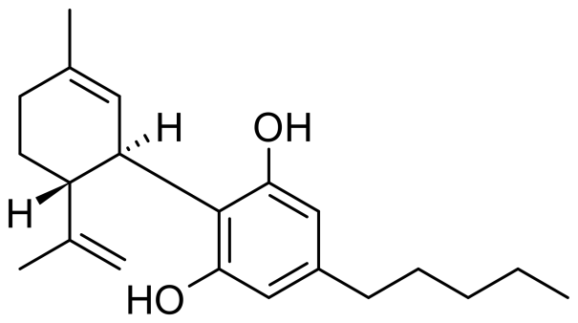
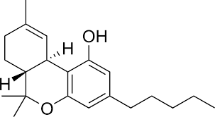
Cannabidiol [CBD]
THC
Cannabidiol is a nonpsychoactive component found in the Cannabis sativa plant. It’s being researched for many possible medical benefits, and unlike tetrahydrocannabinol (THC), this active compound doesn’t get you “high.”
CBD is known to have multiple physiologic mechanisms of action, including 5-HT1A serotonergic agonism, adenosine and opioid receptor modulation, activation of the endocannabinoid system [ECS], antagonism at GPR55 receptors, and activation of transient receptor potential channels [TRPCs]. CBD's activity at 5-HT1A receptors may drive its neuro-protective, anti-depressive, and anxiolytic benefits. CBD was shown to be helpful for decreasing anxiety through a simulated public speaking test at doses of 300–600 mg in single-dose studies. Other studies suggest that much lower doses of 10 mg/kg have a more anxiolytic effect than higher doses of 100 mg/kg in rats.
CBD is a safe compound with a wide range of therapeutic applications, including the treatment of psychiatric disorders. Its therapeutic use, however, has some limiting factors. In addition to its low and variable oral bioavailability in humans, it causes bell-shaped dose-response curves and possesses a narrow therapeutic dose range.

Slide 6
The therapeutic role of Cannabidiol in mental health
CBD-containing compounds such as “Nabiximols” were helpful in alleviating psychotic symptoms and cognitive impairment in patients with a variety of conditions, and several studies provided evidence of effectiveness in the treatment of cannabis withdrawal and moderate to severe cannabis use disorder [CUD] with Grade B recommendation. There is Grade B recommendation supporting the use of CBD for the treatment of schizophrenia, social anxiety disorder and autism spectrum disorder (ASD), and attention deficit hyperactivity disorder (ADHD). Grade C recommendation exists for insomnia, anxiety, bipolar disorder [BPD], posttraumatic stress disorder [PTSD], and Tourette syndrome [TS]. CBD-containing compounds were helpful in alleviating symptoms of cannabis-related disorders, schizophrenia, social anxiety disorder, and comorbidities of ASD, and ADHD. There is weaker evidence for insomnia, anxiety, bipolar disorder, posttraumatic stress disorder [PTSD], and Tourette syndrome. As observed in rodents, recent studies have confirmed the ability of CBD to alter important aspects of aversive memories in humans and promote significant improvements in the symptomatology of PTSD.
The evidence for the use of CBD for psychiatric disorders needs to be further explored in future studies, in a large-scale and well-designed (placebo & crossover controlled) studies.

Slide 7
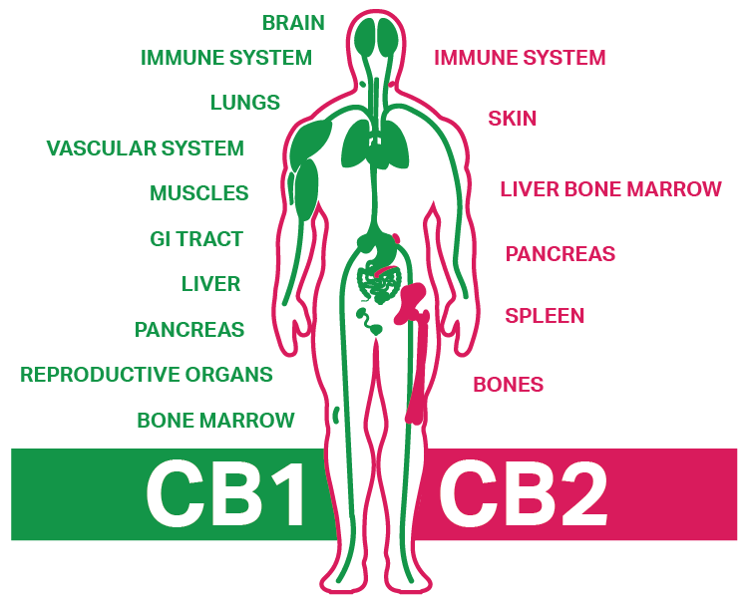
The endocannabinoid system [ECS]
The endogenous cannabinoid system has been shown to play an important role in the process of aversive memory extinction through the activity of central CB1 receptors. Two cannabinoid receptors are known to exist in the human body: CB1R and CB2R. CB1Rs are located mainly in the brain and modulate neurotransmitter [NT] release in a manner that prevents excessive neuronal activity, thus calming and decreasing anxiety. CB1Rs also have a role in reducing pain, inflammation, regulating sensory perception, memory, and cognitive function.

Slide 8
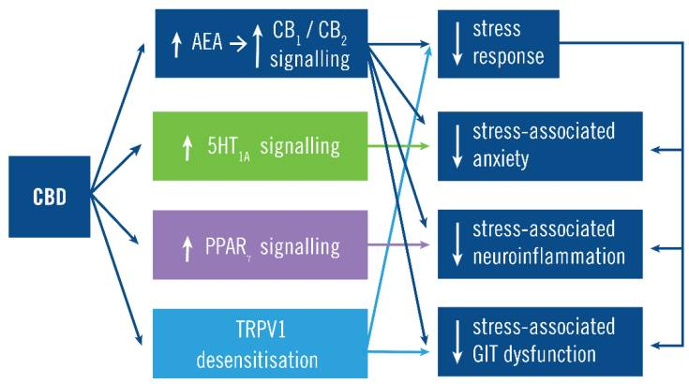
Effects of CBD on STRESS
Inhibition of fatty acid
amide hydrolase [FAAH]
The main action of CBD is to increase CB1 and CB2 signaling by preventing anandamide {N-arachidonylethanolamine (AEA)} degradation. This constrains the stress response and its manifestations both via its inhibition of the stress response and inhibition of some manifestations such as the anxiety, neuro-inflammation, and gastrointestinal tract [GIT] dysfunction. For example, CB1 signaling inhibits stress-associated anxiety by both constraining the stress response and by CB1 activity on forebrain glutamatergic [Glu] {excitatory} neurons . CBD also acts independently of CB1/CB2 signaling by increasing serotonergic 5HT1A signaling, increasing PPARγ nuclear receptor signaling and desensitizing TPRV1, which inhibit stress-associated anxiety, neuro-inflammation and GIT dysfunction.

Slide 9
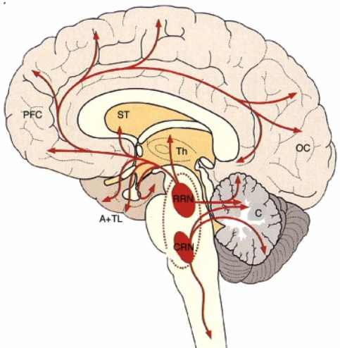
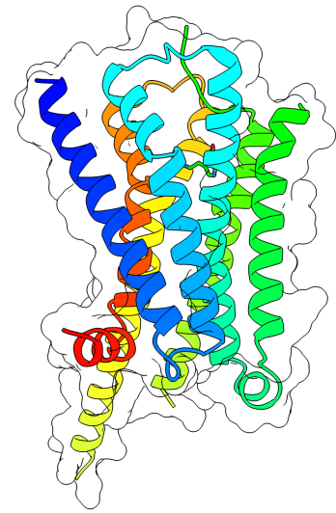
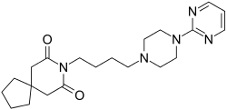
5-HT1AR
The 5-HT1A receptor (5-HT1AR) is an established anxiolytic target. Buspirone and other 5-HT1AR agonists are approved for the treatment of generalized anxiety disorder [GAD]. In preclinical studies, 5-HT1AR agonists are anxiolytic in animal models of general anxiety, prevent the adverse effects of stress, and enhance fear extinction. Both pre- and post-synaptic 5-HT1ARs are coupled to various members of the Gi/o protein family. They are expressed on serotonergic neurons in the raphe nuclei (a cluster of nuclei found in the brain stem that have 5-HT1 receptors and function as auto-receptors in the brain that decrease the release of serotonin). Selective serotonin reuptake inhibitor (SSRI) antidepressants act in these nuclei, as well as at their targets. 5-HT1Rs exert auto-inhibitory function, and are involved in fear and anxiety. Mechanisms underlying the anxiolytic effects of 5-HT1AR activation are complex, varying between both brain region, and pre- versus post-synaptic locus, and are not fully established. While in vitro studies suggest CBD acts as a direct 5-HT1AR agonist, in vivo studies are more consistent with CBD acting as an allosteric modulator, or facilitator of 5-HT1A signaling.
5-HT1AR
Raphe nuclei
Buspirone

Slide 10
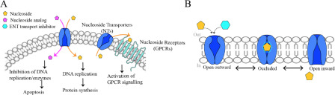
Adenosine A1a & A2a receptors
CBD, alongside with THC, was shown to inhibit adenosine reuptake with an IC50 of 124 nmol/L by acting as competitive inhibitors at the equilibrative nucleotide transporter [ENT] on EOC-20 microglia cells. This increases the endogenous adenosine content available for adenosine receptor activation. Treatment with CBD (1 mg/kg) significantly reduced tumor necrosis factor-alpha (TNFα) in mice challenged with lipopolysaccharides (LPS); This was blocked by pre-treatment with the selective A2a adenosine receptor antagonist, ZM 241385 (10 mg/Kg, i.p.). The role of A2a adenosine receptors as CBD targets was recently confirmed. CBD-mediated anti-inflammatory effects were reversed by the A2a receptor antagonist ZM 241385, in a murine model of acute lung injury. In a different context, CBD was shown to have antiarrhythmic effects against I/R-induced arrhythmias in rats and this was blocked by the adenosine A1a receptor antagonist DPCPX45 indicating that CBD might activate more than one type of adenosine receptor. As a result of adenosine receptors activation, CBD induces calming & relaxing effects, treating insomnia in a safe & natural way.
(A) ENT-mediated uptake and efflux of natural nucleoside (adenosine) regulates a variety of cellular processes via GPCRs. Anticancer and antiviral drugs enter the cell via ENTs. Once inside the cell, they are phosphorylated and then incorporated into newly synthesized DNA or RNA molecules, resulting in cancer cell death. B) Proposed alternative access model of ENT function. Both physiological and synthetic ligands can bind to hENT1 from in inward- or outward-facing conformation such that only one side is accessible at one time.

Slide 11
FAAH enzyme
Fatty acid amide hydrolase [FAAH] (EC 3.5.1.99, oleamide hydrolase, anandamide amidohydrolase) is a member of the serine hydrolase family of enzymes. In humans, it is encoded by the gene FAAH. FAAH is an integral membrane hydrolase with a single N-terminal transmembrane domain. In vitro, FAAH has esterase and amidase activity. In vivo, FAAH is the principal catabolic enzyme for a class of bioactive lipids called the fatty acid amides (FAAs). Members of the FAAs include: Anandamide (N-arachidonoylethanolamine [AEA]), an endocannabinoid [eCB],
2-arachidonoylglycerol (2-AG), another eCB, other N-acylethanolamines, such as N-oleoylethanolamine and N-palmitoylethanolamine [PEA], the sleep-inducing lipid oleamide [OA], the N-acyltaurines, which are also agonists of the transient receptor potential (TRP) family of calcium channels.
FAAH knockout mice [Kos] display highly elevated (>15-fold) levels of N-acylethanolamines and N-acyltaurines in various tissues. Because of their significantly elevated AEA levels, FAAH KOs have an analgesic phenotype, showing reduced pain sensation in the hot plate test, the formalin test, and the tail flick test. Finally, because of their impaired ability to degrade AEA, FAAH KOs also display super-sensitivity to exogenous AEA & 2-AG, cannabinoid receptor agonists.

Slide 12
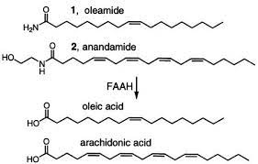
FAAH and its Genes
AEA
AA
Due to the ability of FAAH to regulate nociception, it is currently viewed as an attractive drug target for the treatment of pain.
A Scottish woman with a previously unreported genetic mutation (dubbed FAAH-OUT) in her FAAH gene with resultant elevated anandamide [AEA] levels was reported in 2019 to be immune to anxiety, unable to experience fear, and insensitive to pain. The frequent burns and cuts she suffered due to her hypoalgesia, healed quicker than average. A 2017 study found a strong correlation between national percentage of very happy people (as measured by the World Values Survey) and the presence of the A allele in the FAAH gene variant rs324420 SNP in citizens' genetic make-up.
A mutation in FAAH was initially provisionally linked to drug abuse and dependence but this was not borne out in subsequent studies.
Studies in cells and animals and genetic studies in humans have shown that inhibiting FAAH may be a useful strategy to treat anxiety as well as stress disorders.

Slide 13
The rs324420 SNP
Reference SNP Gene rs324420, also known as c.385C>A or Pro129Thr, is a single nucleotide polymorphism [SNP] in the fatty acid amide hydrolase [FAAH] gene, which has shown associations with some substance use disorders and higher pain tolerance. rs324420(C) allel encodes the more common Pro, while the (A) allele encodes the Thr. (A;C) & (C;C) are normal. Among 80 individuals with drug abuse or alcoholism and over 1,000 controls, the odds ratio for risk of problem drug or alcohol use among rs324420(A;A) individuals was 4.5 (2.2 - 8.4); For street drug use was 2.2 (1.3–3.7); and for combined street drug use and problem drug/alcohol use was 4.9 (2.5–9.7).
When this study was pooled with the results of another study of 249 subjects with documented multiple different drug addictions compared to drug free individuals of the same ethnic backgrounds, the results were consistent and even more significant (p = 0.00003). Risk for drug dependence and abuse was associated with rs324420(A;A) homozygotes. In a study of 40 daily marijuana users who abstained for 24 h and were then presented with a cue-elicited craving paradigm, followed by smoking a marijuana cigarette, rs324420(A) was significantly associated with changes in withdrawal after abstinence and with happiness after smoking marijuana, but was not associated with changes in heart rate after smoking or with changes in craving or other acute effects.

Slide 14
The rs324420(A;A) variant
This variant has also been associated with pain insensitivity. In a 2016 study, about 1,000 women undergoing surgery for breast cancer were tested for cold and heat pain sensitivity; rs324420(A;A) individuals reported significantly lower cold pain sensitivity and less need for postoperative analgesia. The rs324420(A;C) genotype was also seen in a woman with unusually high pain tolerance, along with a ~8kb heterozygous micro-deletion of the adjacent FAAH pseudogene.
From a different perspective, a 2016 study published in the Journal of Happiness Studies found "a strong correlation between a nation's happiness and the presence of the (rs324420) A allele in the fatty acid amide hydrolase (FAAH) gene".
As optimistic, happy people, that are (A;A) allele carriers, suffer much less from depression, anxiety & mental stress disorders and may feel little effect of CBD. The inhibition of FAAH activity by CBD may improve the mental conditions of patients that are carriers of (A;C) or (C;C) alleles - that have a very active FAAH enzyme.
About one third of patients that try CBD oil do not feel improvement in their symptoms. Therefore, we’ll invent a saliva genetic test in order to predict the individual response (or no response) to CBD according to the mutations of the FAAH genes.

Slide 15
The effects of CBD are individual
A professor of clinical psychiatry noted recently: “About 20 percent of Americans may have a genetic mutation that makes them naturally produce more endocannabinoids [eCBs].
If you have that mutation, you might be prone to lower levels of anxiety, but because you already have extra eCBs, you might not see much of a difference when you take CBD.
CBD may be popular, but that doesn’t mean it is a “miracle drug” that will work for everyone. It’s possible that you’ll find that CBD simply doesn’t work for you.
Your level of absorption and reaction to CBD as well as its metabolism depends on a variety of factors including:
Metabolism
Biochemistry
Genetics.
Common forms of CBD application:
Oil tinctures, topical creams, Vaping oils, capsules, transdermal patches, suppositories and edibles like gummies and chocolate.

Slide 16
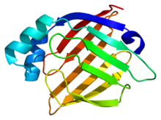
Fatty acid binding protein
FABP3
The fatty-acid-binding proteins (FABPs) are a family of transport proteins for fatty acids [Fas] and other lipophilic substances such as eicosanoids and retinoids. These proteins are thought to facilitate the transfer of FAs between extra- and intra-cellular membranes. Some family members are also believed to transport lipophilic molecules from outer cell membrane to certain intracellular receptors such as PPAR. The FABPs are intracellular carriers that “solubilize” the endocannabinoid [eCB] anandamide (AEA), transporting AEA to the breakdown by FAAH. Compounds that bind to FABPs block AEA breakdown, raising its level. The cannabinoids (THC and CBD) are also discovered to bind human FABPs (1, 3, 5, and 7) that function as intracellular carriers, as THC and CBD inhibit the cellular uptake and catabolism of AEA by targeting FABPs. Competition for FABPs may in part or wholly explain the increased circulating levels of eCBs reported after consumption of cannabinoids. Levels of fatty-acid-binding protein have been shown to decline with ageing in the mouse brain, possibly contributing to age-associated decline in synaptic activity.

Slide 17
THC – CBD – FABP – FAAH - AEA
Δ(9)-Tetrahydrocannabinol (THC) and cannabidiol (CBD) occur naturally in Cannabis and may be formulated, individually or in combination in pharmaceuticals such as Marinol, Sativex or Epidiolex. These hydrophobic compounds are transported in blood by albumin or lipoproteins. Recent reports suggest that CBD and THC elevate the levels of the endocannabinoid [eCB] anandamide (AEA) when administered to humans, suggesting that phytocannabinoids [pCBs] target cellular proteins involved in eCB clearance. Fatty acid-binding proteins (FABPs) are intracellular proteins that mediate AEA transport to its catabolic enzyme fatty acid amide hydrolase (FAAH). By computational analysis and ligand displacement assays, it was shown that at least three human FABPs bind THC and CBD and demonstrate that THC and CBD inhibit the cellular uptake and catabolism of AEA by targeting FABPs. In contrast to rodent FAAH, CBD does not inhibit the enzymatic actions of human FAAH, and thus FAAH inhibition cannot account for the observed increase in circulating AEA in humans following CBD consumption. Using computational molecular docking and site-directed mutagenesis, key residues within the active site of FAAH that confer the species-specific sensitivity to inhibition by CBD, were identified.

Slide 18
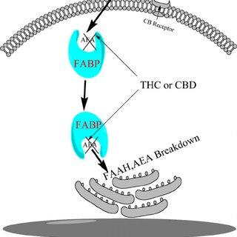
THC & CBD bind FABPs
OUT
IN
The binding pocket
of FABPs cannot
distinguish between
THC & CBD molecules.
When FABPs bind pCBs
they cannot move AEA
from the cell membrane
to the ER and therefore
FAAH cannot metabolize
AEA and its concentrations
gradually increases.
Endoplasmic Reticulum
Cell Nucleus

Slide 19
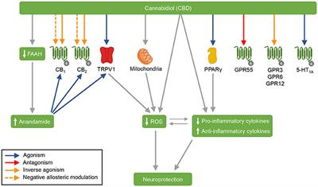
CBD’s Mode of Action
FAAH
Pro-inflammatory
Anti-inflammatory
AEA
Neuro-protection

Slide 20
Doses of CBD for different disorders
Suggested CBD Dosages:
Epilepsy: 600 - 800 mg per day.
Psychosis: 600 mg per day.
Anxiety: 300 - 600 mg per day. Blessing EM et al Cannabidiol as a potential treatment for anxiety disorders. Neurotherapeutics. 2015;12(4):825‐836.
Mental Stress: 300 – 600 mg per day.
Parkinson's disease: 75 - 300 mg per day.
Cancer-related pain: 50 - 600 mg per day.
Insomnia: 25 mg per day.
High blood pressure: 10 mg per day.
Inflammatory bowel disease: 10 mg per day.
One drop = 0.05 milliliter
10 ml bottle = 200 drops
20% CBD in 10 ml = 2,000 mg
10 drops = 100 mg
20 drops = 200 mg
30% CBD in 10 ml = 3,000 mg
10 drops = 150 mg
20 drops = 300 mg.
Finding the right dosage of CBD can be a tricky endeavor. The appropriate amount varies for each individual, as every person has a unique biology that results in a different reaction. One should start with a low dose and slowly increase it over time until he finds his “sweet spot.” Some folks find that taking a daily dose can help sustain a level of CBD in their body, which might stimulate the ECS to make it react more to cannabinoids. Many people use a microdosing technique to find their personal dosage and adjust it as needed over time. Looking at the dosage information for the CBD product that has been FDA approved can also be helpful. For “Epidiolex”, an FDA-approved cannabis-derived medication used to treat seizures in people with certain types of epilepsy, the starting dosage is 5 milligrams per kilogram of body weight. This dose can later be increased to 5 mg per kilogram of body weight twice a day (total of 10 mg/Kg B.W. {about 700 mg per day}).

Slide 21
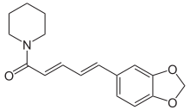

Enhancing CBD’s Bioavailability by Piperine & Chavicine
Chavicine
Piperine
The oral bioavailability of CBD is relatively low, therefore the addition of piperine to the pCB formulations is recently proposed.
Piperine, along with its isomer chavicine, is the alkaloid responsible for the pungency of black pepper and long pepper. It has been used in some forms of traditional medicine. Chavicine is an alkaloid found in black pepper and other species of the genus Piper. It is one of the four geometric isomers of piperine.
A component of pungency by piperine results from activation of the heat- and acidity-sensing transient receptor potential ion channels, TRPV1 and TRPA1, on nociceptors (the pain-sensing nerve cells). Piperine is under preliminary research for its potential to affect bioavailability of other compounds in food and dietary supplements, such as a possible positive effect on the bioavailability of curcumin.

Slide 22
Piperine increases the bioavailability of CBD in the rat
Piperine is an alkaloid naturally found in black pepper with a myriad of pharmacological attributes. Piperine's most far reaching indication is drug absorption enhancement, with supportive data regarding its ability to inhibit first pass effect mechanisms. Besides the role of piperine as an absorption enhancer it also have an apparent effect as a metabolic inducer. Recent studies investigate the effect of repeated administration of piperine in a lipid-based formulation on oral absorption of cannabidiol (CBD), compared to acute piperine dosing. The effect of piperine on CBD absorption was determined pre-clinically in the freely moving rat model. Results of this study demonstrated that there was no significant difference in piperine's effect, when given chronically or in a single dose regimen. Both groups resulted in approximate 2.5-fold increase in oral bioavailability of CBD compared to control group without piperine. Fast-absorbing and delivering of a consistent serving of CBD, ensures an optimal dosage and experience every time.
It is also recommended to ingest CBD oil together with fatty foods.

Slide 23
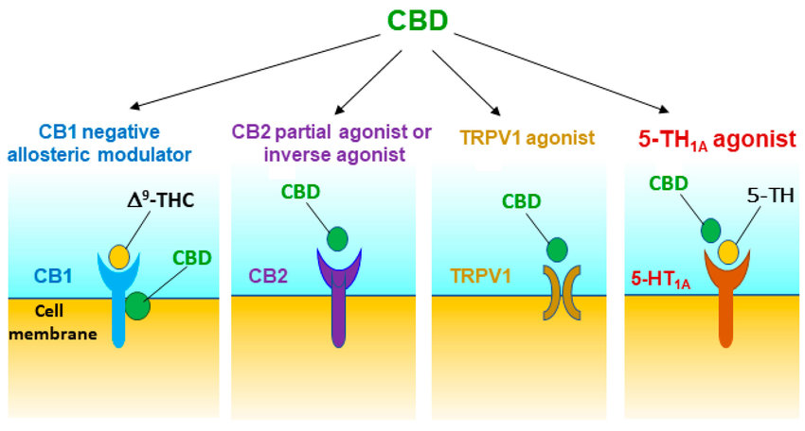
CBD’s opposing modes of action
HT
HT
Inhibition
Stimulation

Slide 24
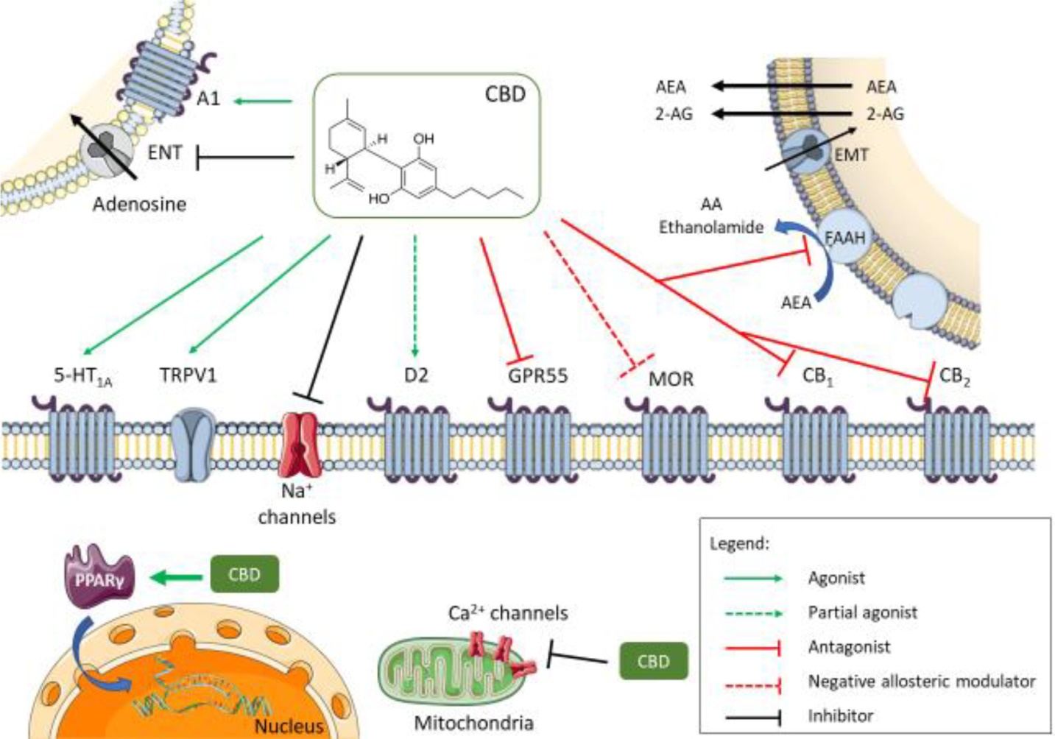
equilibrative
nucleotide
transporter
EMT
eCBs membrane
transporter
Cannabidiol has multiple molecular targets within the cell. It behaves as an antagonist for cannabinoid CB1 and CB2 receptors; however, some of the cannabinoid-mediated effects attributed to CBD may be due to its ability to inhibit eCB degradation through the FAAH enzyme. This, in turn, increases eCB levels causing receptor activation, mainly by anandamide [AEA]. The full agonism at 5-HT1A serotonin receptors and TRPV1 channels is responsible for the anxiolytic and analgesic effects. Partial agonism at D2 dopamine receptors might account for the effects of CBD on emotional memory processing by the ventral hippocampus. Full agonism at adenosine A1 receptors might have beneficial effects on cardiac ischemia/ reperfusion [i/r] lesions in the myocardium as well as for the treatment of insomnia.

Slide 25
Multiple molecular targets of CBD
The negative allosteric modulation of mu opioid receptor [MOR] is an important CBD feature in controlling opioid drug abuse and relapse. Agonism of intracellular PPARγ receptors causes changes in gene transcription and is responsible for the positive effect of CBD on glucose and fatty acid metabolism. CBD has an overall inhibitory effect on sodium and calcium channels exerting a modulatory effect on membrane electrical potential; CBD also antagonizes GPR55 – All these effects would suggest CBD as a potential therapeutic for the treatment of epilepsy as well as of anxiety, depression and mental stress.
CBD, cannabidiol; A1, Adenosine receptor 1; ENT, equilibrative nucleotide transporter; AEA, anandamide; 2-AG, 2-arachidonoylethanolamide; EMT, endocannabinoid membrane transporter; 5-HT1A, 5-hidroxytriptamine 1A receptor; TRPV1, transient receptor potential vanilloid 1; D2, dopamine receptor 2; GPR55, Orphan G protein coupled receptor 55; MOR, µ opioid receptor; PPARγ, peroxisome proliferator-activated receptor gamma.

Slide 26
Therapeutic potential of CBD in psychiatric disorders
Although the pharmacological effects of CBD in different biological systems have been extensively investigated by in vitro studies, the mechanisms responsible for its therapeutic potential are still not clear. Recent in vivo studies indicated that these mechanisms are not unitary but rather depend on the behavioral response being measured. Acute anxiolytic and antidepressant-like effects seem to rely mainly on facilitation of 5-HT1A-mediated neurotransmission in key brain areas related to defensive responses, including the dorsal periaqueductal grey, bed nucleus of the stria terminalis and medial prefrontal cortex [PFC]. Other effects, such as anti-compulsive, increased extinction and impaired reconsolidation of aversive memories, and facilitation of adult hippocampal neurogenesis could depend on potentiation of anandamide [AEA]-mediated neurotransmission. Activation of TRPV1 channels may help us to explain the antipsychotic effect and the bell-shaped dose-response curves commonly observed with CBD. Further studies are needed to investigate the involvement of other possible mechanisms such as: inhibition of adenosine uptake, inverse agonism at CB2 receptor, CB1 receptor & GPR55 antagonism, PPARγ nuclear receptors agonism and intracellular (Ca2+) increase - on CBD behavioral effects.

Slide 27
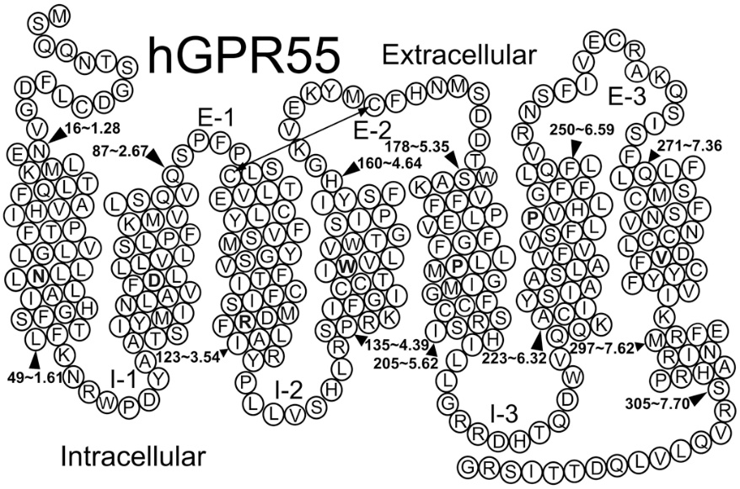
GPR55 (not! CB3R)
Helix net representation of human GPR55. The residues shaded in black represent highly conserved residues in rhodopsin, the prototypical Class A GPCR.
In CBD’s multimodal pharmacologic profile, one molecular target is antagonism of the “orphan” G-protein coupled receptor GPR55, activated by the endogenous ligand lysophosphatidylinositol (LPI). Since LPI activation of GPR55 increases presynaptic Ca2+ and vesicular release at excitatory CA3-CA1 synapses, promoting the excitability of CA1 pyramidal neurons - antagonism of GPR55 may be a promising target for epilepsy management.

Slide 28
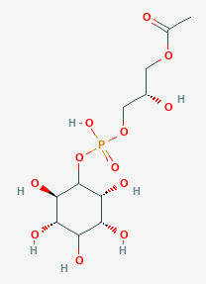
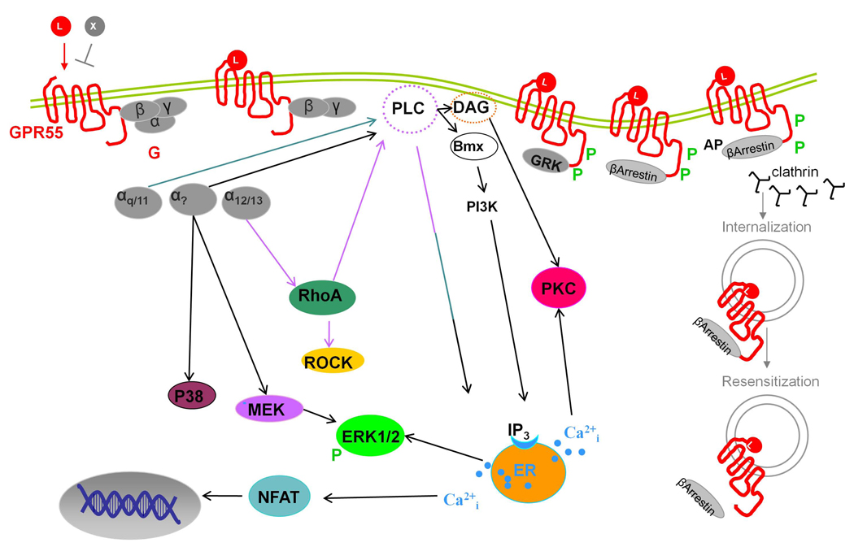
GPR55 mode of action
LPI
LPI
CBD
TPSA = 203
square Angstroms
Nucleus
GPR55 has been shown to utilize Gq and G12/13 for signal transduction; PLC and RhoA are also activated. This signaling mode is associated with temporal changes in cytoplasmic calcium, membrane-bound diacylglycerol [DAG], and plasma membrane topology. LPI [Lysophosphatidylinositol] , SR141716A and AM251 recruit PKCβII-GFP and cause widespread plasma membrane remodeling upon GPR55 activation. Involvement of the actin cytoskeleton was also reported. One should note that although several Gα subunits have been implicated in signal initiation, it appears that activation of GPR55 results in the ultimate generation of the same intracellular molecules, leading to the activation of the MAPK pathways and transcription factors.
CBD is a potent GPR55 antagonist therefore it is currently used to treat epileptic seizures.

Slide 29
TRP channels
Transient receptor potential channels (TRP channels) are a group of ion channels located mostly on the plasma membrane of numerous animal cell types. TRP channels modulate ion entry driving forces and Ca2+ and Mg2+ transport machinery in the plasma membrane. TRPs have important interactions with other proteins and often form signaling complexes. TRP channels are grouped into two broad groups: Group 1 includes TRPC ( "C" for canonical), TRPV ("V" for vanilloid), TRPVL ("VL" for vanilloid-like), TRPM ("M" for melastatin), TRPS ("S" for soromelastatin), TRPN ("N" for no mechanoreceptor potential C), and TRPA ("A" for ankyrin). Group 2 consists of TRPP ("P" for polycystic) and TRPML ("ML" for mucolipin). Most TRP channels are composed of 6 membrane-spanning helices with intracellular N- and C-termini. Mammalian TRP channels are activated and regulated by a wide variety of stimuli and are expressed throughout the body. TRPV was originally discovered in Caenorhabditis elegans, and is named for the vanilloid chemicals that activate some of these channels. These channels have been made famous for their association with molecules such as capsaicin (a TRPV1 agonist).
Cannabidiol binds & activates TRPV1 channel. CBD is reported to produce pain relief. The TRPV1 receptor integrates noxious stimuli and plays a key role in pain signaling. CBD at low doses, corresponding to plasma concentrations observed physiologically, inhibits or desensitizes neuronal TRPV1 signaling by inhibiting the adenylyl cyclase – cAMP pathway, which is essential for maintaining TRPV1 phosphorylation and sensitization. CBD also facilitated calcineurin-mediated TRPV1 inhibition. These mechanisms may underlie nociceptor desensitization and the therapeutic effect of CBD in animal models and patients with acute and chronic pain. Less pain always means less mental stress.

Slide 30
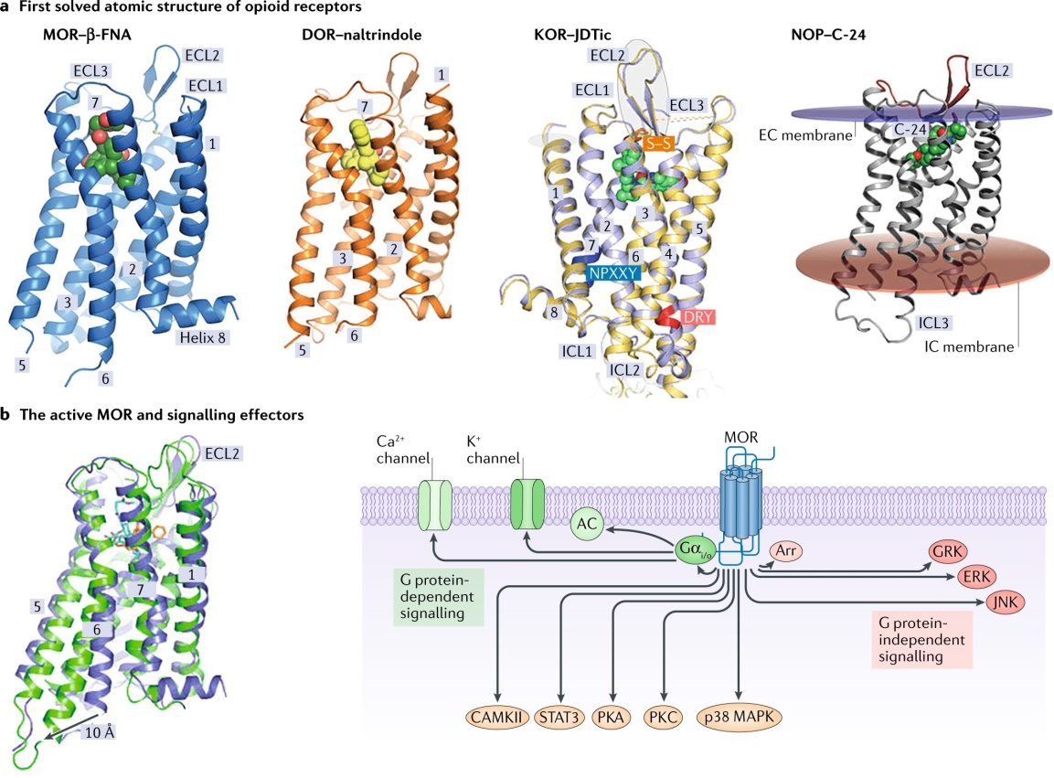
Mu Opioid Receptor [MOR]
Opioids exert their effects through binding to the opioid receptors belonging to the G-protein coupled receptors (GPCRs) family, including mu opioid receptor (MOR), delta opioid receptor (DOR), and kappa opioid receptor (KOR). Among them, MOR is essential for opioid-induced analgesia and also responsible for adverse effects of opioids. Importantly, MOR can form heterodimers with other opioid receptors and non-opioid receptors in vitro and in vivo, and has distinct pharmacological properties, different binding affinities for ligands, downstream signaling, and receptor trafficking. CBD is a negative allosteric modulator of MOR

Slide 31
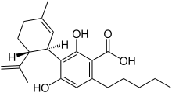
CBDA
COOH
The major phytocannabinoid [pCB] cannabidiol (CBD) has anxiolytic properties and lacks tetrahydrocannabinol [THC]-like psychoactivity. Cannabidiolic acid (CBDA) is the acidic precursor to CBD, and this compound appears more potent than CBD in animal models of emesis, pain and epilepsy. In this short report, we aimed to examine whether CBDA is more potent than CBD in disrupting expression of conditioned fear and generalized anxiety-related behavior induced by Pavlovian fear conditioning. Mice underwent fear conditioning and 24 h later were administered CBD and CBDA before testing for fear expression and generalized anxiety-like behavior. We found that CBD and CBDA had dissociable effects; while CBD but not CBDA disrupted cued fear memory expression, CBDA but not CBD normalized trauma-induced generalized anxiety-related behavior. Neither pCB affected contextual fear expression. Our findings form the basis for future experiments examining whether pCBs, alone and in combination, are effective in these mouse models of fear and anxiety.

Slide 32
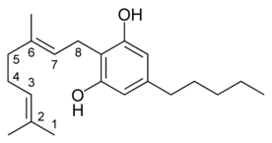
CBG mode of action
CBG
Cannabigerol have a good tolerability and low toxicity in humans.
CBGA, the “mother pCBs”, have numerous therapeutic effects. It activates some receptors [such as: alpha-2 adrenergic receptor, CB2R, PPAR-γ] and ion channels [TRPM8] and antagonizes some others [such as: CB1R, 5-HT1AR and Nav (sodium channel)].
Moreover, CBG have a strong anti-bacterial activity as a result of inhibition of bacterial fatty acid metabolism. CBG kills MRSA that is resistant to most antibiotics. By killing activated skin Keratinocytes, CBG can heal Psoriasis. CBG protects neurons in the PNS & the CNS and treats effectively neuro-degeneration diseases such as AD, HD, PD, MS & Epilepsy. CBG have positive psychological effects, reducing negative emotions (anxiety,
depression, mental stress, fear & anger) and elevating mood & well being.
CBG reduces inflammation and treats IBD. CBG also reduces nausea and enhances appetite. CBG kills cancer cells in culture. CBG also reduces high blood pressure and treats Glaucoma.

Slide 33
Isolate or broad / full spectrum
A full-spectrum CBD product contains multiple cannabis plant extracts, including essential oils, terpenes, and other cannabinoids, such as cannabinol [CBN] & cannabigerol [CBG]. Full-spectrum CBD products may also contain up to 0.3% of tetrahydrocannabinol (THC), the cannabinoid in the cannabis plant that produces the ‘high’ feeling in people. However, such a low amount is not strong enough to have significant psychoactive effects.
CBD isolate is a pure form of CBD. It contains no other cannabis plant compounds. It usually comes from hemp plants, which typically contain very low amounts of THC. CBD isolate is a crystal form of CBD, and it is often ground up and sold as a powder. The CBD extraction process is no different for each of these products, which usually involves: carbon dioxide extraction, steam distillation, solvent extraction & lipid extraction. However, CBD isolate is a much more refined product and goes through extra processing.
CBD isolate may be a suitable product for first-time CBD users who wish to experiment with the potential health benefits, without the interference of other cannabis compounds, which may alter the effects. CBD isolate is also refined, so it has no discernible taste or odor. CBD isolate’s effects against pain and inflammation may only occur at a specific dose. This is in contrast to full-spectrum products, where effects increase as the dosage does. For this reason, people who wish to take high doses of CBD may prefer a CBD isolate. Some people may prefer a product without THC, or they might be sensitive to this substance. As there is no THC, this substance should not show up in any drug tests.
Full-spectrum CBD products contain some THC, but usually at low quantities of less than 0.3%. However, during the manufacturing process, THC levels can rise. With a range of reported health benefits, uses for full-spectrum CBD include: anti-seizure, muscle spasm relief, antianxiety, pain relief, treatment for psychotic disorders, antioxidant and anti-inflammatory activities.
Broad-spectrum CBD is very similar to full-spectrum in that it contains additional cannabis compounds. It produces more beneficial health effects compared to CBD isolate because of the entourage effect.

Slide 34
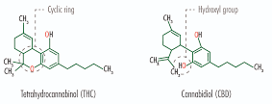
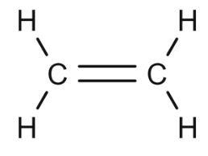
PTSD treatment with small doses of THC
CH3
CH3
CH2
Closed ring
Open
ring
Alkene (Ethene)
CH3
Small doses of THC could boost the effectiveness of traditional therapies used to treat PTSD, according to a new study conducted at Wayne State University in Michigan. Several prior studies have already determined that cannabis can effectively reduce PTSD symptoms, including anxiety, stress, and suicidal thoughts. The new study, which was recently published in Neuropharmacology [August 2022], specifically focuses on how low doses of THC could help boost the effectiveness of cognitive reappraisal (an assessment of something in a different way) therapy for PTSD. The researchers also discovered that the patients on low THC doses had heightened brain activation in brain parts usually less activated for PTSD patients performing similar tasks. Cognitive reappraisal is one therapeutic emotion regulation strategy, that has been widely studied among individuals with mood and anxiety disorders, and numerous differences in brain activation patterns have been shown between individuals with and without PTSD during tasks of cognitive reappraisal.

Slide 35
CBD with a “pinch” of THC
As CBD is non-psychoactive - it is generally believed to be safe for the treatment of mental disorders such as PTSD. Whoever, PTSD patients (that are the most vocal supporters of the medicinal benefits of cannabis) claim that THC assists them in alleviating migraines, relieving mental stress and anxiety and curbing panic attacks as well as nightmares. Recent study from the USA proves that purified CBD works better when little THC is added to it. Low doses of THC or THC combined with CBD were both able to enhance the extinction rate for challenging memories - and reduce overall anxiety responses. It seems that THC drives the extinction rate improvements, while CBD can help alleviate potential side effects from higher doses of THC. Evidence from both healthy humans and PTSD patients suggests that these forms of cannabis suppress anxiety and aversive memory expression without producing significant adverse effects.
Another recent study from Brazil shows how cannabis can reduce activity in the amygdala - a part of the brain associated with fear responses to threats. Those exposed to THC had lowered threat-related amygdala reactivity. This means that those who took low doses of THC showed measurable signs of reduced fear and anxiety in situations designed to trigger fear. The two studies suggest that the phyto-cannabinoids CBD + THC could play a role in extinguishing traumatic memories. Nonetheless, more research must be carried out to substantiate the medicinal benefits and risks of THC.

Slide 36
Summary & Conclusions
Stress and anxiety are common experiences for many people and millions of adults in the USA say they feel stress daily. Work, family issues, health concerns, and financial obligations are parts of everyday life that commonly contribute to heightened mental stress levels. Factors such as genetics, level of social support, coping style, and personality type, influence a person’s vulnerability to stress. Minimizing the chronic stress of daily life is important for overall health as chronic stress increases the risk of heart, kidney & liver diseases, anxiety disorders and depression.
Several evidence-based strategies can help in reducing stress and improve the overall psychological well-being. Physical exercise, mindfulness, getting social support, spending time with a pet, minimizing screen time, and getting outside to nature more often are all effective methods.
Cannabidiol activates indirectly CB1 & CB2 receptors of the ECS as a result of FAAH enzyme inactivation that elevates the concentrations of anandamide. CBD also binds & activates the serotonin 5-HT1A receptor exerting anxiolytic effects. CBD is a partial agonist of D2 dopamine receptor causing alertness & well-being. CBD desensitizes neuronal TRPV1 ion channel signaling reducing pain sensation. CBD is a negative allosteric modulator of the mu opioid receptor. Full agonism of CBD at adenosine A1 receptors (as a result of ENT activation) might have beneficial effects on insomnia.

Slide 37
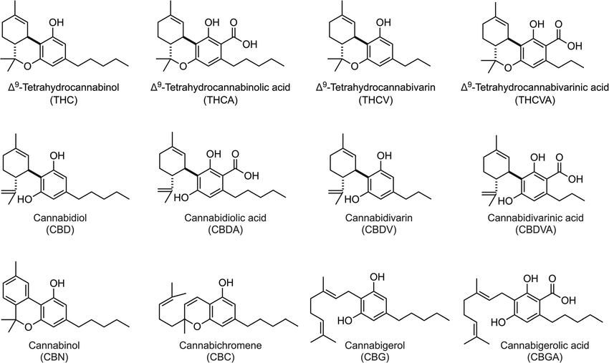
Chemical structure of some pCBs

Slide 38
CBD-Prescription Drugs Interactions

Slide 39
Prescription Drug Interactions with Cannabis
In general, cannabis is less likely to have negative interactions with pharmaceuticals compared to alcohol. Even so, there are at least 24 prescription drugs that can cause serious health consequences when combined with cannabis. For example, smoking weed while drinking “Alfentanil”, a narcotic cough medication, can reportedly cause respiratory distress, coma, and even death.
Around 350 other drugs could also potentially cause minor or moderate side effects if mixed with cannabis.
Many doctors are woefully uneducated about cannabis, which makes it hard for them to warn their patients about cannabis contraindications. And although every legal weed product comes plastered with warning labels, few states actually require cannabis packaging to list interactions with common prescription medicines.
Without clear advice from their physicians, many patients turn to the internet for answers. Unfortunately, many big tech companies censor any and all cannabis-related content.
CBD most potently inhibited catalytic activity of human CYP3A enzymes, especially CYP3A4 and CYP3A5. The two phenolic hydroxyl groups in the resorcinol moiety of CBD may play an important role in the CYP3A inhibition.

Slide 40
Cannabinoid Interactions with Cytochrome P450 Drug Metabolism
Cannabis-based products are being used for numerous health conditions, often in conjunction with prescribed medications. The risk of clinically significant drug-drug interactions (DDIs) increases in this setting of poly-pharmacy, prompting concern among health care providers. Serious adverse events can result from DDIs, specifically those affecting CYP-mediated drug metabolism. Both cannabidiol (CBD) and Δ9-tetrahydrocannabinol (Δ9-THC), potently inhibit CYPs. Cannabis-based products contain an array of phytocannabinoids [pCBs], many of which have limited data available regarding potential DDIs.
The pCBs exhibited varied effects and potencies across the CYP isoforms. CYP2C9-mediated metabolism was inhibited by nearly all the pCBs with estimated Ki values of 0.2-3.2 μM. Most of the pCBs inhibited CYP2C19, whereas CYP2D6, CYP3A4, and CYP2B6 were only partially inhibited by the pCBs. Effects of the pCBs on CYP2D6, CYP1A2, CYP2B6, and CYP3A4 metabolism were limited so in vivo DDIs mediated by these isoforms would not be predicted. Only CYP2C9-mediated metabolism was inhibited by pCBs at clinically relevant concentrations. In vivo DDI studies may be justified for CYP2C9 substrates with a narrow therapeutic index.

Slide 41
Drug Interactions with CYP3A4 Enzyme
CYP3A4 is the most important of the CYP450 enzymes for drug metabolism and for drug interactions. It is not practical to memorize the many CYP3A4 substrates, but it would be prudent to be familiar with the most common CYP3A4 inhibitors and inducers since such drugs are likely to interact with approximately half of all drugs on the market. Therefore, it is not surprising that the drug toxicity of CYP3A4 substrates, due to inhibition of CYP3A4, is relatively common. CYP3A4 is also sensitive to enzyme induction, and a number of drugs are known to be CYP3A4 inducers. CYP3A4 inducers tend to reduce plasma concentrations of CYP3A4 substrates, resulting in reduced efficacy of the substrate. This type of drug interaction is probably more frequent than commonly realized, since a reduced drug effect may be attributed simply to lack of patient response.
Many drugs that are CYP3A4 substrates, inhibitors, and inducers are also inhibitors or inducers of the ABC transport protein known as P-glycoprotein. The ATP-binding cassette transporters (ABC transporters) are a transport system superfamily that is the largest and the oldest gene family. It is represented in all extant phyla, from prokaryotes to humans. ABC transporters belong to trans-locases. Many drug interactions, therefore, involve additive effects of both CYP3A4 and P-glycoprotein.

Slide 42
Metabolism of CBD by CYP450 enzymes
Cannabidiol (CBD) has been shown to be extensively metabolized by experimental animals and humans. However, human hepatic enzymes responsible for the CBD metabolism remain to be elucidated. The in vitro metabolism of CBD with human hepatic microsomes (HLMs) was studied to clarify cytochrome P450 (CYP) isoforms involved in the CBD oxidations. CBD was metabolized by pooled HLMs to eight monohydroxylated metabolites (6α-OH-, 6β-OH-, 7-OH-, 1″-OH-, 2″-OH-, 3″-OH-, 4″-OH-, and 5″-OH-CBDs). Among these metabolites, 6α-OH-, 6β-OH-, 7-OH-, and 4″-OH-CBDs were the major ones. Seven of 14 recombinant human CYP enzymes examined (CYP1A1, CYP1A2, CYP2C9, CYP2C19, CYP2D6, CYP3A4, and CYP3A5) were capable of metabolizing CBD. The correlations between CYP isoform-specific activities and CBD oxidative activities in 16 individual HLMs indicated that 6β-OH- and 4″-OH-CBDs were mainly formed by CYP3A4, which was supported by inhibition studies using ketoconazole and an anti-CYP3A4 antibody. The correlation and inhibition studies also showed that CBD 6α-hydroxylation was mainly catalyzed by CYP3A4 and CYP2C19, whereas CBD 7-hydroxylation was predominantly catalyzed by CYP2C19. This study indicated that CBD was extensively metabolized by HLMs. These results suggest that CYP3A4 and CYP2C19 may be major isoforms responsible for 6α-, 6β-, 7-, and/or 4″-hydroxylations of CBD in HLMs.

Slide 43
CBD is an inhibitor of the catalytic activity of cytochrome P450 2C19
(S)-Mephenytoin 4'-hydroxylase enzyme activities of human liver microsomes (HLMs) and recombinant CYP2C19 were inhibited by CBD in a concentration-dependent manner (IC₅₀ = 8.70 and 2.51 µM, respectively). Kinetic analysis for inhibition revealed that CBD showed a mixed-type inhibition against (S)-mephenytoin 4'-hydroxylation by recombinant CYP2C19. To clarify the structural requirements for CBD-mediated CYP2C19 inhibition, the effects of CBD-related compounds on CYP2C19 activity were examined. Olivetol inhibited the (S)-mephenytoin 4'-hydroxylase activity of recombinant CYP2C19 with the IC₅₀ value of 15.3 µM, whereas d-limonene slightly inhibited the activity. The inhibitory effect of CBD-2'-monomethyl ether (IC₅₀ = 1.88 µM) on CYP2C19 was comparable to that of CBD, although the inhibitory potency of CBD-2',6'-dimethyl ether (IC₅₀ = 14.8 µM) was lower than that of CBD. Cannabidivarin [CBDV], possessing a propyl side chain, showed slightly less potent inhibition (IC₅₀ = 3.45 µM) as compared with CBD, whereas orcinol and resorcinol did not inhibit CYP2C19 activity at all. These results indicate that CBD caused potent CYP2C19 inhibition, in which one free phenolic hydroxyl group and the pentyl side chain of CBD may play important roles.
Esomeprazole, sold under the brand name “Nexium”, is a medication which reduces stomach acid. Nexium is a proton pump inhibitor (PPI) that is used to treat gastro-esophageal reflux disease, peptic ulcer disease, and Zollinger–Ellison syndrome. It
Esomeprazole is the (S)-(−)-isomer of omeprazole. It works by blocking H+/K+-ATPase in the parietal cells of the stomach and is a competitive inhibitor of the enzyme CYP2C19, so it might affect drugs that rely on this enzyme.

Slide 44
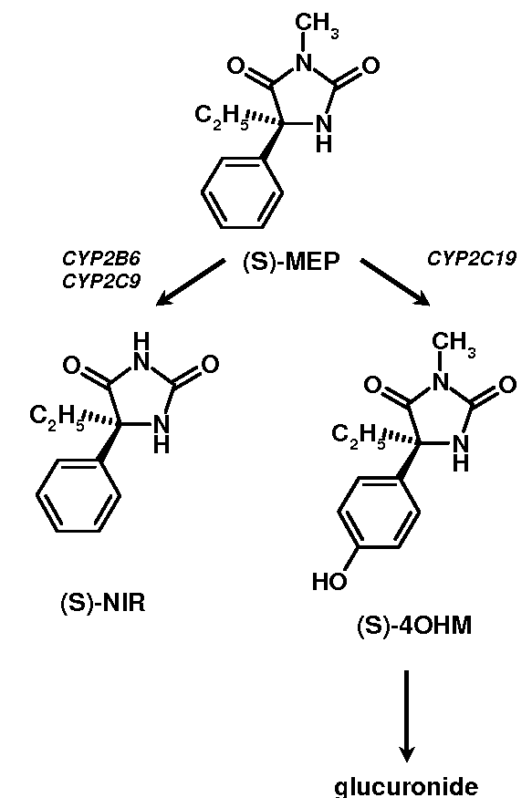
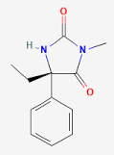
CYP2C9 & CYP2C19
Each enzyme have a
different mode of action
(S)-Mephenytoin
CYP2C9
*
CYP2C19
5
Hydroxylation
5-Mephenytoin
Diazepam and warfarin are broken down by CYP2C19. If these are used alongside a proton pump inhibitor [PPI], level of active ingredients in the body might rise.
Clopidogrel (Plavix) needs CYP2C19 to be converted into its active form. Using this type of drug alongside Nexium will reduce its effect.

Slide 45
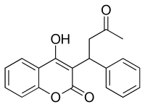
Warfarin treats blood clots
Warfarin, sold under the brand name Coumadin, is a medication that is used as an anticoagulant (blood thinner). It is commonly used to prevent blood clots such as deep vein thrombosis and pulmonary embolism, and to prevent stroke in people who have atrial fibrillation, valvular heart disease or artificial heart valves. Warfarin decreases blood clotting by blocking an enzyme called vitamin K epoxide reductase that reactivates vitamin K1. Without sufficient active vitamin K1, clotting factors II, VII, IX, and X have decreased clotting ability. The anticlotting protein C and protein S are also inhibited, but to a lesser degree. Warfarin first came into large-scale commercial use in 1948 as a rat poison. Warfarin was formally approved for human use by the U.S. Food and Drug Administration (FDA) to treat blood clots in 1954. In 1955, warfarin's reputation as a safe and acceptable treatment was bolstered when President Dwight D. Eisenhower received warfarin following a massive and highly publicized heart attack. Eisenhower's illness kickstarted a transformation in medicine where coronary artery disease, arterial plaques, and ischemic strokes were treated and prevented by using blood thinners such as warfarin. It is on the World Health Organization's [WHO] List of Essential Medicines. In 2019, it was the 50th most commonly prescribed medication in the USA, with more than 14 million prescriptions.

Slide 46
Warfarin interacts with many commonly used drugs, and the metabolism of warfarin varies greatly between patients. Some foods have also been reported to interact with warfarin. Apart from the metabolic interactions, highly protein bound drugs can displace warfarin from serum albumin and cause an increase in the International Normalized Ratio [INR]. When taken with nonsteroidal anti-inflammatory drugs (NSAIDs), warfarin increases the risk for gastrointestinal bleeding. This increased risk is due to the anti-platelet effect of NSAIDs as well as the possible damage to the gastrointestinal mucosa. Many commonly used antibiotics, such as metronidazole or the macrolides, will greatly increase the effect of warfarin by reducing its metabolism in the body. Other broad-spectrum antibiotics can reduce the amount of the normal bacterial flora in the bowel, which make significant quantities of vitamin K1, thus potentiating the effect of warfarin. In addition, food that contains large quantities of vitamin K1 will reduce the warfarin effect. Several mechanisms have been proposed for this effect, including changes in the rate of breakdown of clotting factors and changes in the metabolism of warfarin. Excessive use of alcohol is also known to affect the metabolism of warfarin and can elevate the INR and increase the risk of bleeding. Warfarin also interacts with many herbs and spices such as ginger and garlic and others used for medicinal purposes (such as ginseng and Ginkgo biloba). All may increase bleeding in people taking warfarin; similar effects have been reported with borage (starflower) oil. St. John's Wort, sometimes recommended to help with mild to moderate depression, reduces the effectiveness of a given dose of warfarin; it induces the enzymes that break down warfarin in the body, causing a reduced anticoagulant effect. Warfarin consists of a racemic mixture of two active enantiomers—R- and S- forms—each of which is cleared by different pathways. S-warfarin is 2–5 times more potent than the R-isomer in producing an anticoagulant response. Both enantiomers undergo CYP-mediated metabolism by many different CYPs to form 3',4',6,7,8 and 10-hydroxy warfarin metabolites, major being 7-OH warfarin formed from S-warfarin by CYP2C9 and 10-OH warfarin from R-warfarin by CYP3A4.

Slide 47
CYP3A4 Substrates (in alphabetical order):
Alfentanil (Alfenta)
Alfuzosin (Uroxatral)
Almotriptan (Axert)
Alprazolam (Xanax)
Amiodarone (Cordarone)
Amlodipine (Norvasc)
Apixaban
Aprepitant (Emend)
Astemizole
Atazanavir (Reyataz)
Atorvastatin (Lipitor)
Bepridil (Vascor)
Bexarotene (Targretin)
Bosentan (Tracleer)
Brexpiprazole (Rexulti)
Bromocriptine (Parlodel)
Budesonide (Entocort)
Buprenorphine (Subutex)
Bupropion (Buspar)
Cabazitaxel (Jevtana)
Carbamazepine (eg, Tegretol)
Cevimeline (Evoxac)
Cilostazol (Pletal)
Cisapride (Propulsid)
Clarithromycin (Biaxin)
Clonazepam (Klonopin)
Clopidogrel (Plavix)
Colchicine
Cyclophosphamide (Cytoxan)
Cyclosporine (Neoral)
Dabrafenib
Daclatasvir (Daklinza)
Dapsone (Avlosulfon)

Slide 48
Darunavir (Prezista)
Dasatinib (Sprycel)
Delavirdine (Rescriptor)
Dexamethasone (Decadron)
Dihydroergotamine
Diltiazem (Cardizem)
Disopyramide (Norpace)
Docetaxel (Taxotere)
Donepezil (Aricept)
Doxorubicin (Adriamycin)
Droperidol
Dutasteride (Avodart)
Ebastine (Kestine)
Efavirenz (Sustiva)
Eletriptan (Relpax)
Elvitegravir (Stribild)
Eplerenone (Inspra)
Ergotamine (Ergomar)
Erlotinib (Tarceva)
Erythromycin
Estazolam (ProSom)
Eszopiclone (Lunesta)
Ethinyl Estradiol
Ethosuximide (Zarontin)
Etoposide (Vepesid)
Etravirine (Intelence)
Everolimus (Afinitor)
Exemestane (Aromasin)
Felodipine (Plendil)
Fentanyl (Sublimaze)
Finasteride (Proscar)
Flurazepam (Dalmane)
Fluticasone
Fosamprenavir (Lexiva)
Galantamine (Reminyl)
Gefitinib (Iressa)

Slide 49
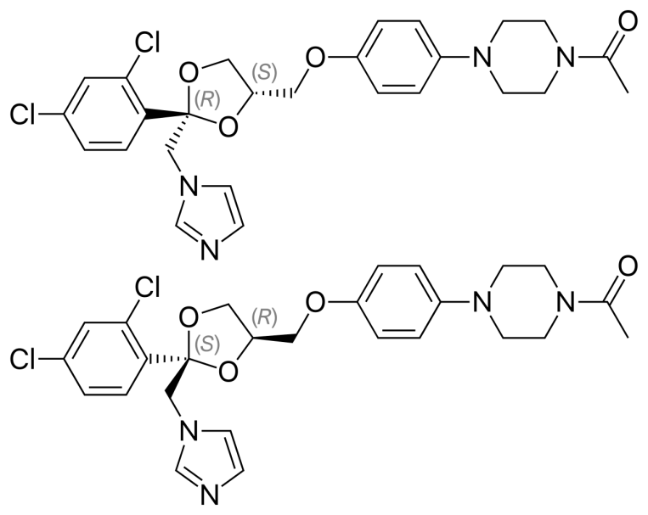
Granisetron (Kytril)
Halofantrine (Halfan)
Ifosfamide (Ifex)
Imatinib (Gleevec)
Indinavir (Crixivan)
Irinotecan (Camptosar)
Isradipine (DynaCirc)
Itraconazole (Sporanox)
Ixabepilone (Ixempra)
Ketoconazole (Nizoral)
Lapatinib (Tykerb)
Levomethadyl (Orlaam)
Loperamide (Imodium)
Lopinavir (Kaletra)
Loratadine (Claritin)
Lovastatin (Mevacor)
Maraviroc (Selzentry)
Mefloquine (Lariam)
Methylprednisolone
Midazolam (Versed)
Mifepristone (Mifeprex)
Modafinil (Provigil)
Nefazodone
Nevirapine (Viramune)
Nicardipine (Cardene)
Nifedipine (Adalat)
Nimodipine (Nimotop)
Nisoldipine (Sular)
Nitrendipine (Baypress)
Oxybutynin (Ditropan)
Oxycodone (Percodan)
Paclitaxel (Taxol)
Paricalcitol (Zemplar)
Paritaprevir (in Technivie)
Pimozide (Orap)
Ketoconazole

Slide 50
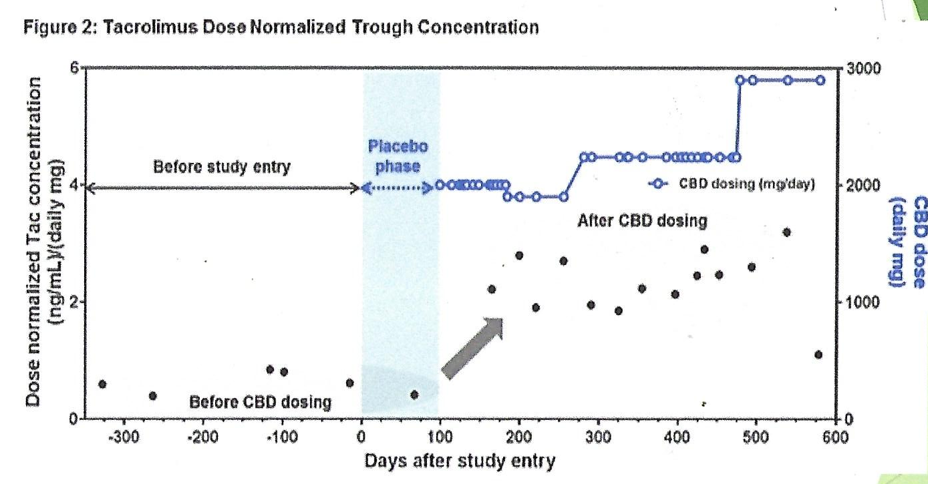
Pioglitazone
Praziquantel (Biltricide)
Prednisolone
Prednisone
Propoxyphene (Darvon)
Quazepam (Doral)
Quetiapine (Seroquel)
Quinacrine
Quinidine
Quinine
Ranolazine (Ranexa)
Regorafenib (Stivarga)
Repaglinide (Prandin)
Rifabutin (Rimactane)
Riociguat
Ritonavir (Norvir)
Rivaroxaban
Saquinavir (Invirase)
Sibutramine (Meridia)
Sildenafil (Viagra)
Simvastatin (Zocor)
Sirolimus (Rapammune)
Solifenacin (Vesicare)
Sorafenib (Nexavar)
Sufentanil (Sufenta)
Sunitinib (Sutent)
Suvorexant (Belsomra)
Tacrolimus (Prograf)
Tadalafil (Cialis)
Tamoxifen (Nolvadex)
Tamsulosin (Flomax)
Teniposide (Vumon)
Terfenadine
Testosterone
Tiagabine (Gabitril)
Tinidazole (Tindamax)
CBD treatment increases Tacrolimus concentrations.
Tac. is an immunosuppressive drug used after allogeneic
organ transplant to reduce the risk of organ rejection.

Slide 51
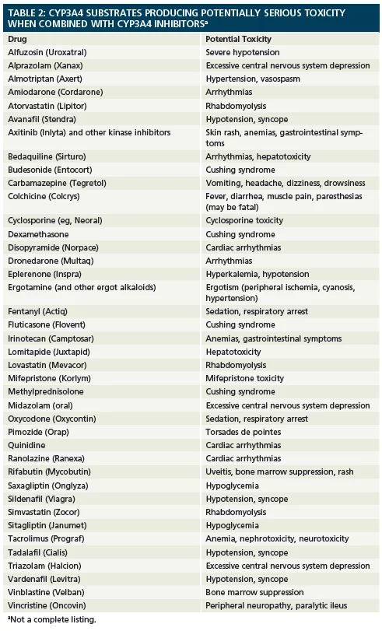
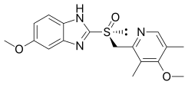
Tipranavir (Aptivus)
Tofacitinib
Topiramate (Topamax)
Triazolam (Halcion)
Vardenafil (Levitra)
Vemurafenib (Zelboraf)
Verapamil (Calan)
Vilazodone (Viibryd)
Vinblastine (Velban)
Vincristine (Oncovin)
Ziprasidone (Geodon)
Zolpidem (Ambien)
Zonisamide (Zonegran)
Zopiclone (Imovane).
Esomeprazole

Slide 52
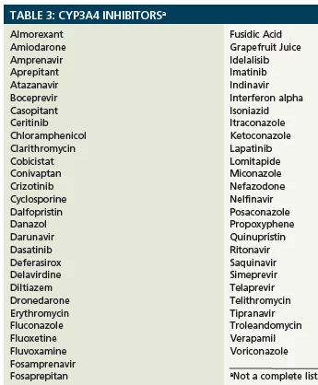
CYP3A4 Inhibitors
Drugs that inhibit CYP3A4 activity (Table 3) will usually inhibit the metabolism and increase the plasma concentrations of the CYP3A4 substrate medications. Some drugs, such as: clarithromycin, itraconazole, ketoconazole, nefazodone, nelfinavir, and ritonavir, are particularly potent inhibitors of CYP3A4. Patients on these drugs may have markedly reduced CYP3A4 activity.
Grapefruit juice contains psoralem which produce “suicide inhibition” of CYP3A4 (a reactive intermediate forms a covalent bond to irreversibly inactivate the enzyme). This causes large increases in blood levels of drugs that are metabolized by CYP3A4.

Slide 53
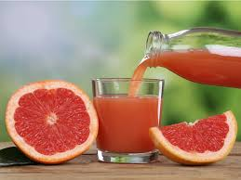
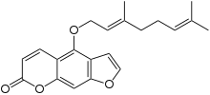

Furanocoumarins
Psoralem
Bergamottin
The furanocoumarins [FCs] are a class of organic chemical compounds produced by a variety of plants. Most of the plant species found to contain FCs belong to a handful of plant families. The families Apiaceae and Rutaceae include the largest numbers of plant species that contain FCs. The families Moraceae and Fabaceae include a few, widely distributed plant species that contain FCs. Generally FCs are most abundant in plants that have flowers and in ripe seeds and fruits. (An exception is the common fig where FCs are found chiefly in the milky sap of the leaves and shoots but not in the fruits).
FCs have other biological effects as well. In humans, bergamottin and 6',7'-dihydroxybergamottin are responsible for the "grapefruit juice effect", in which these FCs affect certain P450 liver and gut enzymes, such as the inhibition of CYP3A4 which either activates or deactivates many drugs, thus leading to higher or lower levels in the bloodstream. FCs have various effects which can specifically increase or decrease (depending on the drug) the blood levels of many pharmaceuticals in ways that can be life-threatening and so FDA approved such drugs include warnings for grapefruit.

Slide 54
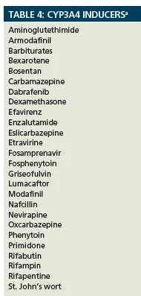
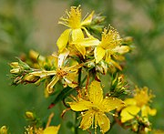
CYP3A4 Inducers
Drugs that induce (increase) activity of CYP3A4 are listed in Table 4. The CYP3A4 enzyme is especially susceptible to enzyme inducers, and marked reductions in the plasma concentrations of CYP3A4 substrates may occur. For example, a patient taking the potent CYP3A4 inducer Rifampin may have a roughly 90% reduction in serum concentrations of CYP3A4 substrates, such as buspirone, triazolam, and verapamil.
Hypericum perforatum, known as St. John's wort, is a flowering plant in the family Hypericaceae. Possibly a hybrid between H. maculatum and H. attenuatum, the species can be found across temperate areas of Eurasia. The species is harmful to livestock and can interfere with prescription drugs. It has been used in folk medicine over centuries. Currently, St. John's wort is promoted for depression, menopausal symptoms, ADHD, somatic symptom disorder and obsessive-compulsive disorder [OCD].
People that suffer from such mental disorder may also use high doses of CBD oil.

Slide 55
CBD-Drug Interactions Summary
Taking CBD with other medications may increase the risk of unwanted symptoms or toxicity. Taking CBD at the same time with over-the-counter [OTC] or prescription medications and substances that cause sleepiness, such as opioids, benzodiazepines (Xanax), antipsychotics, antidepressants, antihistamines (Benadryl), or alcohol may lead to increased sleepiness, fatigue, and possibly falls and accidents when driving. Increased sedation and tiredness may also happen when using certain herbal supplements, such as kava, melatonin, and St. John’s wort. Taking CBD with stimulants (Adderall) may lead to decreased appetite, while taking it with the diabetes drug (metformin) or certain heartburn drugs (Prilosec) may increase the risk of diarrhea.
Many drugs are broken down by enzymes in the liver, and CBD may compete for or interfere with these enzymes, leading to too much or not enough of the drug in the body. The altered concentration, in turn, may lead to the medication not working, or an increased risk of side effects.
Researchers evaluated existing information on five prescription CBD and THC cannabinoid medications: antinausea medications used during cancer treatment (Marinol, Syndros, Cesamet); a medication used primarily for muscle spasms in multiple sclerosis (Sativex); and an antiseizure medication (Epidiolex). Overall, the researchers identified 139 medications that may be affected by cannabinoids. This list was further narrowed to 57 medications, for which altered concentration can be dangerous. The list contains a variety of drugs from heart medications to antibiotics, although not all the drugs on the list may be affected by CBD-only products (some are only affected by THC). Potentially serious drug interactions with CBD included: a common blood thinner, (warfarin)- a heart rhythm medication (amiodarone) - a thyroid medication (levothyroxine) – and several medications for seizure (clobazam, lamotrigine, and valproate).

